Slide 1
Parts of Speech Flipbook

Slide 2
Noun: a person, place, thing, or idea
Common
Dog
Cat
curiousity
Proper
Mrs. McDonald
Summit Hill Junior High
Chicago, Illinois

Slide 3
Pronoun: a word used in place of a noun
Types: personal, indefinite, possessive, reflexive, relative, demonstrative
EX: I, she, he, me, our, us, you, his, theirs, my, who, whom, any, it

Slide 4
Verb: a very expresses action or being
Action verbs: what the subject does
Helping Verbs: has, have, had, had been
Help those verbs with ing ending: am, are, is, was, were, been
Future: will and shall
Linking Verbs: not active, couch potato verbs
Present: am, are, is
Past: was were
Participle: have been, has been, had been

Slide 5
Adjective: modifies or describes a noun or pronoun
Usually answers questions like:
Which one
What kind
How many
Ex: Dave Barry's books are hilarious; they seem so random.
Describptive adjects call up images, tones, and feelings
Deomonstrative Adjectives:
EX: This pen is red.
This – demonstrative adjective
Pen - noun
 | Singular | Plural
here | this | these
there | that | those

Slide 6
Adverb: a word or phrase that modifies an adjective or verb Expresses how, place, time, how much, frequency
How: peacefully, carefully, easily
Where/Place: above, far, away, here
When/time: now, yesterday, soon
How much: very entirely
How often: always often never
EX: She visits her dad often.

Slide 7
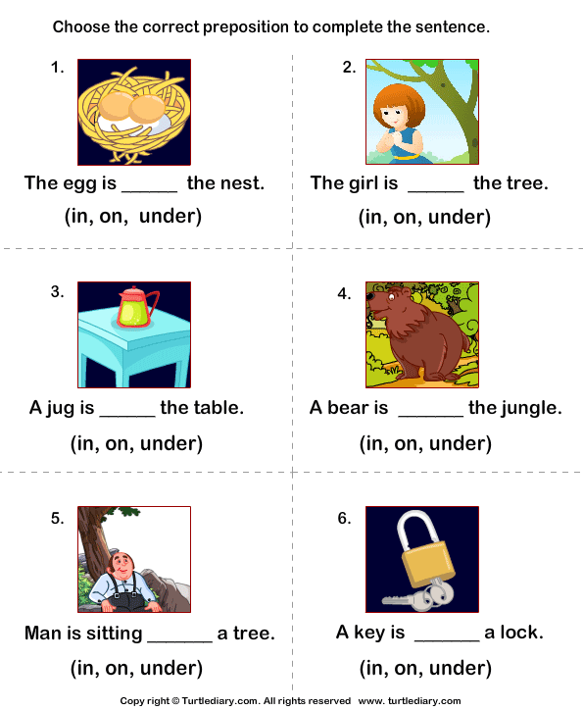
Preposition: are words that show the relationship between a noun or pronoun and some other word or element in the rest of the sentence.
EX: She swam across the lake.
The cupcake with sprinkles is mine.

Slide 8
Conjunction: is a word used to connect words, phrases and clauses
FANBOYS
For (because)
And (in addition to)
Nor (and not)
But (however)
Or (either)
Yet (but)
So (therefore)

Slide 9
Interjections: used to express sudden emotion surprise, disgust, joy
EX: No, go away.
Ex: Indeed, I want to leave.

