Slide 1
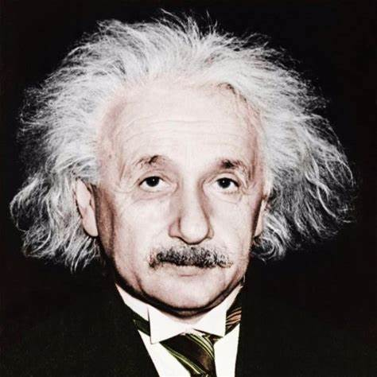
Albert Einstein
By: Ms. Williamsen
Period: ____

Slide 2
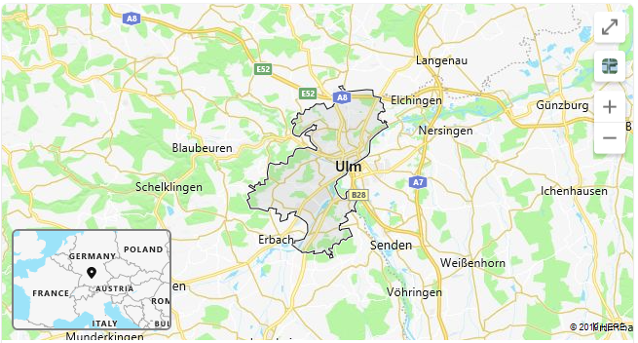
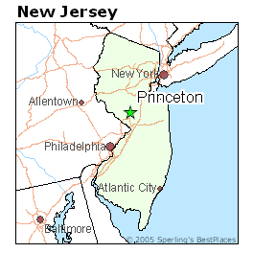
Birth/Death
Born: March 14, 1879
Where: Ulm, Württemberg, Germany
Death: April 18, 1955 (age 76)
Where: Princeton, New Jersey, United States of America

Slide 3
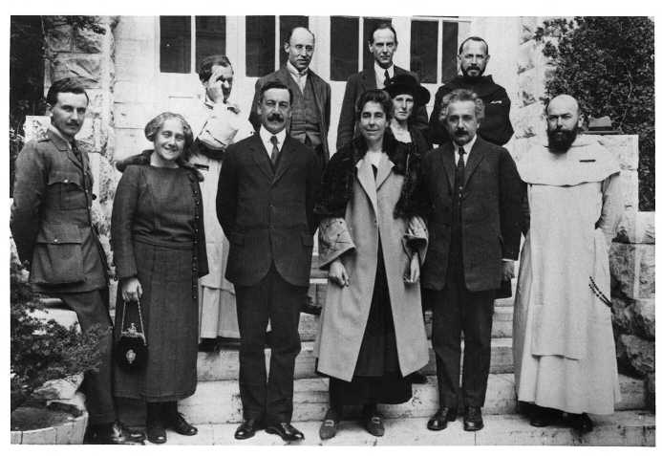
Fun fact #1 Einstein’s Family
Einstein had 1 sister whose name was Maria, but they called her Maja. She was two years younger than him.
He had 3 children after getting married in 1903 to Mileva. He had 1 daughter: Lieserl and 2 sons: Hans and Eduard. In 1919, Mileva and Einstein divorced.
Later in the year 1919, Einstein remarried to Elsa Lowenthal.

Slide 4
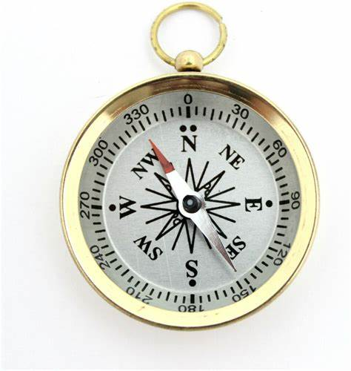
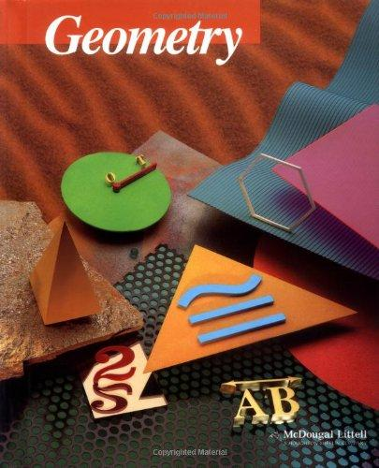
Fun fact #2 Two Wonders
There were 2 things that Einstein became fascinated with at a young age, which led to his beliefs and discoveries in science and math.
1. A Compass (at age 5)
2. A Geometry Book (at age 12)

Slide 5
Fun fact #3 Miracle year
1905 was known as Einstein’s Miracle year.
He wrote 4 groundbreaking articles.
The 1st article discussed the Quantum Theory.
The 2nd article discussed the existence of the atoms with proof from experiments conducted.
The 3rd article discussed his special theory of relativity.
The 4th articles discussed the relationship between mass and energy.

Slide 6
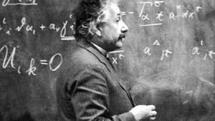
Mathematical contributions
He is mainly known for the equation $E=mc^{2}$. The relation between energy and mass.
This equation is used in physics and states that energy & mass are equivalent. Anything that has mass has an equivalent amount of energy and vice versa.

Slide 7
Why is $E=mc^{2}$ important?
$E=mc^{2}$ is used in many places, not just a science lab.
Telecommunication satellites
CT and PET scans
Radioactivity: Using a radioactive substance to illuminate processes on the human body
Atomic Energy produced at Nuclear Power Plants

Slide 8
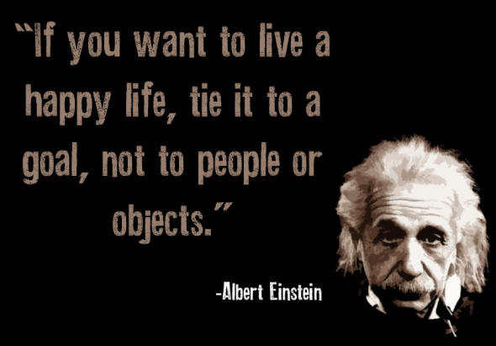

Slide 9
References
Pictures
https://www.bing.com/images/search?view=detailV2&thid=AMMS_23ad465bea2d0f3c4a2390d4d5bf0589&mediaurl=http%3a%2f%2fpbs.twimg.com%2fprofile_images%2f879355674957926400%2fVSGZHGib.jpg&exph=512&expw=512&q=Albert+Einstein&selectedIndex=0&stid=f9cec5a8-ecc3-6957-c308-3a2e08bb9f92&cbn=EntityAnswer&ajaxhist=0
https://www.bing.com/images/search?view=detailV2&ccid=oZRK4bkv&id=A8A19AD1B08DE8A76CE5AF059153571B59709135&thid=OIP.oZRK4bkvP3crQos_CvAljwHaH0&mediaurl=https%3a%2f%2fi.ebayimg.com%2fimages%2fi%2f331153922217-0-1%2fs-l1000.jpg&exph=1000&expw=947&q=compass&simid=608026467778038891&selectedIndex=1&ajaxhist=0
https://www.bing.com/images/search?view=detailV2&ccid=cNFElG6p&id=A87B72E277B37C922AB27CF9D5293565544AE474&thid=OIP.cNFElG6p-Nb_7GgudBx6swHaJJ&mediaurl=http%3a%2f%2fwww.directtextbook.com%2flarge%2f0395977274.jpg&exph=500&expw=405&q=Geometry+book&simid=608045863880100311&selectedIndex=2&ajaxhist=0
https://www.bing.com/images/search?view=detailV2&ccid=Ef3%2fgWmY&id=FC36D30951D0AFC3BE8BF8C1E618C43269B5A616&thid=OIP.Ef3_gWmYqRminUArWUySRwHaHa&mediaurl=https%3a%2f%2fimages.onlinelabels.com%2fimages%2fclip-art%2fbarretr%2fbarretr_Pencil.png&exph=1000&expw=1000&q=pencil+clipart&simid=608051335660506840&selectedIndex=2&ajaxhist=0

Slide 10
references
Information
https://www.history.com/topics/inventions/albert-einstein
https://www.britannica.com/biography/Albert-Einstein
https://www.quora.com/What-is-the-importance-of-E-MC²

