Slide 1
Chapter 1: Activity
Character Cards

Slide 2
Directions
Many different dog breeds were mentioned in this chapter. For this activity, you will pick a dog breed from the list and create a character card for the breed. The card needs to include:
A picture of the dog
Its average weight, size, and origin
3 interesting facts
Your card will also need to include:
3 verbs (highlight in yellow)
3 nouns (highlight in green)
3 adjectives (highlight in blue)
3 pronouns (highlight in purple)
Website to use:
http://www.animalplanet.com/breed-selector/dog-breeds.html

Slide 3
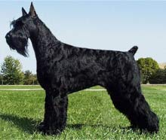
Example: Giant Schnauzer
Height: 25.5-27.5 inches (male), 23.5-25.5 inches (female)
Weight: 60-85 pounds (male), 55-75 pounds (female)
Origin: Germany
1. This breed was created to drive cattle and pull produce carts to the market.
2. Nowadays, Giant Schnauzers are used as guard dogs, and they are in law enforcement.
3. This breed is hypoallergenic, which is great for anyone with allergies. It means they produce less dander and allergens.

