Slide 1




Slide 2

CONCEPTS EXPLORED IN THIS LESSON
1) Hazardous Safety Symbols
2) Hazardous Household Product Symbols
3) WHMIS
4) Lab and Safety Conduct
5) Identify the Broken Lab Safety Rules

Slide 3
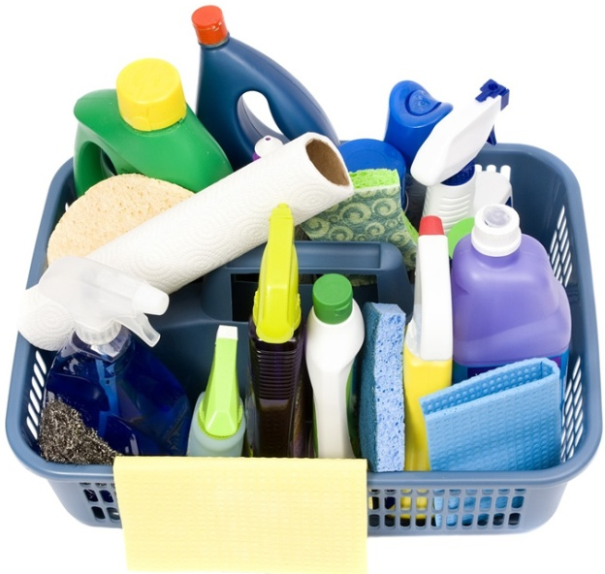



HAZARDOUS SAFETY SYMBOLS
warn users
have been developed to _________ of the hazards
associated with different products.
Safety Symbols:
TWO TYPES of Safety Symbols
1) HHPS
2) WHMIS
“Hazardous Household
Product Symbol”
“Workplace Hazardous
Materials Information System”
Found on _________
products – mostly
_______.
Found on _________
products – mostly
_______.
household
workplace
cleaners
cleaners

Slide 4




HAZARDOUS HOUSEHOLD PRODUCT SYMBOLS
12
There are ___ HHPS representing different types and
levels of hazard.
FOUR TYPES:
4
There are __ different types of hazards.
poisonous
explosive
corrosive
flammable
3
There are __ levels of hazards, each more harmful than the previous.
THREE LEVELS:
more harmful
caution
warning
danger
color
yellow
orange
red
# of sides
3 sides
4 sides
8 sides

Slide 5
HAZARDOUS HOUSEHOLD PRODUCT SYMBOLS
type
level
Combining the ____ and ____ of hazard creates a HHPS .
caution
poison
warning
poison
danger
poison
warning
corrosive
danger
explosive
caution
flammable

Slide 6












HAZARDOUS HOUSEHOLD PRODUCT SYMBOLS
Label each safety symbol by LEVEL and TYPE of hazard.
danger
poisonous
caution
explosive
warning
poisonous
danger
flammable
caution
corrosive
warning
explosive
danger
explosive
caution
poisonous
caution
flammable
danger
corrosive
warning
flammable
warning
corrosive

Slide 7








WORKPLACE HAZARDOUS MATERIALS INFORMATION SYSTEMS SYMBOLS
Match each symbol with the correct name.
There are __ WHMIS symbols.
8
circle
Each WHMIS symbol has a _____ for its border.
flammable
oxidizing agent
dangerously reactive
biohazardous and infectious
corrosive
poisonous: immediate & toxic effects
compressed gas
poisonous: other effects

Slide 8
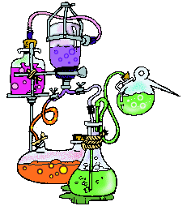
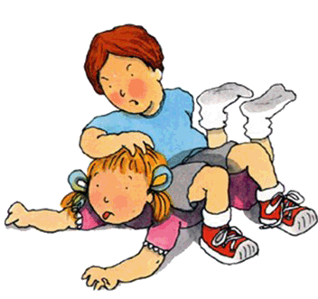
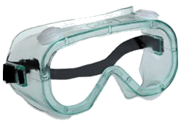


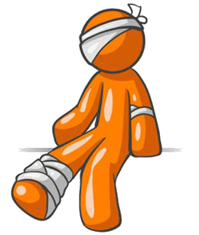
LAB SAFETY AND CONDUCT
Chemical Use
Personal Behavior and Attire
LAB CONDUCT AND SAFETY
Proper
Equipment Use
s
Clean Up
Injuries

Slide 9
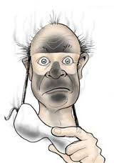
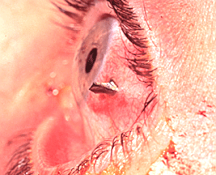



PERSONAL BEHAVIOR AND ATTIRE
GOGGLES:
all
Goggles worn at __ times.
eyes
Protects your ____ from
unexpected splatters and
shatters.
Ouch!
CONTACTS:
contacts
Never wear _______ during a
lab.
Chemicals can get trapped between the lens and your eye.
SHOES:
open-toed
No _________ shoes allowed in the lab.

Slide 10

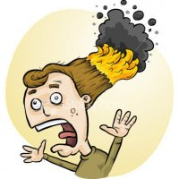
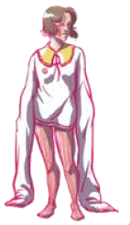



PERSONAL BEHAVIOR AND ATTIRE
HAIR:
Long hair
________ needs to be
tied back.
LOOSE CLOTHES:
___________ need to be
Loose clothes
secured and out of the way.
HORSEPLAY:
fooling around
No ____________
during the lab!

Slide 11



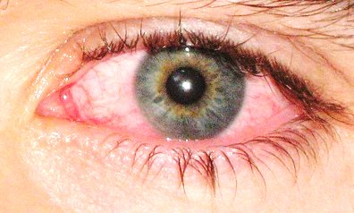

PERSONAL BEHAVIOR AND ATTIRE
HANDS:
Do not put your hands in your ____
or ______ during the lab.
eyes
mouth
YUCK!
FOOD & DRINK:
eating
drinking
No _____ or ______
in the lab.

Slide 12
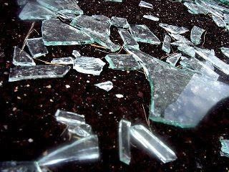
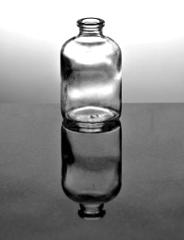



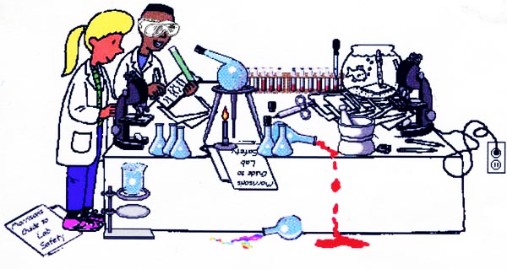
PROPER EQUIPMENT USE
EDGE OF LAB BENCH:
Do not place equipment at the
____ of the lab bench.
edge
CHAIRS:
chairs
Move all _____ to the
away
back of the room _____ from the
benches before the lab starts.
Students must _____ during a lab.
stand
WORK AREA:
tidy
Keep your work area ____.
Move bags and books
to the wall.

Slide 13
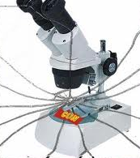
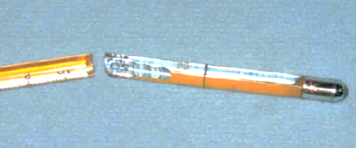
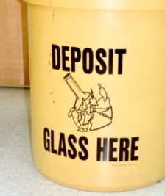
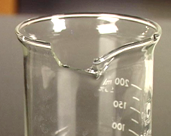
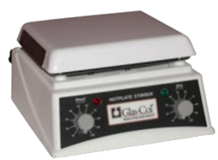

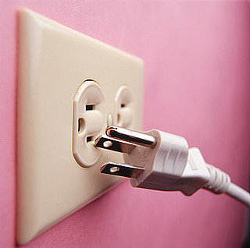
PROPER EQUIPMENT USE
BROKEN EQUIPMENT:
Broken equipment must be
________ to the _______.
reported
teacher
Don’t just put it back!
BROKEN GLASS:
reported
Broken glass must be ________ to
the _______ and placed in the
proper container.
teacher
HOTPLATE:
______ the hotplate
when not in use to
prevent burns and
to let it _________
before storing.
Unplug
cool down

Slide 14
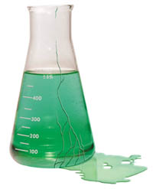

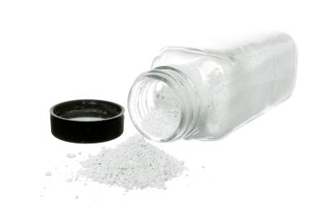



CHEMICAL USE
CHEMICAL SPILLS:
Inform
teacher
______ your ______ of any
chemical spills
before cleaning.
HAZARDS:
Know
_____ the hazards in the
lab ______ starting your
experiment.
before
SINK:
pour
sink
Do not ____ any chemicals down the ____.

Slide 15

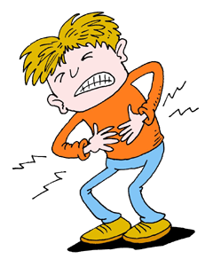
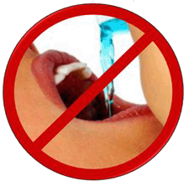
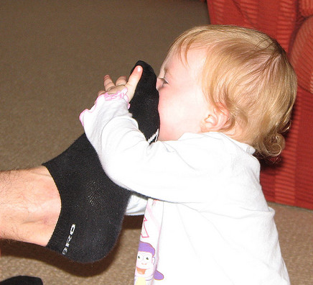
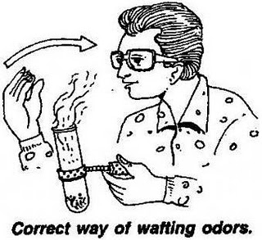

CHEMICAL USE
Or worse!
TASTE:
Do not ____ any of the chemicals.
taste
SMELL:
Smell a chemical using the
“___________” or “_______”
method.
hand-waving
wafting
AMOUNT:
Take only the amount of chemicals that you need.
Share – don’t be ______!
greedy
Less chemicals used means less harm to the
environment.
Greedy
Smurf

Slide 16

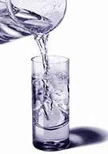


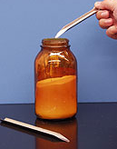
CHEMICAL USE
WATER FIRST:
When mixing chemicals,
always add the _________.
water first
This prevents the chemical
from ________.
splashing
In some cases, the large volume
of water ___________ that may
be generated when the two
substances combine.
absorbs heat
CONTAMINATION:
cross-contaminate
Be careful not to _______________ your chemicals.

Slide 17
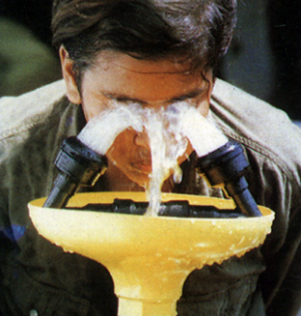
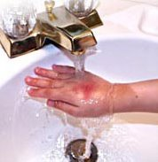
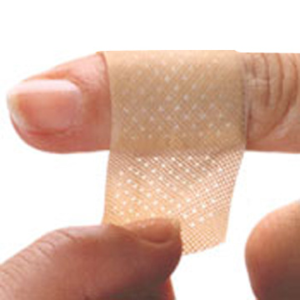
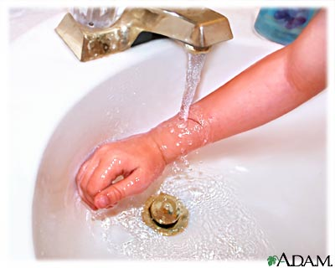
INJURIES
EYE WASH STATION:
If something enters your eye, have a partner
direct you to the ______________.
eye wash station
Position face above the station with eyes _____ for
___ minutes.
open
10
BURN OR CHEMICALS ON THE SKIN:
Immediately inform your teacher and place injury
under ____________ for ____ minutes.
running water
5-10
CUTS:
Immediately ______ your
_______ , _____ the cut and
put a bandage on it.
inform
teacher
clean

Slide 18

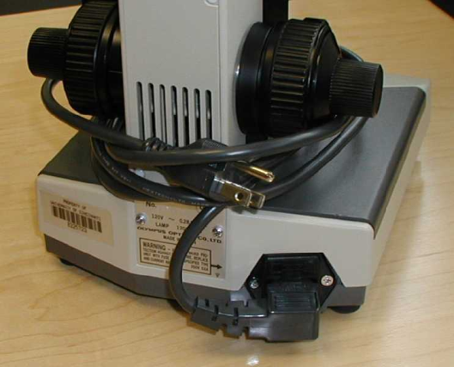
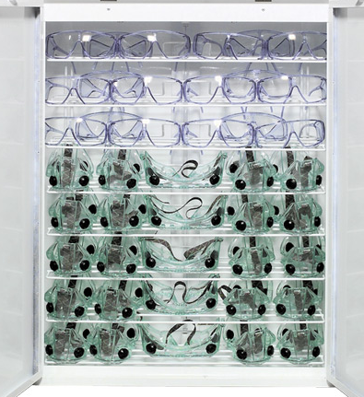
CLEANUP
CLEAN EQUIPMENT:
All equipment needs to be properly _______ ,
______ and put in the ______________.
washed
rinsed
drying rack/area
PUT AWAY EQUIPMENT:
________ all equipment to where you
originally got it, if you do not have to wash
it (e.g. microscopes and hotplates).
Put back
PUT AWAY GOGGLES:
neatly
storage area
Put goggles back ______ into the ___________.

Slide 19


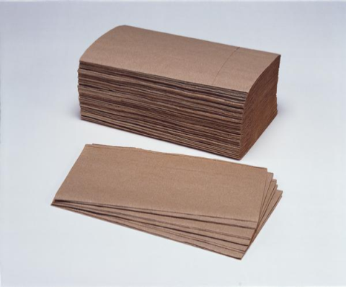


CLEANUP
LAB BENCH:
_____ then __________ lab bench
with paper towel.
Spray
wipe down
PAPER TOWEL:
Do not put paper towel in the
recycling; it goes in the _______.
garbage
WASH HANDS:
hands
Wash your _____ at the end of the lab.

Slide 20
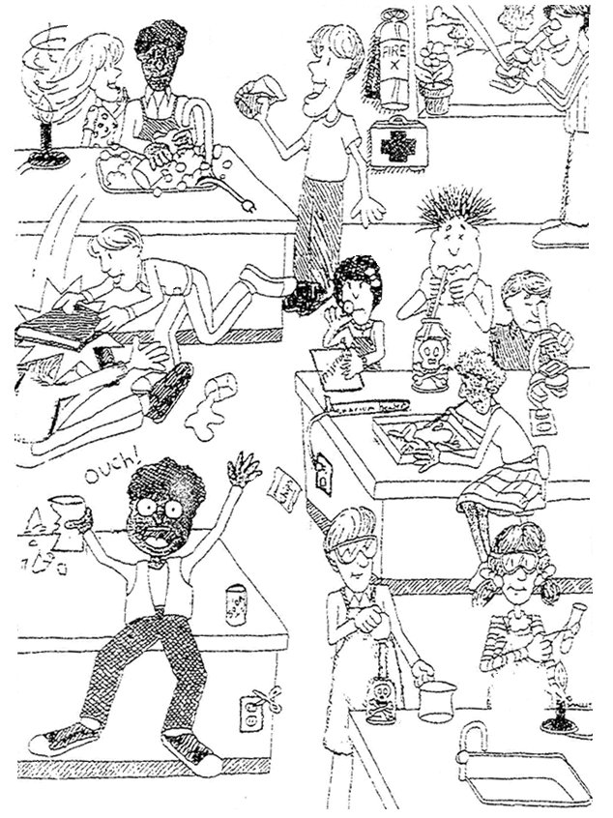

IDENTIFY THE BROKEN LAB SAFETY RULES
Donna
Jacob
Ted
Vincent
Patrick
Can you find at least 13 broken safety rules?
Nico
Minh
Suying
Hakim
Samira
Toby
Mohammed
lab safety video
Claire

Slide 21
The End!

Slide 22


Created by Anh-Thi Tang – Tangstar Science
Copyright © Anh-Thi Tang (a.k.a. Tangstar Science)
All rights reserved by author.
TERMS OF USE: This document is for personal use only and may only be used by the original purchaser. Copying for more than one teacher, classroom, department, school, or school district is prohibited. Additional licenses can be purchased at a discount for others to use in your department. This entire document, or any parts within, may not be reproduced or displayed for public viewing. You may NOT electronically post this product online including to teacher blogs, classroom websites or school networks. Failure to comply is a copyright infringement and a violation of the Digital Millennium Copyright Act (DMCA).
http://www.teacherspayteachers.com/Store/Tangstar-Science

