Slide 1
Type your name here

Slide 2
Directions:
For each slide, add text boxes or pictures to fill in the blank spaces.
You can use online pictures or clipart.
When you finish, delete this slide with the directions. Then, you can save this digital scrapbook or print it!

Slide 3
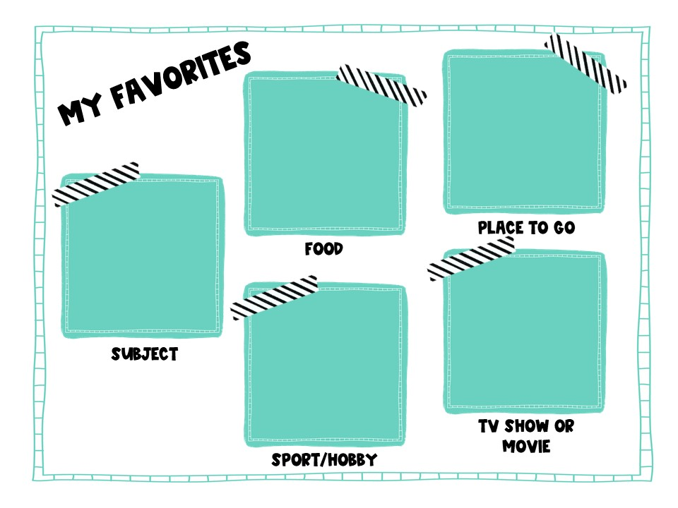

Slide 7
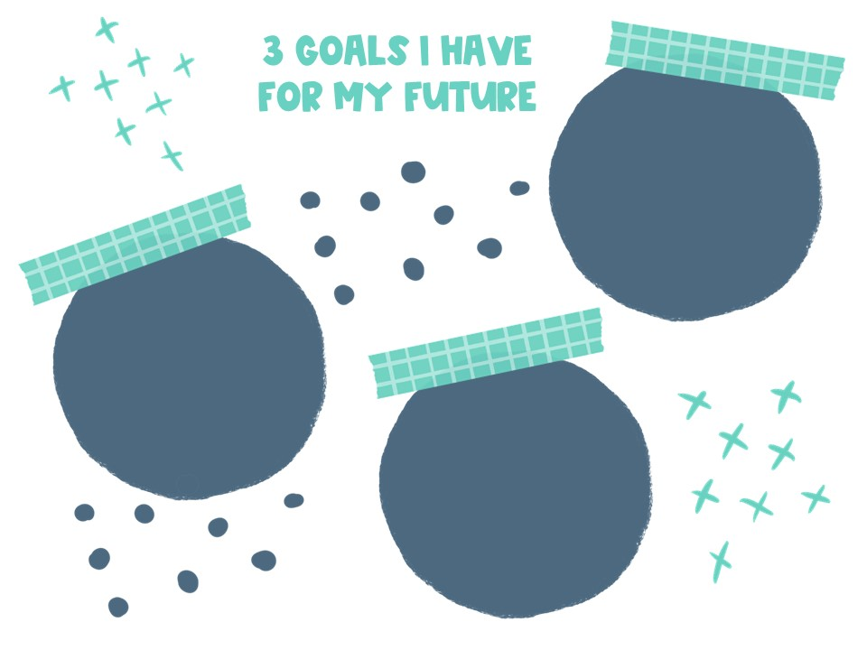

Slide 9
