Slide 1
Hilda Walker Curriculum Night
Welcome!

Slide 2
About Me:
Mrs. Uloswceh – The kids call me Mrs. U.
Undergraduate degree from the University of Illinois at Champaign-Urbana
Graduate degree from Saint Xavier University
Taught in Orland Park District 135 for six years
This is my third year teaching 5th grade at Walker.

Slide 3
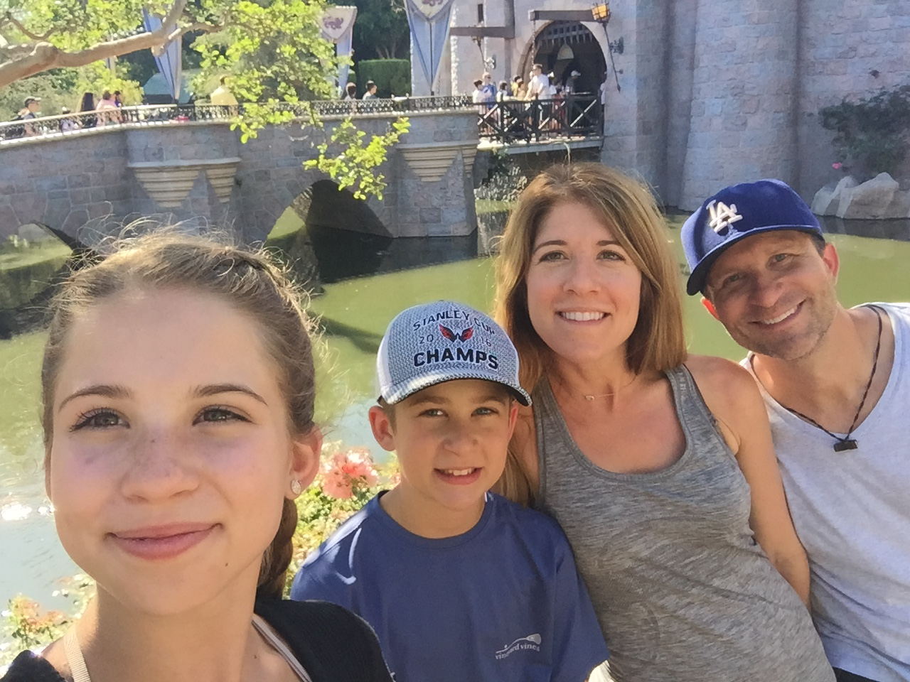
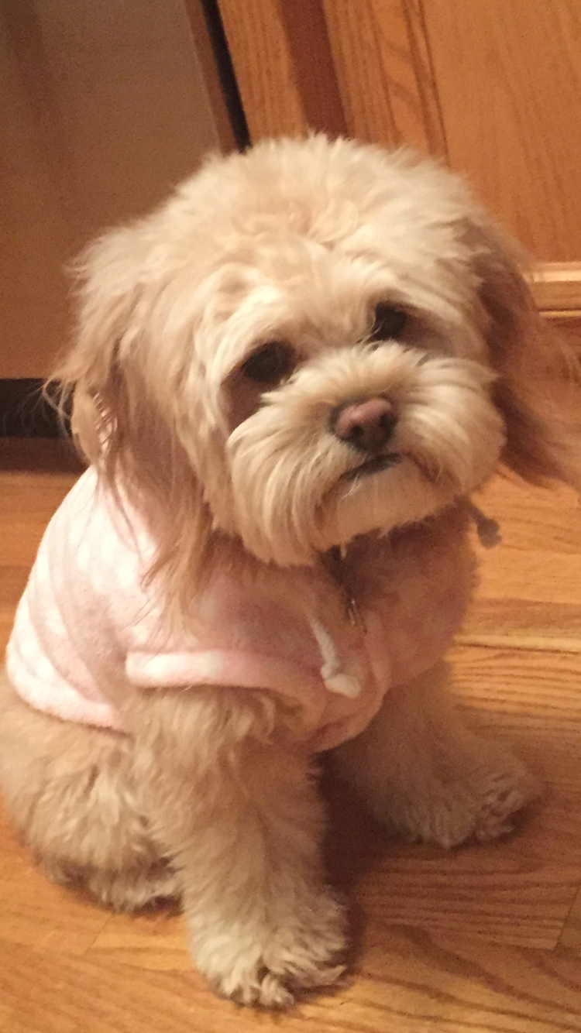
My Family
I’m married with two children
Abbi – 14
Nate – 12
Both are/were students in
Summit Hill District 161
Our dog – Bella

Slide 4
Absences and Tardies
Please call the office to report an absence.
At this time, you can request to pick up homework. We will have it in the office by 3pm for you to pick up.
If your child arrives late, they must stop in the office to receive a late pass before coming to class.
If your child will be leaving early, please send me a note or an email so that I can provide your child with any make up work that they will need to complete.

Slide 5
AM Class Schedule
Daily Cycle
Cycle *Monday - Tech
Reading *Tuesday - Library
LA *Wednesday - Music
Social Studies *Thursday - Art
Intramurals/Lunch *Friday – Study Skills
Science
PE
Math

Slide 6
Fifth Grade ELA Curriculum
Reading
Novels
Students will work on objectives designed around the common core standards, including figurative language, theme, character traits, and point of view to name a few.
We will be reading 4 or 5 novels throughout the year.
We will use the Journey series as part of our Revolutionary War Unit during Quarter 2.
Novels are a large part of our reading curriculum in room 233. Students are more engaged when reading high interest novels.
Our first novel is called Restart. Many of you have purchased this book already. Thanks!
It is available on Amazon for under $6.

Slide 7
Novel Studies
Classroom Novels
Schoolwide Novel

Slide 8
ELA Curriculum Cont.
Writing
English/Grammar
Writing will be incorporated into many subject areas.
Book projects will also be assigned quarterly. We did begin discussing our first Biography report.
The Grammar curriculum is designed around the Common Core standards as well.
Grammar Skills are very important, as they carry over into writing and foreign languages.

Slide 9
Homework
Students will have about 40 minutes of homework each night.
If your child does not complete the assigned homework, they will attend Study Hall during lunch to complete the missing assignment.
Students will also receive a pink slip if they have a missing assignment. After 5 pink slips in one quarter, students will have to attend Study Hall daily until the end of the quarter.

Slide 10
Grades
District 161 has implemented a new grading scale.
90 - 100 A
80 - 89 B
70 – 79 C
60 – 69 D
50 – 59 F
All grades are categorized as Summative or Formative. Summative grades will count as 75% of your child's grade, and Formative grades will count as 25%.
Grades are available online through PowerSchool and will be updated each week.

Slide 11
Reassessments
Reassessments will be available for summative tasks.
The most recent score will be recorded.
Students must fill out a request to retest form that will need to be signed by a parent.
ALL assessments that earned a grade of a D or F must be retaken. The teacher will initiate the reassessment process.
All students will be given opportunities to reassess throughout the year on summatives that earned an A, B, or C. Every student can request one reassessment per subject, per quarter. The student needs to initiate the reassessment process within 2 days of the original assessment.

Slide 12
Behavior
Discipline Policy
If a student is not following expectations the following will occur.
2 Verbal Warnings
Behavior Reflection
Parent Contact and loss of Friday Reward time
This process will start over each week.
PBIS
Students receive Paw tickets when they are "caught" following expectations. These paws can be exchanged for popcorn, nachos, and additional items during designated dates during lunch time.
Team Rewards
Positive notes to students
Positive notes sent home
PRAISE!!

Slide 13
Friday Folders
Friday Folders will be sent home on the last day of the week. Please empty the folder, sign the form, and return the folder back to school. Feel free to jot down comments and questions.

Slide 14
