Slide 1
Bowling

Slide 2
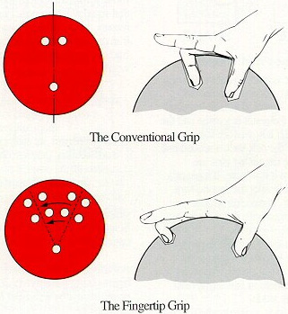
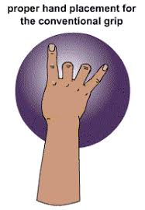
The Grip
Silent coyote
The only fingers
out of the ball are
your pointer and
pinky fingers

Slide 3
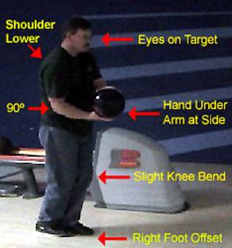
Bowlers stance
Hand under the ball
Arm at 90 degree angle
Off hand holding the side
Off foot slightly back

Slide 4
The Approach
Three step approach
3 step approach
Opposite (begin back swing)
Same (top of back swing)
Opposite (Roll ball)
4 step approach
Same (begin back swing)
Opposite (bottom of back swing)
Same (top of back swing)
Opposite (Roll ball)

Slide 5
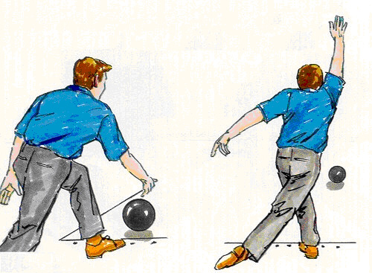
Follow through
Release and follow through
Opposite knee slightly bent
Hand shake with the sky

Slide 6
The cues
GRIP
STANCE
OPPOSITE – SAME – OPPOSITE
Roll
FOLLOW THROUGH

Slide 7
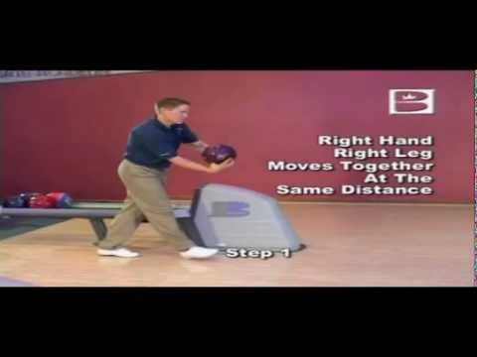
Professional Example

Slide 8
Bowling
The front pin of the set is called the HEAD pin.
The right and left side of the head pin is called the POCKET.
Knocking all the pins down in one turn is a STRIKE.
Knocking down all the pins in two turns is a SPARE.

Slide 9
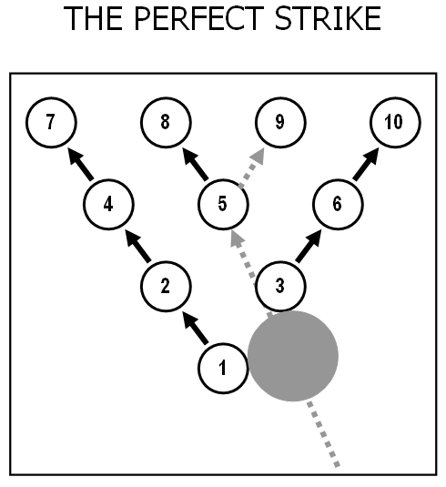
Aim for the pocket

Slide 10
Pocket Practice
Todays goal : Roll the ball to the pocket
Today’s Jobs
Bowler
Pin setter
Ball returner
Waiting in line

