Slide 1
POETRY
Read the following slides…
During the next few weeks, you will use these skills to become a poet!
I’ve
got
crazy
skills!

Slide 3
Do you have skills?
Do you like to play basketball?
Football? Sing? Draw? Paint? Play piano? Skateboard? Ski? Cook? Read?
All of these activities require certain skills. Practicing the skills will help you become a better player, artist, musician, cook, or more!
I’ve
got
mad
skills!

Slide 4
He’s got skills?
This basketball
Player
needs to have
the skills of
passing,
shooting,
dribbling, and
jumping to play.
Slam
Dunk!

Slide 5
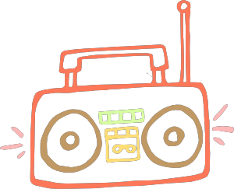
They’ve got skills
Go
T-Rex
Go!
These dancers
need to have
the skills of
jumping, bouncing,
twisting, turning,
and bending to the
beat of the music.

Slide 6
What skills are needed?
Turn to your neighbor and share what skills are needed for these activities:
I like
to swim!
swimming
soccer

Slide 7
What about writing poetry?
It also takes skills to write poetry.
Your goal will be to identify which skills are used in the poems you read and write.
Wow! Poets must have skills too!

Slide 8
Please Note
Can you imagine a basketball game where the players only used the one skill of dribbling?
No one would ever shoot!
Poets often use
more than one
skill in their poems.
Many of the poems
in this presentation combine rhyme with another skill.

Slide 9
Rhyme
A poem that uses rhyme will have two or more words that sound the same.
The rhyming words are often at the end of the line.
The Triceratops had a large head frill.
It was slanted like a hill.
How fun to slide
Down this slope
On a bubbly sled of soap.

Slide 10
Rhythm
A poem that uses rhythm will have a beat or pattern of beats. These beats are made by the syllables.
9
The fossil I found was long but round.
I found it buried in the ground.
I brought it to a very safe place.
Somewhere special with lots of space.
8
9
8
Count the syllables on each line. Can you find a pattern?

Slide 11
Repetition
A poem that uses repetition will have the same words repeated
It does not need to rhyme.
The Brachiosaurs stretched its
Neck, neck, neck.
Because it wanted to
Check, check, check.
Were there leaves to
Eat, eat, eat?
It sure can’t chew
Meat, meat, meat.

Slide 12
Formula
A poem that uses a formula will follow a pattern, plan or design.
Pterodactyl
Wide, graceful
Flying, soaring, gliding
Pterodactyls were flying dinosaurs.
Pterosaur

Slide 13
Which skills are used in this poem?
This footprint’s round like a hula Hoop, hoop, hoop.
It looks like someone took a,
Scoop scoop, scoop.
Of mud and dirt out of the
Ground, ground, ground.
I’m so glad it was
Found, found, found.
Rhyme
Rhyme
Rhythm
Repetition
Formula
Rhythm
Repetition

Slide 14
Which skills are used in this poem?
Triceratops
Round, wide
Chewing, stomping, defending
A three horned dinosaur.
Ceratopsid
Formula
Rhyme, Rhythm, Repetition, Formula,

Slide 15
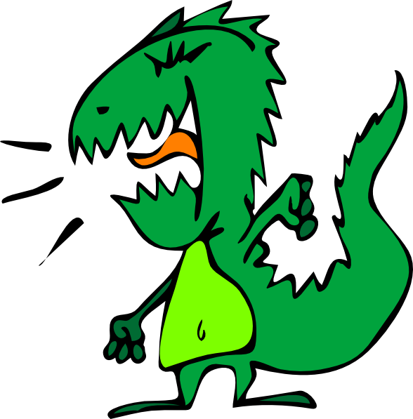
Which skills are used in this poem?
This grouchy dinosaur seems awfully mad.
He’s yelling and stomping, which is bad.
He should calm down and chill out.
No one wants to hear him shout.
Rhyme
Rhythm
Rhyme, Rhythm, Repetition, Formula,

Slide 16
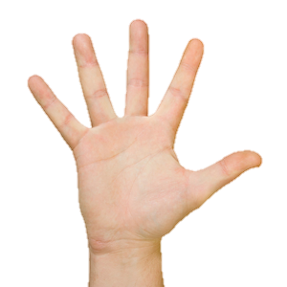
Alliteration
A poem that uses alliteration has several words that begin with the same consonant sound.
The fabulous fossil Flipped like a frog Then fell fifty feet Into Frank’s hand.
I found a fossil!
That was fun!

Slide 17
Similes
A poem that uses similes will compare two things using like or as.
The Pterodactyl’s wings stretched wide
Like an airplane trying to glide.
It soared and hunted with keen eyes
As an eagle often spies.

Slide 18
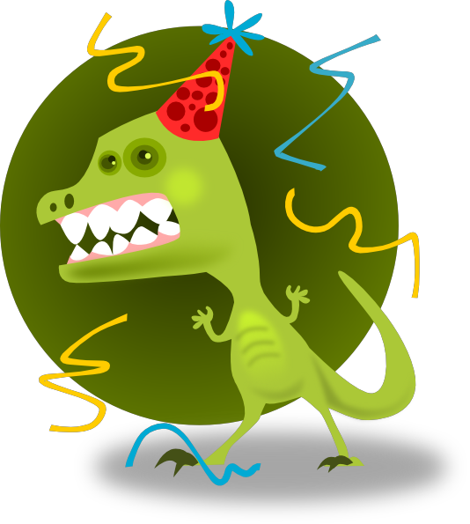
Onomatopoeia
A poem that uses onomatopoeias will have words spelled to copy the sounds something or someone might make.
The dinosaur seemed overjoyed.
Yipee!
Then he seemed a bit annoyed .
Arrrrr!
His tummy seemed to hurt a bit.
Ohhhhh!
Maybe that’s why he’s throwing a fit.
Whaaaaa!

Slide 19
Word Placement
A poem that uses word placement puts the words on the page in a special way to make the poem more meaningful.
Dinosaurs
are
Blissful, happy, joyful, glad, smiley, glowing never sad.

Slide 20
Which skills are used in this poem?
This pretty pink dinosaur paints with a pup.
Its adorable and small as a tea cup.
Painting a picture of purple pickles and things
They prefer to paint pizzas that Dance and sing.
Rhyme
Alliteration
Simile
Alliteration, Rhythm, Repetition, Formula,
Rhyme , Onomatopoeia, Simile, Word Placement

Slide 21
Which skills are used in this poem?
I can hear the brush.
Swish swash
Dunk into the paint.
Splish, splash.
Smear on the paper.
Swift, swash.
Then fall to the ground.
Dish, Dash.
Alliteration, Rhythm,
Repetition, Formula,
Rhyme, Onomatopoeia,
Simile, Word Placement
Rhyme
Onomatopoeia

Slide 22
Credits

