Slide 1
Recycling Activity
Earth Day ~ April 22, 2020

Slide 2
This week in Science…
Since Earth Day is this week, you will be making a new creation out of recycled items around your house. Please do not go out and purchase new items for this project.
When you’re finished, please do the following:
Upload a picture of your creation to our Science Teams page so we can all see your awesome work and give you a thumbs up for a job well done!
Make sure you include a short description of your new creation as well.

Slide 3
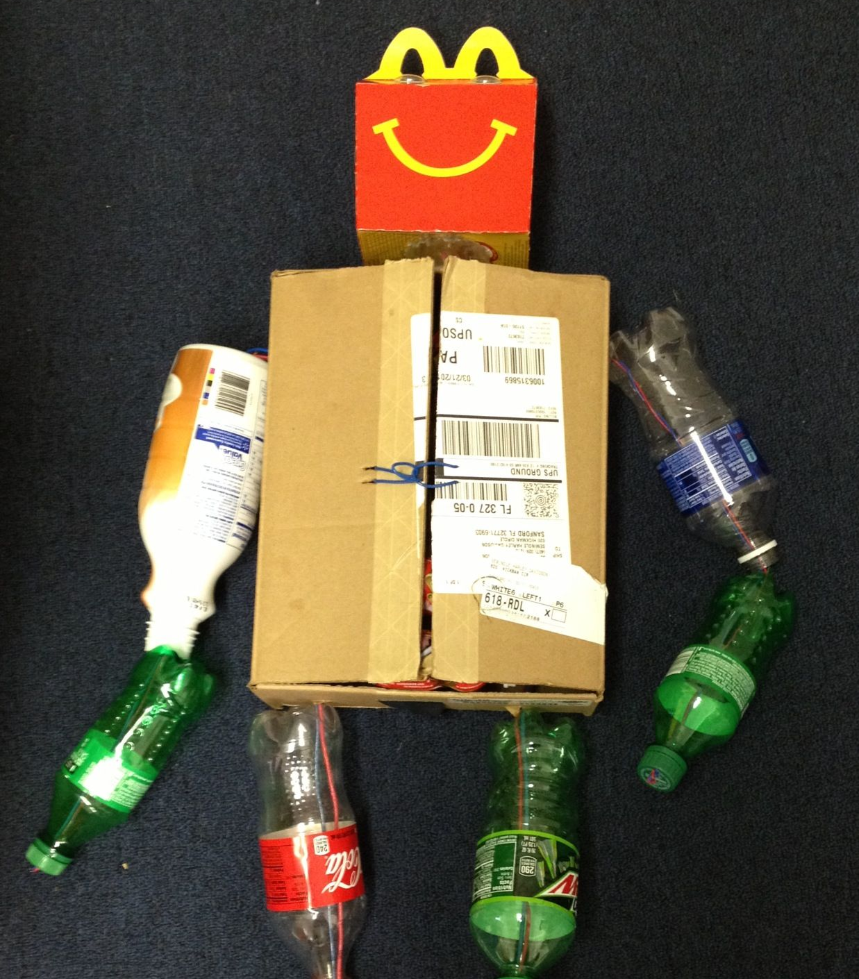
Example
You can create a robot.
What unique thing can your robot do? Does it do your chores for you or make dinner? Can it mow your yard? Tell us all about it!
Upload a picture and short description to our Science Teams page to make sure you get credit for completing this assignment.

Slide 4
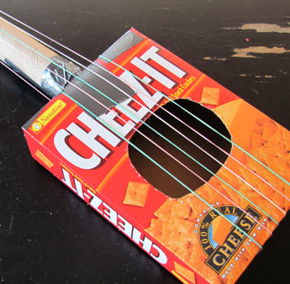
Example
You could create an instrument.
What is your instrument called? What real-life instrument does it sound similar to? Does it make higher sounds or lower sounds? How much does it cost to purchase?
Upload a picture and short description to our Science Teams page to make sure you get credit for completing this assignment.

Slide 5
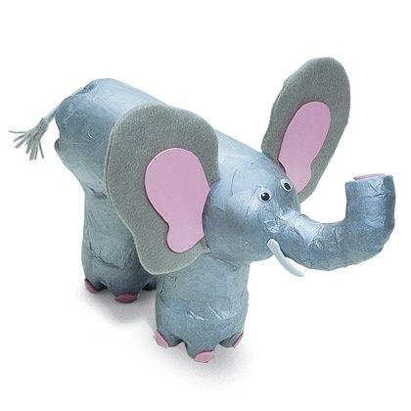
Example
Create an animal – either a realistic one or a make-believe one.
What type of animal did you create? What’s your animal’s name? Where does it live? What does it eat? Can you have one as a pet or are the only found in the wild?
Upload a picture and short description to our Science Teams page to make sure you get credit for completing this assignment.

Slide 6
Ready, Set, Go!
Now that you’ve seen some examples and have an idea of what I’m looking for, it’s time to start building!
Remember, you do not need to go out and purchase anything to complete this assignment. Simply use what you can find around your house.
When you’re finished, make sure you upload a picture and a short description to our Science Teams page so you can get credit for completing this assignment.
I can’t wait to see your new creations! Happy building! ☺

