Slide 1
Academic Improvement

Slide 2
Academic Improvement – Reading Goals
Increase comprehension and understanding of fiction and nonfiction text.
Increase critical thinking, going beyond what is written in the text.
Increase fluency (rate, speed, accuracy).
Increase vocabulary and decoding skills.

Slide 3
Academic Improvement – Math Goals
Increase computational fluency
Increase single-step and multiple-step calculations
Increase mathematical reasoning

Slide 4
Placement Into Academic Improvement
Based on:
-Previous NWEA scores (Fall, Winter, Spring)
-Teacher Recommendation
Students are progress monitored with NWEA and AIMSweb throughout the year to make sure placement is correct.
After data review, if a student proves not to need the Academic Improvement course, he/she will be placed into the Encore rotation.

Slide 5
Reading Textbooks
Reading Express Workbook – Comprehension Intervention
Be a Better Reader Workbook – Supplemental Comprehension
Lexia – Supplemental online comprehension and word study work

Slide 6
Math Textbooks
Momentum Math – Math Skills

Slide 7
materials
InterventionWorkbooks (stay in classroom)
AR Book
Folder
Pencil
Homework

Slide 8
Grading
Pass = 100% - 70%
Fail = 69% and below
Per Summit Hill School District 161 Policy:
Formative Assessment is the formal and informal processes teachers and students use to gather evidence for the purpose of improving learning. Assessment for learning is how we provide students valuable feedback on their progress toward achieving the specific learning target.
Summative Assessment provides evidence of student achievement for the purpose of making a judgment about student competence or program effectiveness. Assessment of learning is how we know our students have achieved specific learning expectations.

Slide 9
Summative Reassessment
Students may complete a reassessment on a summative score.
The most recent score will be recorded.
Students must complete the summative reassessment form and all items listed on the form.​
Students may attend intramural study hall for extra study time.
Students complete pretest corrections in class as part of test study prior to initial test.
Students will complete an alternate review of test material.

Slide 10
Behavior & Discipline
Students will receive verbal reminders, parent/guardian phone calls, and detention as needed
Follow all rules outlined in the student handbook.
Be respectful to staff, students, and yourself.
Make complete efforts on all assignments and participate in class.

Slide 11
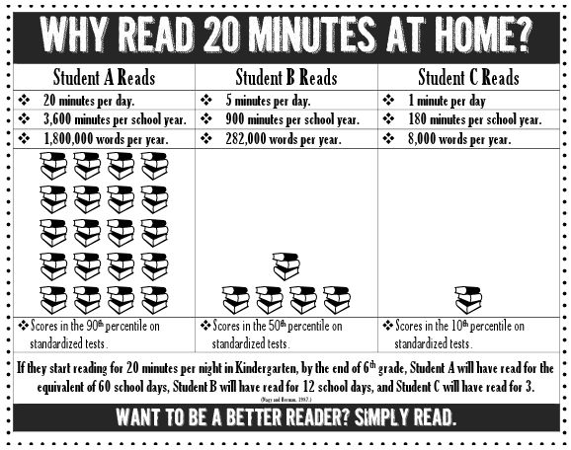
Why Reading Is Important

Slide 12
Reading Topics Covered
Vocabulary Skills
Text Features
Text Structures
Reading Comprehension
Literary Elements
Genres
Reading Strategies

Slide 13
Math Topics Covered
Operations
Equations
Graphing
Measurement
Statistics
Fractions
Percents
Variables

Slide 14
Contact Information
Please see my class website.
Email is the best way to reach us: cpellicci@summithill.org or lschmidt@summithill.org

