Slide 1
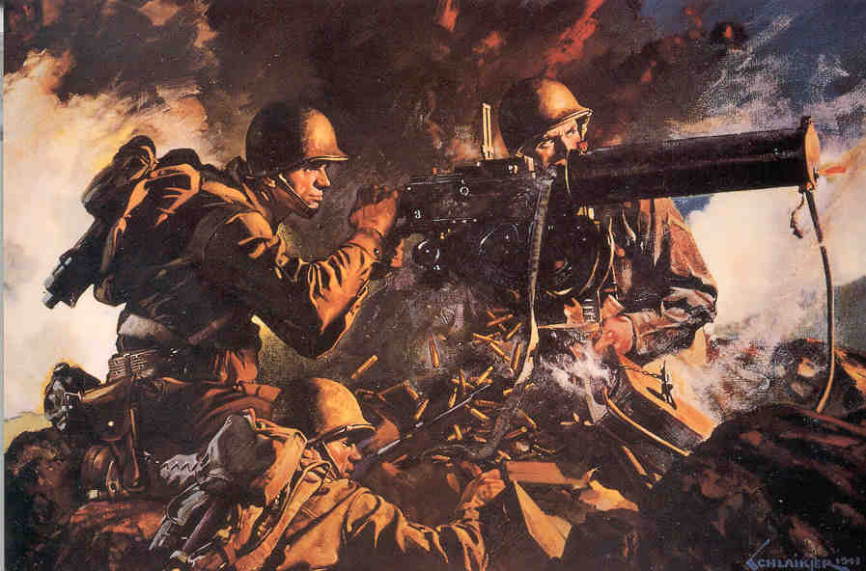
Chapter 11 Sections 4 & 5

Slide 2
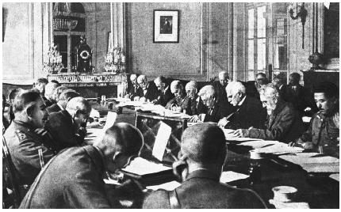
Allies on the Move
  The U.S., Britain, the Soviet Union, and 23 other Allied nations pledged to defeat the Axis Powers.

Slide 3
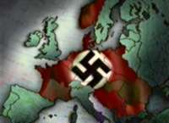
The Allied leaders decided to try to defeat Hitler before going to Japan.
    The Germans controlled most of Europe and much of North Africa.
    They had to be stopped before they succeeded in controlling the Soviet Union.

Slide 4
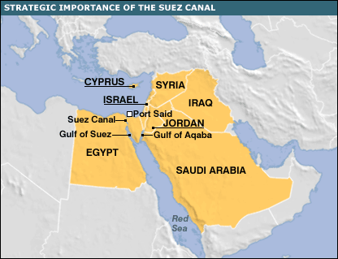
The Allies decided to attack the Axis forces in North Africa first.
  The British prevented the Axis Powers from capturing the Suez Canal.
    This was an important victory because the Suez Canal connects Europe and Asia via a sea route.

Slide 5
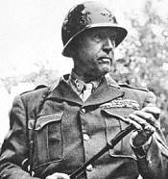
American general Eisenhower led American, British, and Canadian troops into Algeria and Morocco.

Slide 6
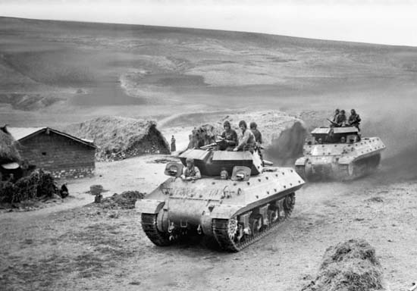
American tanks in Tunisia

Slide 7
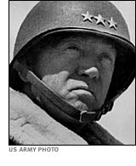
The Americans were defeated in Tunisia.
American general Paton’s forces and British air and naval forces finally drove the Germans out of North Africa in May 1943.

Slide 8
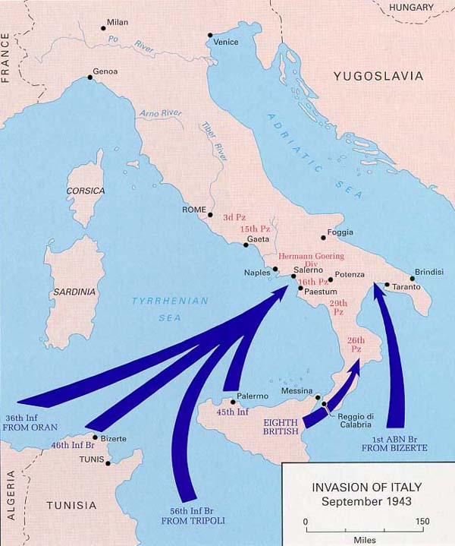
The Allied nations invaded Italy in September 1943.
  Sicily fell first then the Allies move on to the mainland.

Slide 9
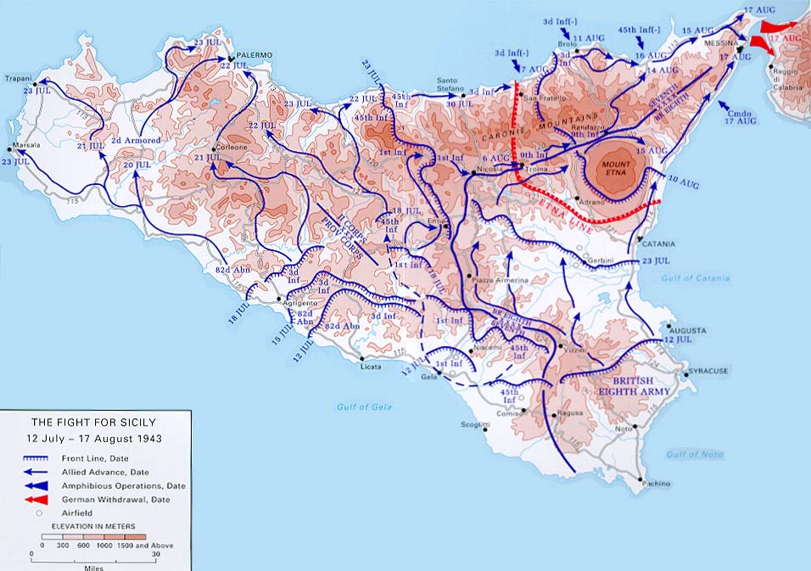
Sicily Invasion

Slide 10
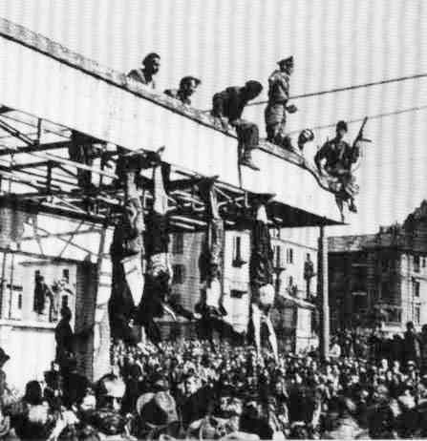
  The people of Italy eventually overthrew Mussolini and surrendered to the Allies.
  The Allies moved to capture Rome, but they were met with resistance from German troops.

Slide 11
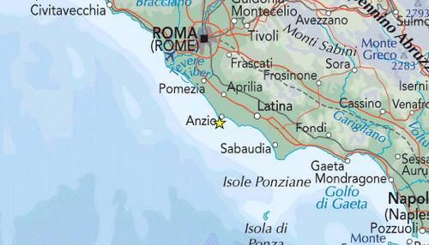
Anzio, Italy Invasion
German forces held off Allied forces at Anzio, a seaport near Rome, for four months.

Slide 12
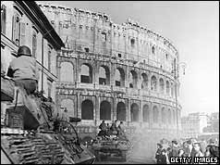
Rome falls to the Americans
  In June 1944 the Allied forces finally broke through German lines and freed Rome.

Slide 13
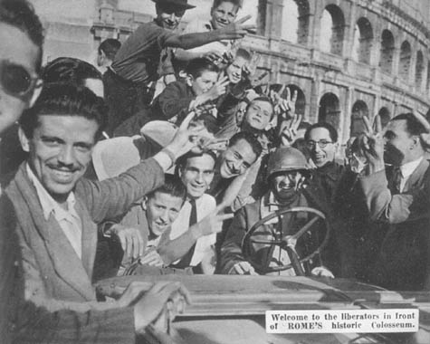
Italians welcome the Americans

Slide 14
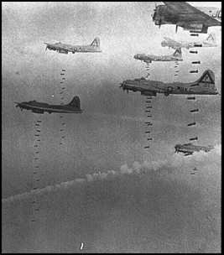
The British and American forces mounted a powerful bombing assault against Germany in the summer of 1942.

Slide 15
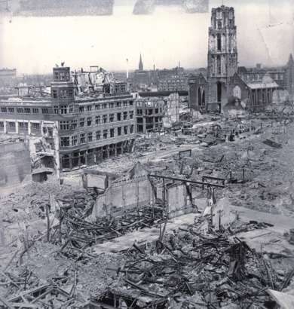
German factories and cities were bombed by hundreds of American bombers day after day.
  Thousands of German civilians were killed and cities were destroyed.

Slide 16
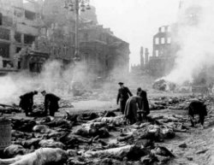
Dresden, Germany

Slide 17
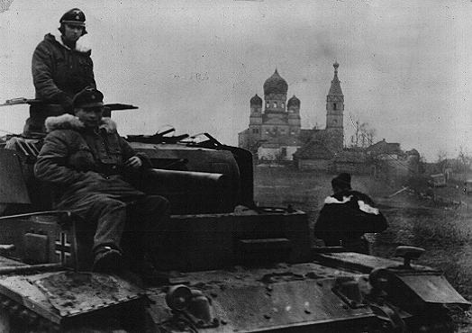
Eastern Front
  For months Germany had focused most of it’s energy on the Soviet Union.
  Leningrad, Moscow, and Stalingrad were Germany’s main targets.

Slide 18
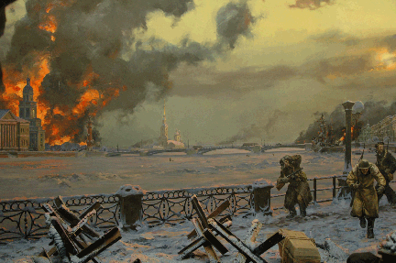
Leningrad
  Germany set up a military blockade around the city and continued to attack it for 900 days.
  The people of the town were forced to eat horses, cats, and dogs after their food supplies ran out.
    Thousands died
  The Germans could not take the city and the siege ended in 1944.

Slide 19
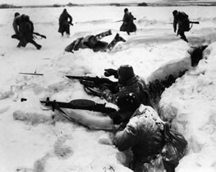
Moscow
  The German’s tried to capture the Soviet capital city of Moscow in 1941.
  Heavy losses and bad weather slowed their advance, but the Germans reached the outskirts of Moscow
  The Soviets staged a counterattack and forced a German retreat.

Slide 20
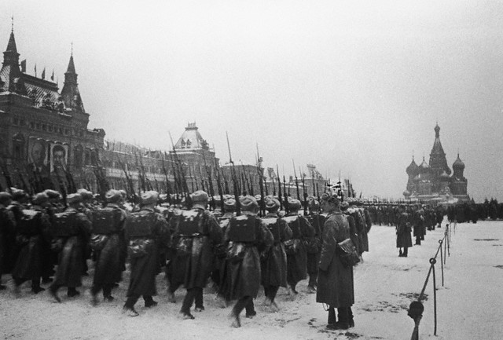
Soviets defend Moscow

Slide 21
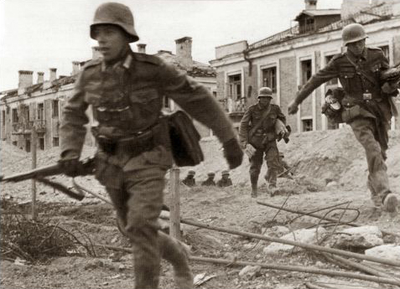
Stalingrad
Germany attacked Stalingrad in the spring of 1942
  Stalingrad was a key city because it led to the oil-rich lands to the south.
  The Germans had to fight street to street and house by house.

Slide 22
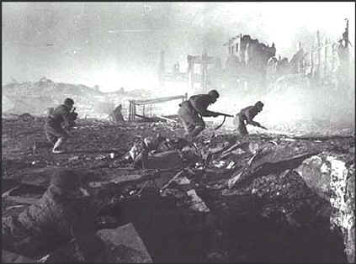
Stalingrad
No sooner had the Germans won Stalingrad than Soviet forces surrounded the city.
  The Soviets cut off the German supply lines.
  Cold and starving, the German troops fought on until February 1943 when the tattered remains of their army finally surrendered.

Slide 23
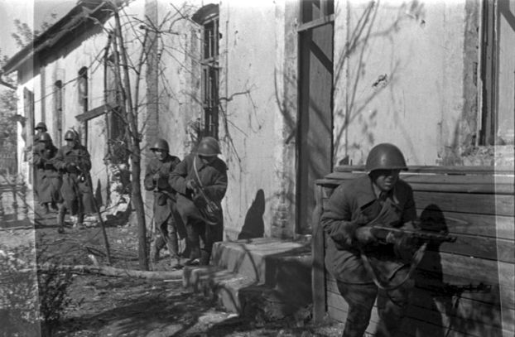
Stalingrad
The German defeat at Stalingrad was a major turning point in the war.

Slide 24
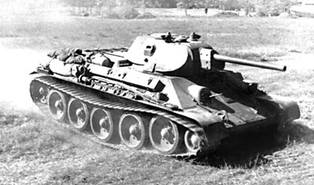
The Nazis were unable to take any of the 3 major Soviets cities
  The regrouped Soviets would chase the Nazis out of the Soviet Union, across Eastern Europe, and into Germany.
Soviet T-34 Tank

Slide 25
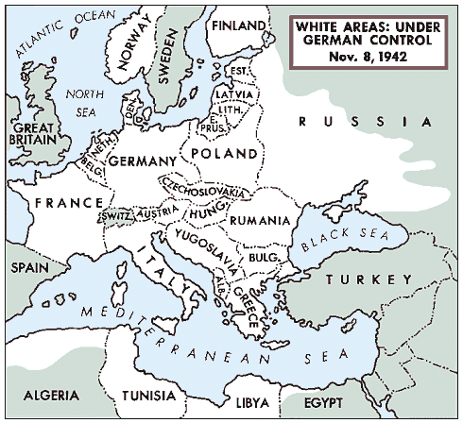
Invasion Of France
  As the Soviets worked their way toward Germany from the east, the Allies made plans to invade Nazi controlled France from the west.

Slide 26
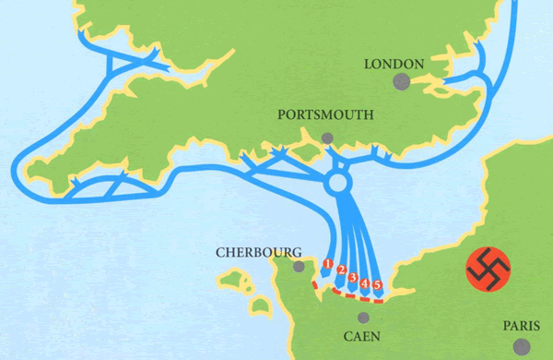
June 6, 1944 “D-Day”
General Eisenhower, the commander of Allied forces in Europe, directed an invasion in Normandy, France.
    The invasion was known as Operation Overlord.

Slide 27
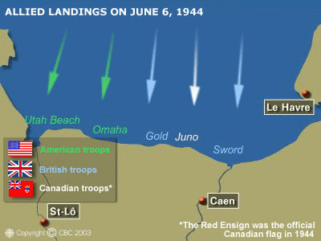
5 Separate beaches were attacked

Slide 28
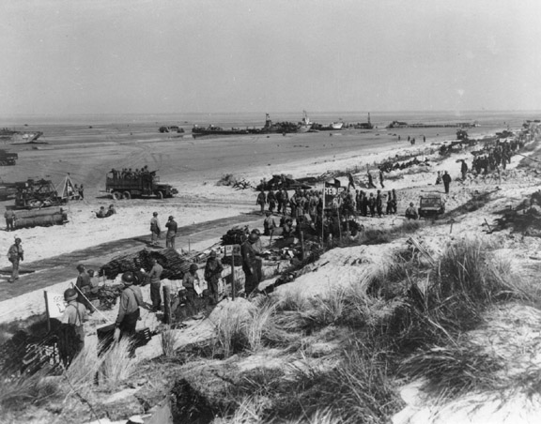
Utah Beach : Americans

Slide 29
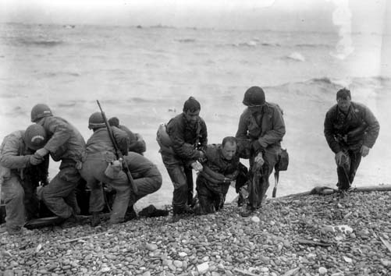
Utah Beach

Slide 30
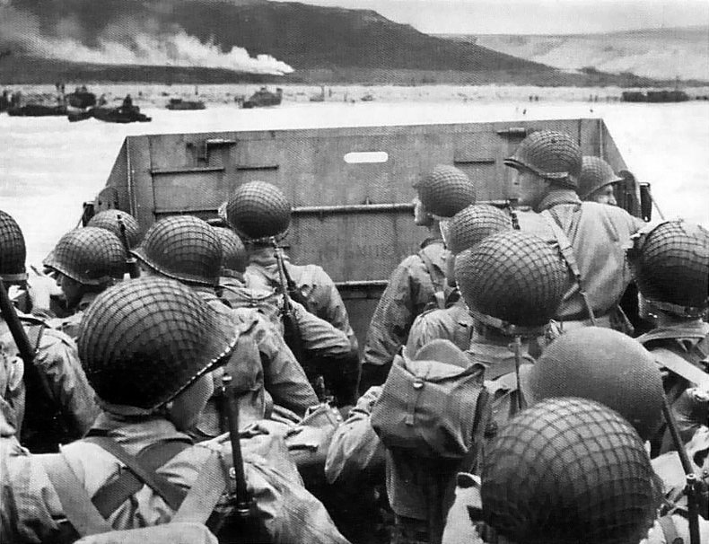
Omaha Beach: Americans

Slide 31
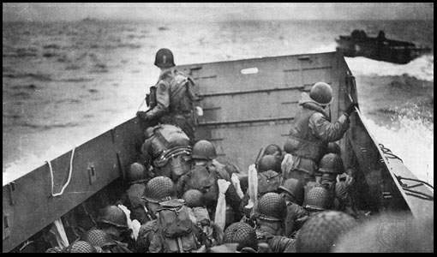

Slide 32
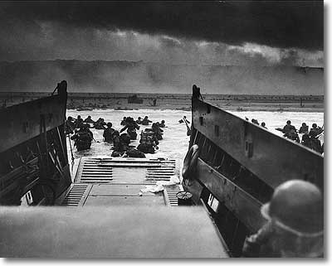

Slide 33
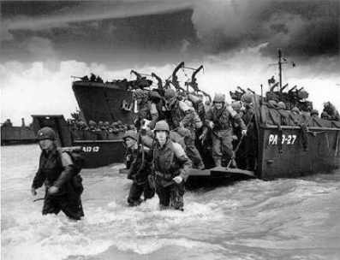

Slide 34
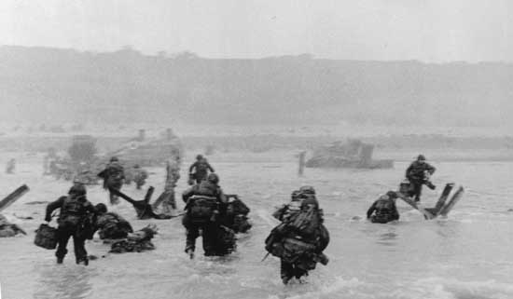

Slide 35
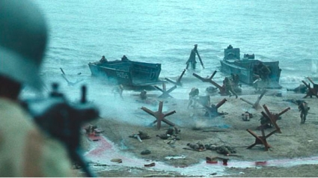

Slide 36
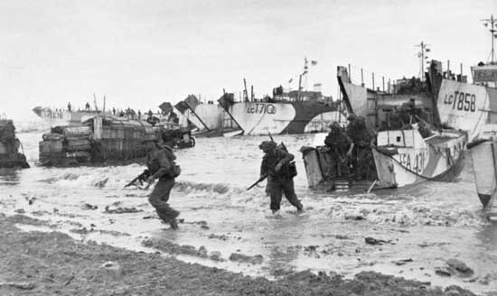
Gold Beach: British

Slide 37
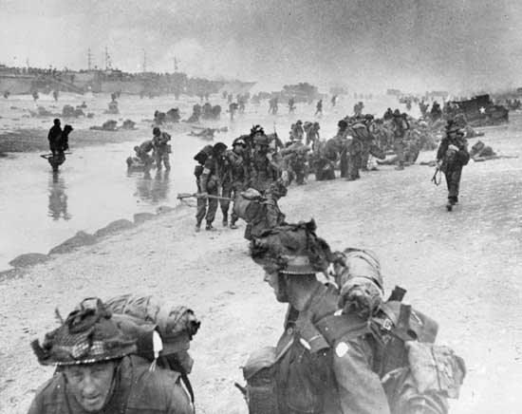
Sword Beach: British

Slide 38
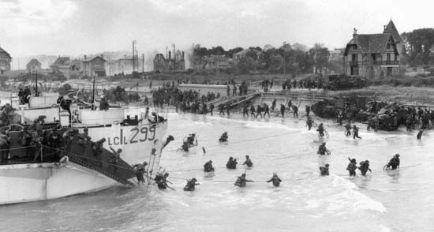
Juno Beach: Canadians

Slide 39
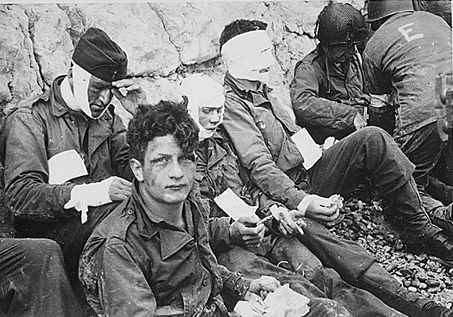
The troops arrived on ships, waded to shore, and were met with German fire and land mines.
  Many soldiers were killed as they tried to run for higher ground.

Slide 40
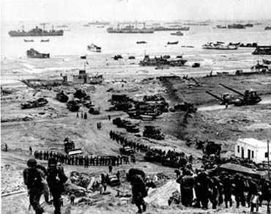
1 million Allied forces landed at Normandy within a 3 week period.

Slide 41
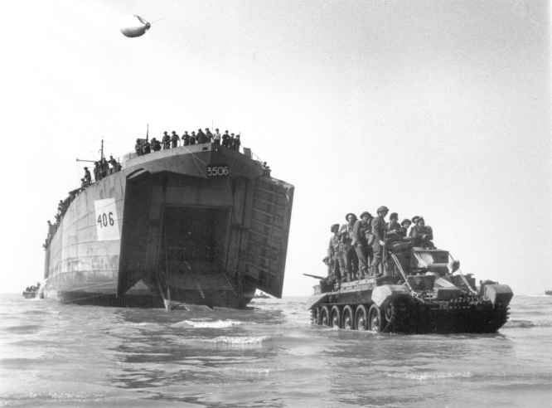
  The Allies unloaded more than 560,000 tons of supplies and 170,000 vehicles.

Slide 42
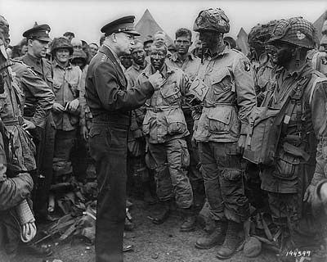
All 5 beaches were taken from the Germans and this gave the Allies a foothold on the west coast of Europe.

Slide 43
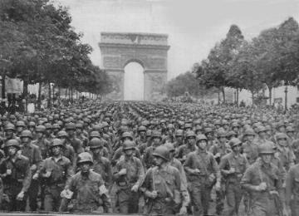
Paris
From Normandy, the Allies traveled quickly on to Paris.
On August 25 Paris was freed from the Germans.

Slide 44
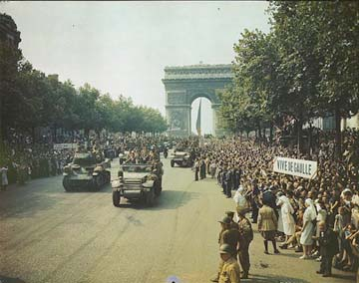

Slide 45
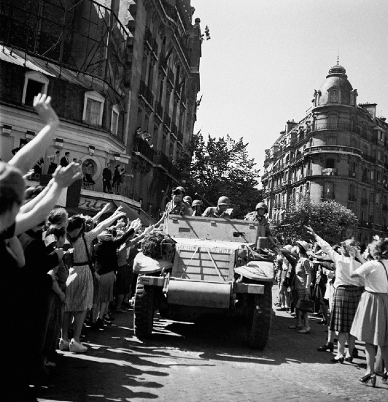
Paris
As American and French troops marched through Paris they were met by joyful crowds

Slide 46
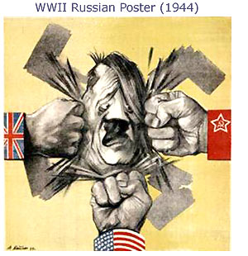
Victory In Europe
  By late 1944, Germany had basically been pushed back to it’s original borders.
    The Soviet Union pushed them back from the east.
    American and British troops pushed them back from the west and south.

Slide 47
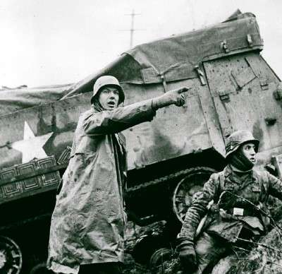
The Battle of the Bulge
In December 1944, the Germans made one last effort to attack the Allies.
  German’s surprised Allied forces by attacking Belgium.

Slide 48
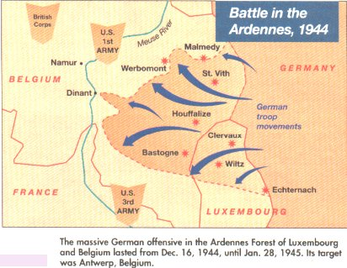
BATTLE OF THE BULGE
  The Battle of the Bulge lasted for several weeks and caused more than 75,000 casualties.
  The Allies eventually were able to push the Germans back into Germany.
    This was the last major German offensive of the war.

Slide 49
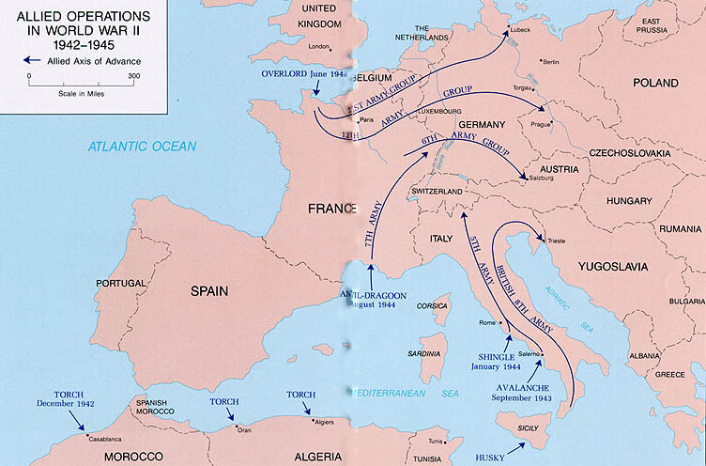

Slide 50
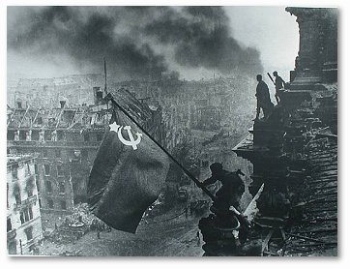
Battle for Berlin
The Soviets surrounded the German capital of Berlin in April of 1945

Slide 51

Battle of Berlin

Slide 52

Battle for Berlin
Knowing there was no way to win the war, Hitler committed suicide in his underground bunker.

Slide 53

V-E Day
On May 7, 1945, the Germans surrendered unconditionally.
On May 8, 1945, the Allied forces declared V-E Day for “Victory in Europe”

Slide 54

V-E Day

Slide 55

The U.S. Mourns
FDR died suddenly before the Allied forces ended the war in Europe.
  FDR led the U.S. for 12 years as president.
  Harry S. Truman became president.

Slide 56


Slide 57

FDR

Slide 58

Holocaust
Hitler and the Nazi leaders had attempted genocide to rid the world of Jews.

Slide 59


Slide 60


Slide 61


Slide 62


Slide 63


Slide 64


Slide 65


Slide 66

Holocaust
Thousands of Jews were killed and buried in mass graves.
Millions were sent to concentration camps, where they lived under inhumane conditions

Slide 67


Slide 68

Holocaust
Thousands died of illness and starvation.

Slide 69

Holocaust
Nazis killed Jews in gas chambers and burned their bodies in ovens.
  Approximately 6 million Jews were killed by the Nazis during the Holocaust.

Slide 70


Slide 71


Slide 72


Slide 73

Ovens

Slide 74

Ovens

Slide 75


Slide 76


Slide 77

Holocaust
Besides Jews, millions of Soviet prisoners, Poles, Gypsies, and people with handicaps were killed at concentration camps.

Slide 78

The Pacific Front
Not only was the U.S. military base at Pearl Harbor attacked on December 7, 1941, but so was Wake Island, Guam Island, and the Philippines Islands

Slide 79

The Pacific Front
In the Philippines, Japanese forces captured the capital city of Manila and fiercely attacked American and Filipino troops

Slide 80

The Pacific Front
The American and Filipino troops were forced to surrender after supplies ran low.

Slide 81

The Pacific Front
The sick and starving prisoners of war were forced to walk 60 miles to prison camps by the Japanese
  The walk became known as the Bataan Death March.

Slide 82

The Pacific Front
More than 20,000 prisoners died along the way.
  The Japanese shot or stabbed those who were too weak to continue the march.

Slide 83

The Pacific Front
Battle of the Coral Sea
    Americans prevented Japan from attacking Australia.

Slide 84

The Pacific Front
Battle of Midway
  This was the first major loss for Japan
    Americans destroyed 4 Japanese aircraft carriers and hundreds of airplanes in the battle.

Slide 85

The Pacific Front
Island Hopping
  A strategy used by General MacArthur and Admiral Chester Nimitz, commanders of the Allied forces in the Pacific.
  The idea was to capture strategic islands that could be used as bases from which they moved others closer to the Philippines and Japan.

Slide 86

The Pacific Front
  Guadalcanal
    Heavy fighting occurred on this Solomon Island from August 1942 until February 1943.
    In the end, Americans finally seized control of this strategic island from the Japanese.

Slide 87

The Pacific Front
  Guam
    Guam was seized from the Japanese in June of 1944.
    It was an important base from where bomb strikes against Japan were launched.

Slide 88

The Pacific Front
  Battle of Leyte Gulf
    Leyte Gulf is located in the Philippines
    This was the largest naval battle in the history of the U.S.
      The battle involved 282 ships.
    Most of the Japanese fleet was destroyed by the American ships.

Slide 89

The Pacific Front
  Iwo Jima and Okinawa
    These islands were captured in March and June of 1945 after fierce fighting.
    Thousands of Americans were killed, and many thousands more were wounded.

Slide 90

Okinawa & Iwo Jima

Slide 91


Slide 92

Okinawa & Iwo Jima

Slide 93


Slide 94


Slide 95


Slide 96


Slide 97


Slide 98

Okinawa & Iwo Jima

Slide 99

Okinawa & Iwo Jima

Slide 100

Okinawa & Iwo Jima
The Americans had destroyed most of Japan’s air force and navy by the end of these battles.

Slide 101

The Pacific Front
  Japan and Tokyo
    The Americans bombed Tokyo and other Japanese cities.
      Thousands of Japanese civilians died and their economy was ruined.

Slide 102

The Pacific Front
Japan used kamikaze pilots to crash planes loaded with explosives into American ships, sinking several.
  The kamikaze pilots were well aware of their missions.

Slide 103

Kamikaze

Slide 104

The Atomic Bomb
Albert Einstein, a German-born physicist, informed FDR of the existence of technology that could create a powerful bomb made from the power of atoms.

Slide 105

The Atomic Bomb
FDR created a top secret mission to build an atomic bomb first before the Nazis, who also were working on the same project.
  It was called the Manhattan Project

Slide 106

The Atomic Bomb
The atom bomb was tested in the desert in New Mexico in July 1945.

Slide 107

The Atomic Bomb
  The Japanese refused to surrender even though it had little chance of winning.
    The Allied nations warned Japan in the Potsdam Declaration that, if they did not surrender, they would be completely destroyed.

Slide 108

The Atomic Bomb
When the Japanese refused to surrender, President Truman approved the use of the atomic bomb. Little Boy

Slide 109

The Atomic Bomb
The atomic bomb was dropped on Hiroshima, Japan, on August 6, 1945.
  It killed 70,000 people

Slide 110

Enola Gay

Slide 111

Hiroshima

Slide 112

Hiroshima

Slide 113

Hiroshima

Slide 114

The Atomic Bomb
Three days after the first, another atomic bomb was dropped on Nagasaki, Japan.
  It killed more than 40,000 people

Slide 115

Nagasaki

Slide 116

Nagasaki

Slide 117

The Atomic Bomb
The atomic bombs were extremely powerful and cities were completely destroyed.

Slide 118

Atomic Bomb
Lives were also destroyed.
  Between the 2 bombs, about 110,000 Japanese died.

Slide 119

Atomic Bomb

Slide 120

Atomic Bomb

Slide 121

The Atomic Bomb
Many more people died years later from radiation given off by the bombs.

Slide 122

Atomic Bomb

Slide 123

Atomic Bomb

Slide 124

The War Ends

Slide 125

The War Ends
  V-J Day
    Japan surrendered after the bombings.
    April 15, 1945, was declared V-J Day for “Victory in Japan”

Slide 126

The War Ends
WWII officially ended when Japan signed the formal surrender on September 2, 1945.
  It took place on board the U.S.S. Missouri.

Slide 127

Japan Surrenders aboard the U.S.S. Missouri

Slide 128

Japan Surrenders

Slide 129

Nuremburg War Crimes Trial
Japanese and Nazi leaders were tried for war crimes and crimes against humanity.

Slide 130

The War Ends
Allied authorities led the trials
  The trials took place in Nuremberg, Germany and Tokyo, Japan

Slide 131

Tokyo War Crimes Trial

Slide 132

Results of the war
WWII was the most destructive War in history.

Slide 133

Results of the war
More than 40 million people who died during the war were civilians.
  Due to bombing, starvation, disease, torture, and murder.

Slide 134

Results of the war
About 322,000 Americans died and 800,000 were injured.

Slide 135

Results of the war
More than 20 million people from the Soviet Union died.

Slide 136

Results of the war
Survivors had to rebuild their countries and lives after the war.

Slide 137

WWII Memorial in Washington D.C.

Slide 138

WWII Memorial in Washington D.C.

Slide 139

WWII Memorial in Washington D.C.

Slide 140

WWII Memorial in Washington D.C.

