Slide 1
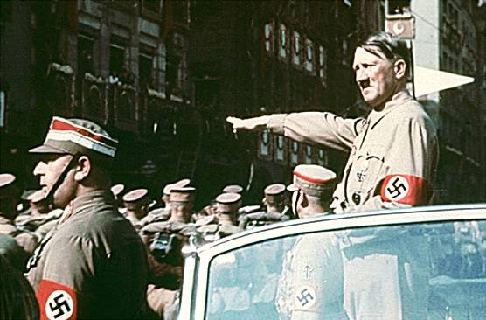
The War Begins: World War II
Section 11.2

Slide 2
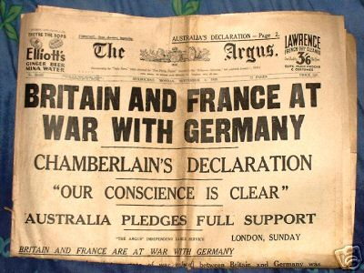
War in Europe
  WWII began in September 1939, when Great Britain and France declared war on Germany.
    Germany’s invasion of Poland was the deciding final factor.

Slide 3
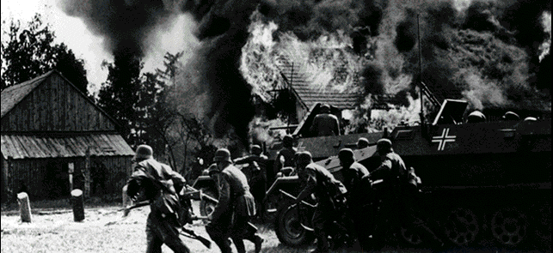
Germany’s rapid and powerful invasion of Poland was called blitzkrieg, or “lightning war”.

Slide 4
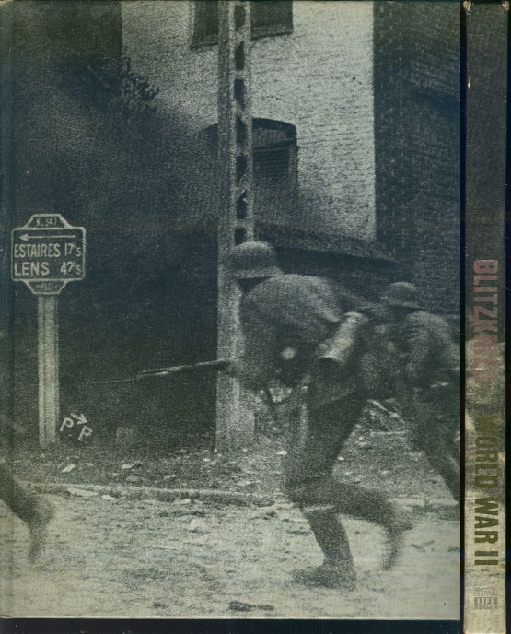
Thousands of German soldiers invaded Poland

Slide 5
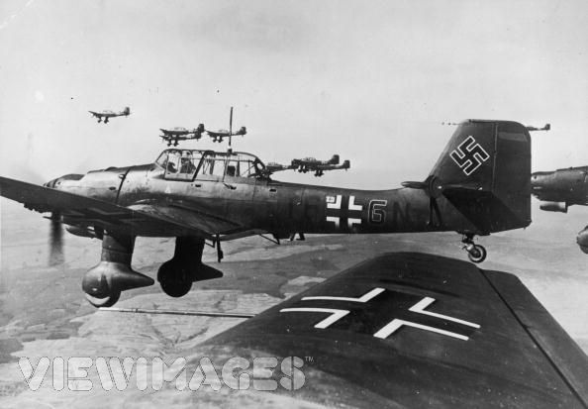
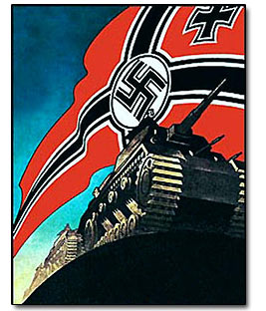
German planes and tanks attacked Poland with bombs and machine-gun fire.
  Poland was defeated before Britain and France could help.

Slide 6
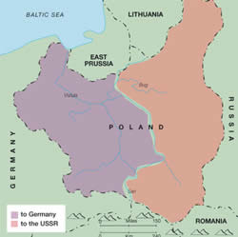
As part of the secret Nazi-Soviet agreement between Hitler and Stalin, the Soviet Union moved in and occupied eastern Poland after Germany had taken over western Poland.

Slide 7
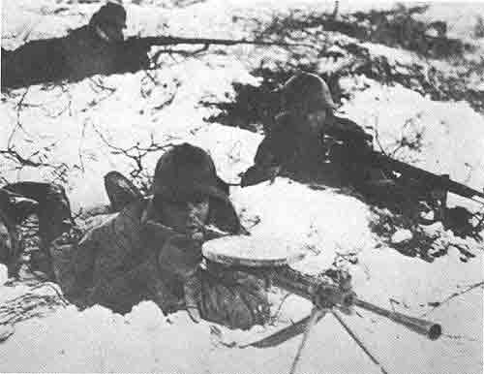
The Soviet Union also established military bases in Latvia, Lithuania, Estonia, and Finland

Slide 8
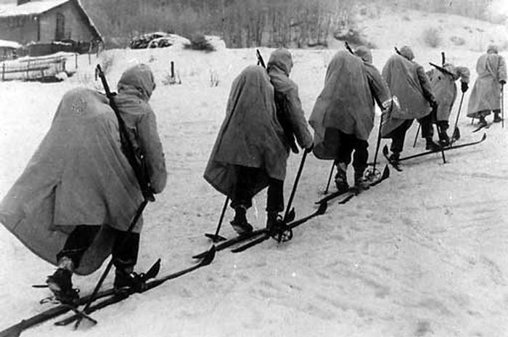
Finland bravely fought back, but eventually surrendered in March of 1940

Slide 9
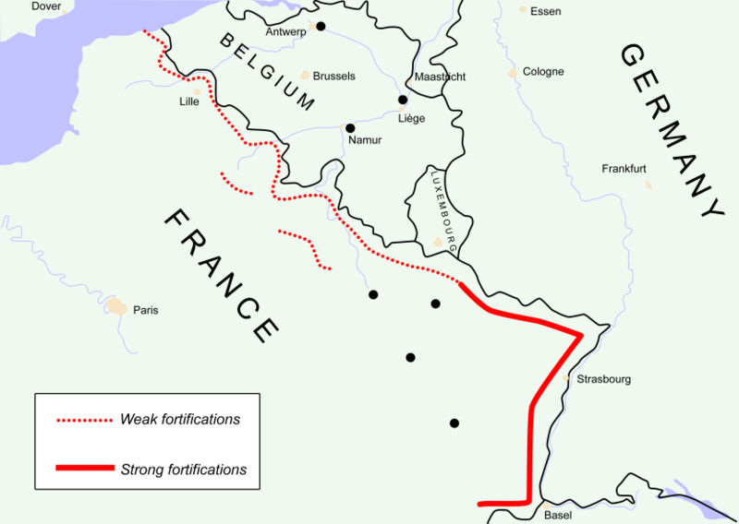
In preparation for a possible battle with Germany, French and British soldiers built a string of steel-and-concrete bunkers along the German border from Belgium to Switzerland
  This bunker line was called the Maginot Line

Slide 10
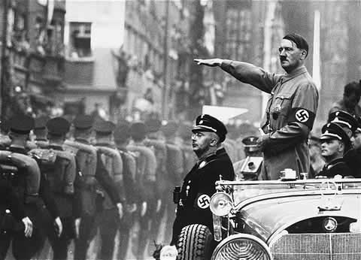
Hitler On The Attack

Slide 11
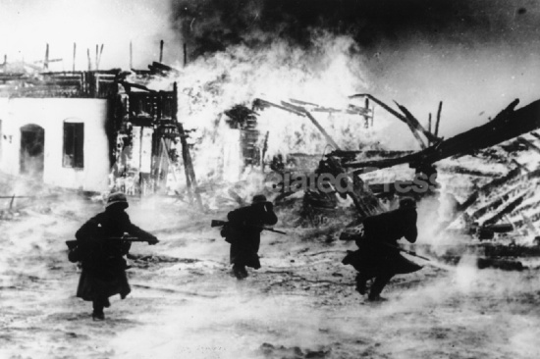
Germany invades and takes over Denmark and Norway in April of 1940

Slide 12
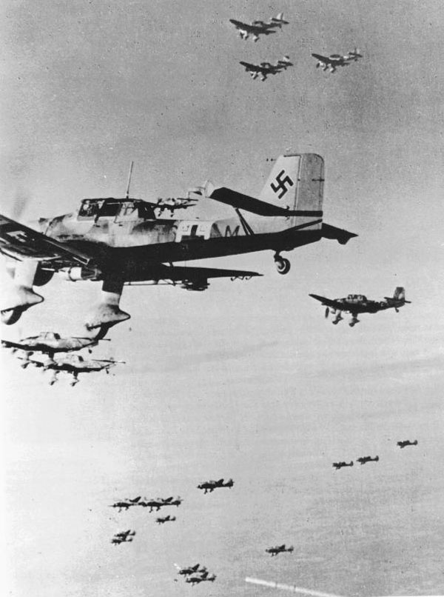
Germany invades and takes over Belgium and the Netherlands in May of 1940
  Belgium and the Netherlands surrender after terrible bombing raids

Slide 13
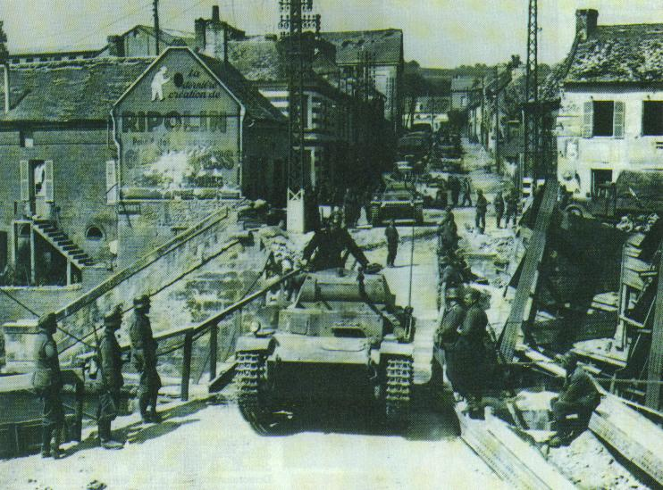
The Axis Invade France

Slide 14
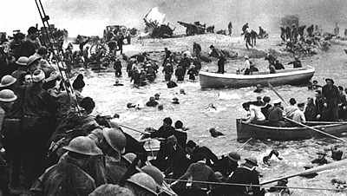
Germany chases overpowered, retreating allied troops west to the English Channel where they were trapped.
  More than 800 British ships crossed the channel and rescued more than 300,000 French and British troops.

Slide 15
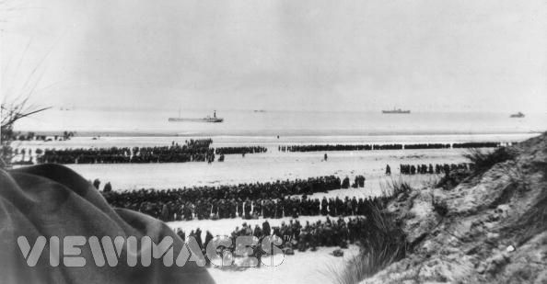

Slide 16
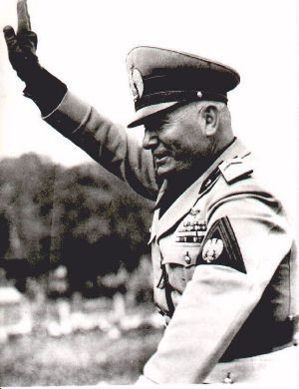
Italy invaded France from the southeast to help Germany.
  Japan also joined in to help Germany and Italy in France.
  Germany continued to move into France toward Paris.

Slide 17
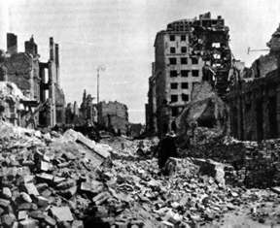
Germany used the blitzkrieg offensive to attack Paris in June of 1940.
  After 2 weeks of fighting, the French surrendered.

Slide 18
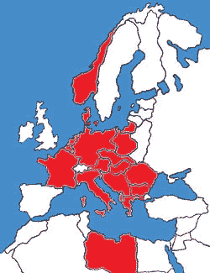
Germany dominated all of western Europe, except for Great Britain

Slide 19
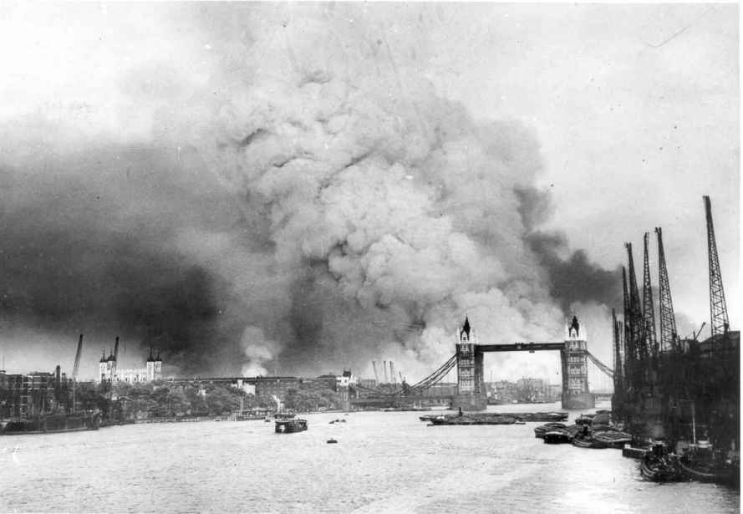
The Germans bombed Great Britain in August of 1940.
  Many civilians were killed in the raid.
  Shipyards, industries, and cities were destroyed.

Slide 20
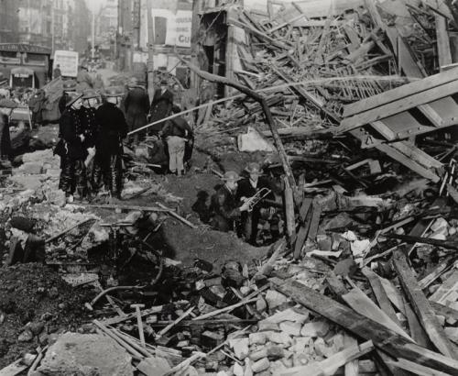

Slide 21
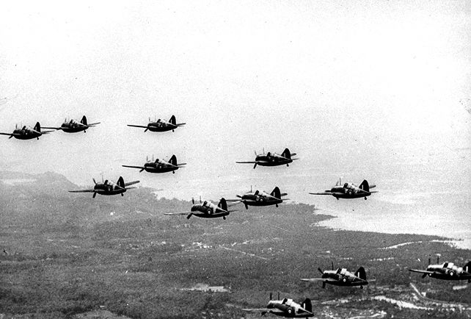
The British Royal Air Force counter-attacked the German air force, causing heavy losses for the Germans.
    Hitler finally called off the Battle of Britain in October of 1940.

Slide 22
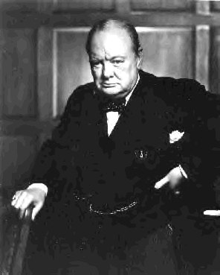
British Prime Minister Winston Churchill’s plan to not surrender to Germany had worked.

Slide 23
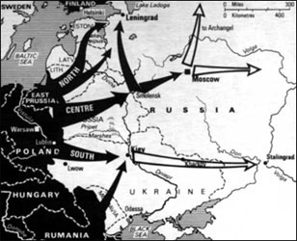
In June of 1941 Germany invaded the Soviet Union
  Hitler broke the Nazi-Soviet agreement with Stalin.

Slide 24
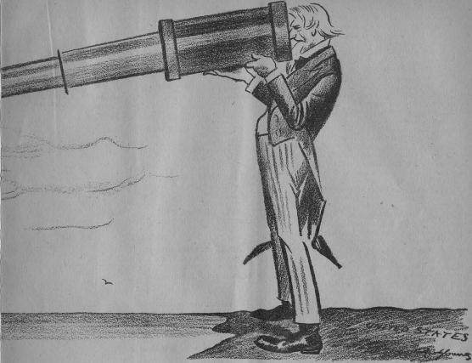
America And The War

Slide 25
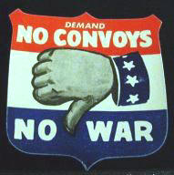
United States wanted to stay neutral
  A group supporting isolationism was formed called the America First Committee.
    Henry Ford and Charles Lindbergh were among the group’s leaders.
    They believed America should stay out of Europe’s problems.

Slide 26
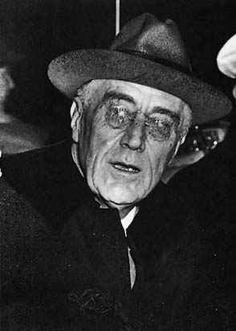
The United States became more and more concerned about what was happening in Europe
  FDR prepared for war even though he promised not to get involved.

Slide 27
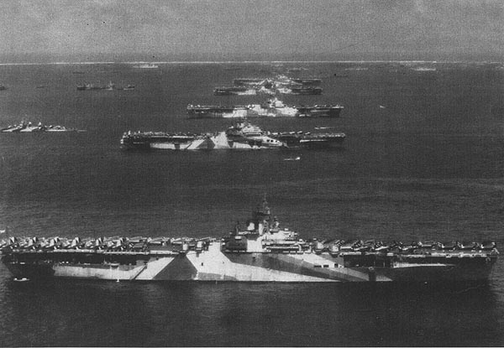
Congress approved a build up of the Navy in 1938

Slide 28
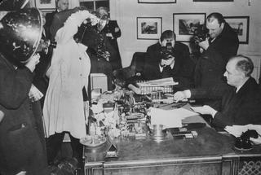
In 1939 Congress passed a NEW Neutrality Act that permitted the U.S. to sell weapons to countries that had the money to pay for them.

Slide 29
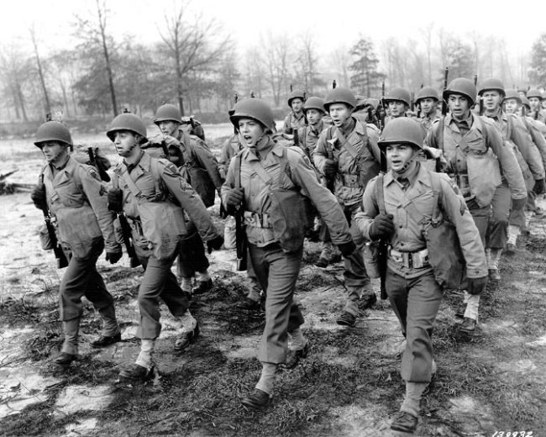
The first peace time draft in history was signed by FDR in 1940.
  Called the Selective Training and Service Act.
  American men, ages 21 – 35, were required to register for the draft.

Slide 30
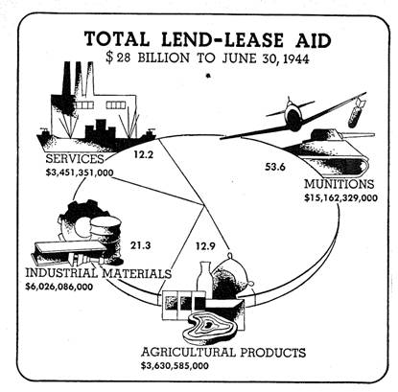
March 1941, Congress passed the Lend-Lease Act
  Allowed the U.S. to sell, lend, or lease weapons or supplies to any country that was important to the defense of the U.S.
    This law allowed the U.S. to help the British and French
    Isolationists were afraid the law would lead to further American involvement in the war.

Slide 31
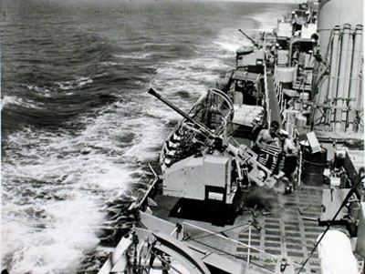
April 1941, American ships began escorting British cargo ships in the Atlantic.
  German submarines had been attacking British ships
  Now, the Germans began shooting at American ships
    FDR ordered American naval ships to shoot any German or Italian ships found in certain areas.

Slide 32
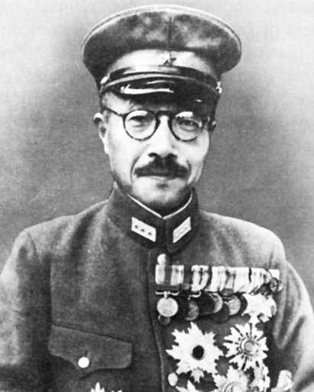
The Japanese Threat
  A new Japanese prime minister came to power in 1941 named General Hideki Tojo.

Slide 33
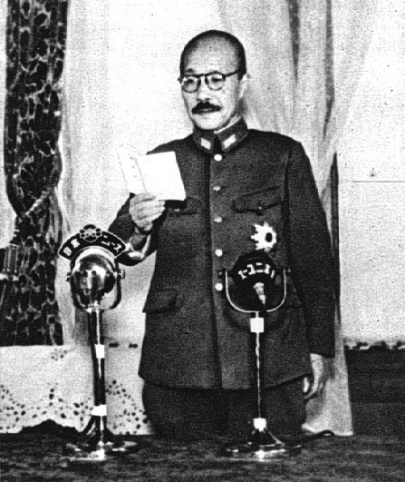
Japan controlled much of China in the 1930’s, but Tojo felt it was important to acquire more territories.
  Took over Indochina in 1940
  Tojo wanted to control the Dutch Indies, British Malaya, and the Philippines.
    The Philippines were a United States territory.

Slide 34
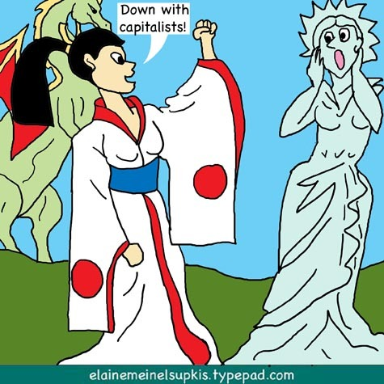
In response to Japan’s aggression, the U.S. put economic pressure on Japan.
  FDR froze all Japanese assets in American banks, so Japan could not get its money from the U.S.
  The U.S. stopped selling gasoline, oil, and other resources to Japan.

Slide 35
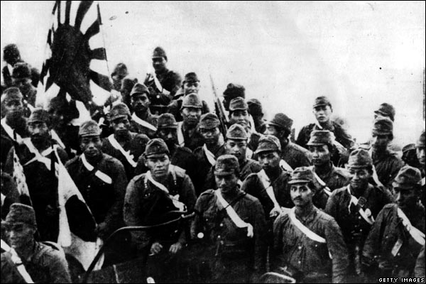
The economic pressure angered Tojo and he planned an attack on the United States.
  Tojo felt Japan could win a war with the United States.

Slide 36
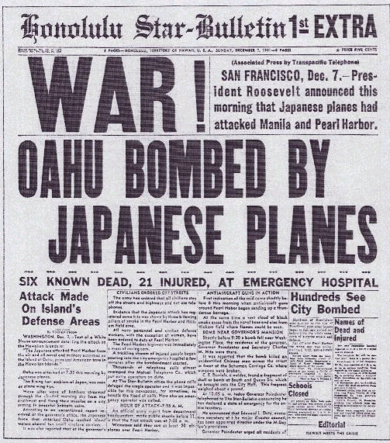
December 7, 1941

Slide 37
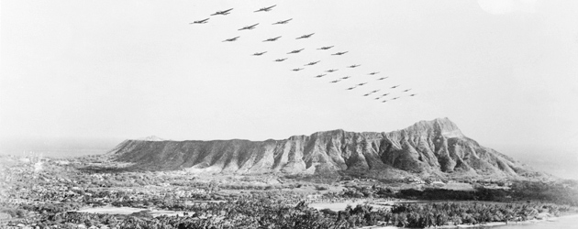
Japanese warplanes attacked an American military base in Pearl Harbor, Hawaii.

Slide 38
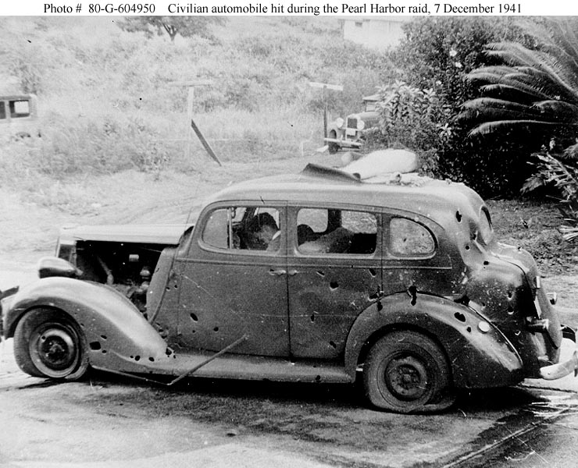
More than 2,300 people were killed, including many civilians.

Slide 39
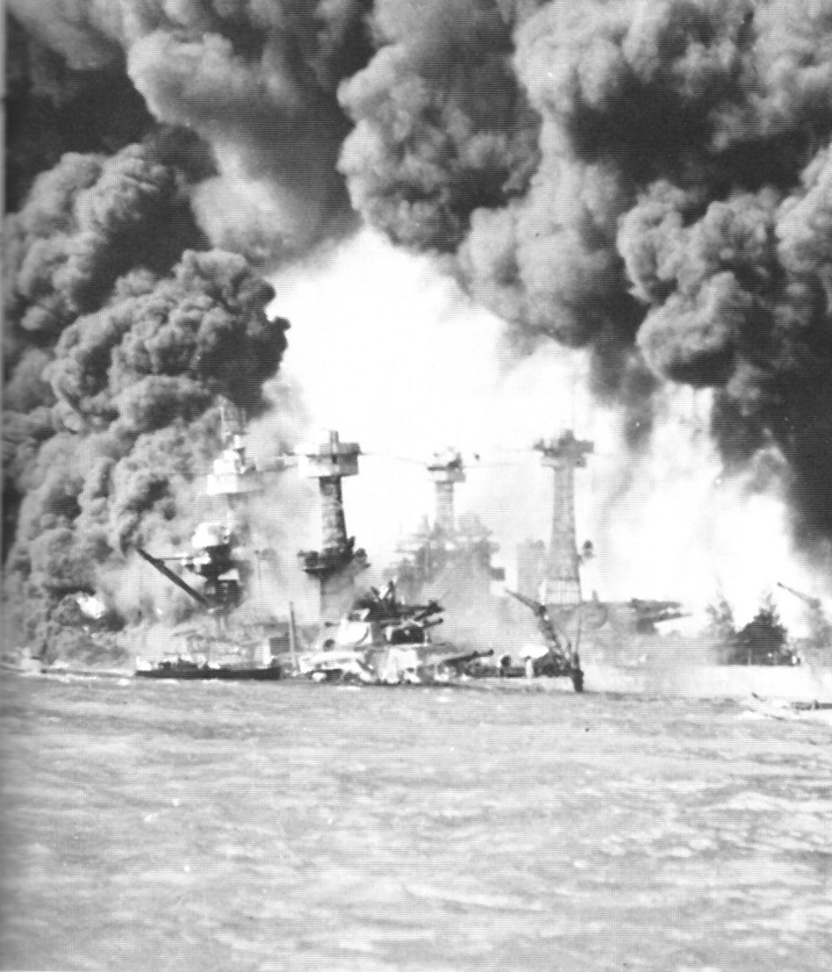
Eight battleships, three cruisers, four other ships, and hundreds of planes on the ground were destroyed.

Slide 40
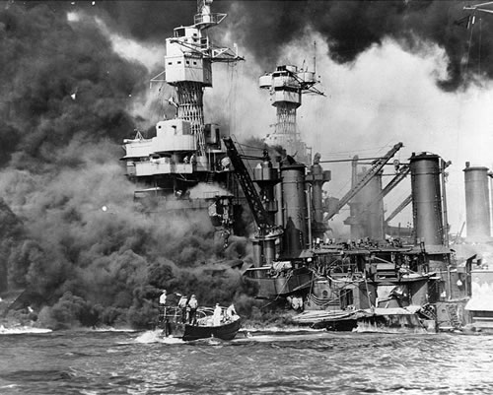
Pearl Harbor was the worst defeat in the history of the U.S. military.

Slide 41
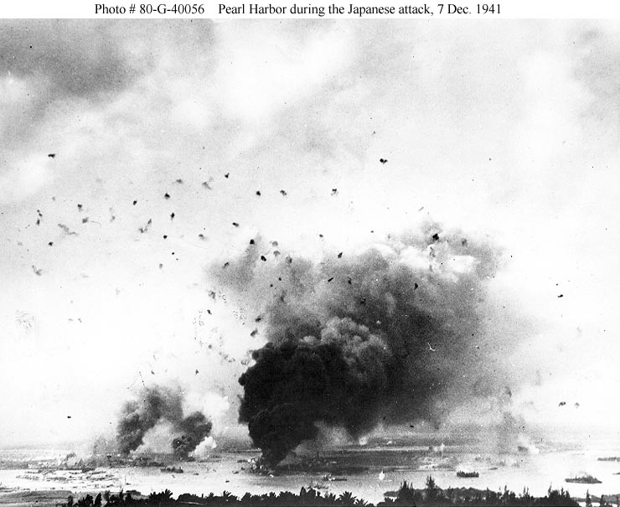

Slide 42
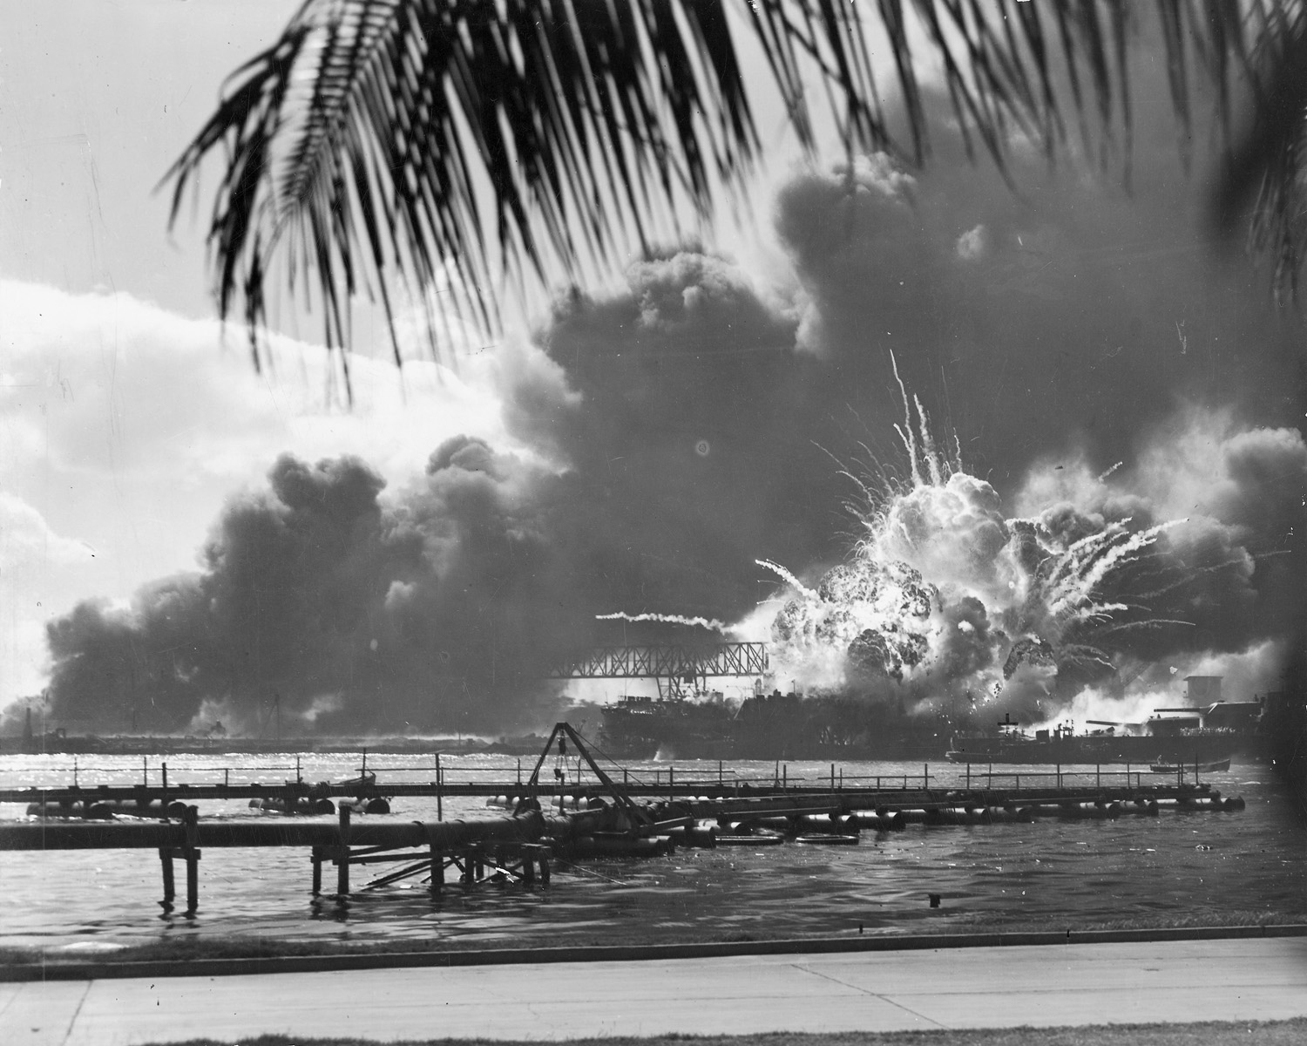

Slide 43
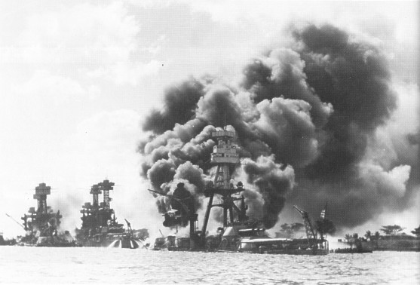

Slide 44
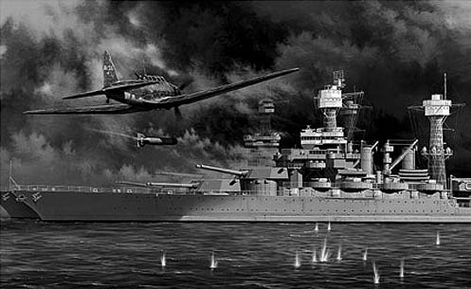

Slide 45
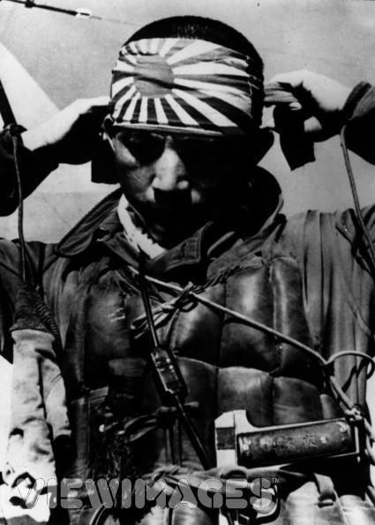

Slide 46
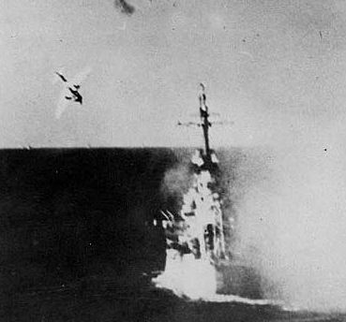

Slide 47
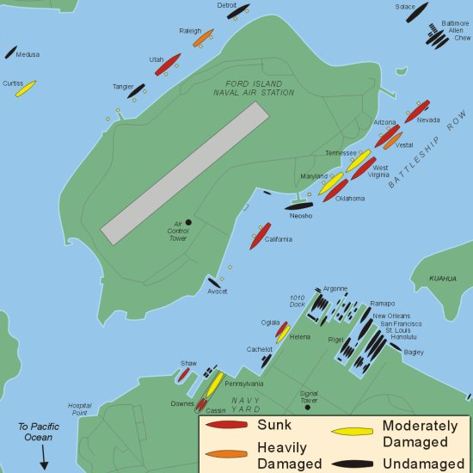

Slide 48
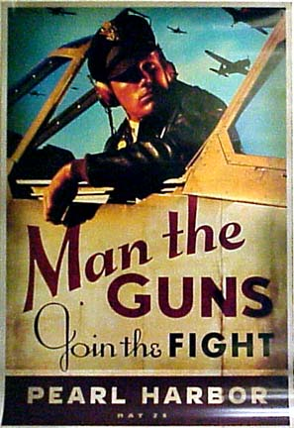
Americans quickly supported involvement in WWII after Pearl Harbor.
  Congress declared war on Japan on December 8, 1941.

Slide 49
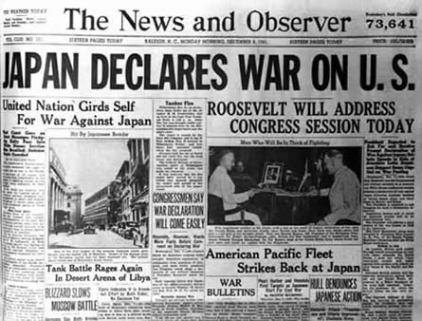
Japan’s allies—Germany and Italy – declared war on the United States 3 days later.
  In response, Congress declared war on Germany and Italy.

Slide 50

Set Alliances
  The Allied nations – Great Britain, France, the Soviet Union, and the United States.

Slide 51

The Axis Powers – Germany, Italy, and Japan

