Slide 1
Chapter 10.1
The
Great Depression

Slide 2
Economy during the 1920’s

Slide 3
Ups and Downs of the Stock Market

Slide 4
The economy in the 1920’s experienced great prosperity.

Slide 5
People were advised to invest monthly in the stock market.

Slide 6
Stock Market: An organized system for buying and selling shares in corporations or businesses.

Slide 7
Shares: Blocks of investment in businesses purchased by people hoping to make a profit off the success of that business.

Slide 8
The value of stocks on the New York Stock Exchange hit a record high in 1929.

Slide 9
People were doing anything they could to buy shares of stock, even if they didn’t have the money to back it up.
Buying stock on margin: Investors paid a fraction of the stock price and borrowed the rest from banks.
As long as the stock value increased, the investor and the bank made money.

Slide 10
The Crash

Slide 11
Some investors thought the stock market was going too well and they became afraid that it might fall.
Concerned investors figured they should sell some of their stock just to be safe.

Slide 12
This large amount of stock sales caused the value of all stocks to drop.

Slide 13
Banks became worried and demanded repayment of the money they lent to investors who bought stocks on margin.
People who bought their stocks on margin had to sell their stocks in order to pay back the banks.
All this selling of stocks caused the prices of stocks to keep falling even more!

Slide 14
“Black Tuesday”
October 24, 1929

Slide 15
Almost 13 million shares were sold by panicked investors.

Slide 16
This panicked selling of shares continued into the following week.
The New York Stock Exchange decided to close for a few days in order to stop the panic selling.
The stock market had crashed.

Slide 17
The Great Depression

Slide 18
The Great Depression
The stock market crash caused the U.S. economy to crash too.

Slide 19
The Great Depression
Income from farm and major industries dropped.

Slide 20
The Great Depression
Fewer orders for automobiles and construction were placed.

Slide 21
The Great Depression
Americans lost much of their income, so spending was down.

Slide 22
The Great Depression
Small banks were forced to close.
People who borrowed money from banks were not able to pay back their loans, or defaulted.
Thousands of these banks were forced to close.

Slide 23
The Great Depression
Loss of jobs

Slide 24
The Great Depression
Millions of Americans lost their jobs.
Some people were able to keep their jobs part-time or at lower wages.

Slide 25
The Great Depression
People lost their homes to repay loans they defaulted on.
Some people had to use old boxes for shelter.

Slide 27
The Great Depression
When several people grouped their box homes together, they became known as Hoovervilles.
People were frustrated that President Herbert Hoover had done nothing to help.

Slide 28
The Great Depression
Millions of starving, hungry people.
Local Governments and charities ran soup kitchens.
People waited in line for hours for bread, coffee, or soup.

Slide 29
Hoover and the Great Depression
Hoover believed the poor economy was only going to be temporary.
He thought the former prosperity would soon return.
He did not try to cure the problem with help from Congress.

Slide 30
Hoover and the Great Depression
Hoover called for voluntary action by individuals and local governments to provide help to the needy.
The number of needy was too overwhelming and volunteers soon ran out of money.

Slide 31
Hoover and the Great Depression
Hoover tried to help create new jobs by allowing money for public works.
Public Works: Projects such as building parks, libraries, and highways.
State and local governments eventually ran out money for these projects.

Slide 32
Bonus Army
WWI veterans demanded their promised bonus.
They weren’t supposed to receive it until 1945, but they wanted it now
Many veterans were out of work and saw it as relief

Slide 33
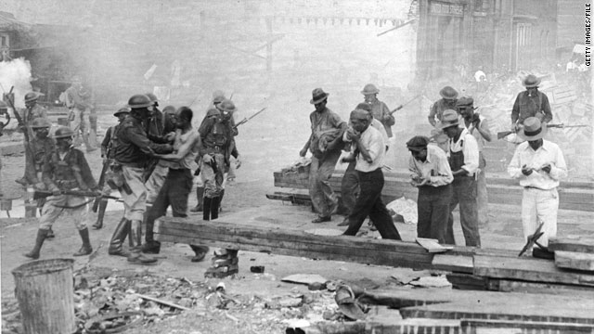
Bonus Army
Hoover’s response to the Bonus Army’s demand
He used the Army to disband them

