Slide 1
Chapter 7
Section 2 & 3
PowerPoint

Slide 2
Samoa
A group of islands 3,000 miles south of Hawaii
Germany, Great Britain, and the United States competed for power in Samoa

Slide 3
Samoa
Samoans gave the here countries special trading privileges
The three countries decided to divide up the islands without asking the Samoans.

Slide 4
Samoa
The U.S and Germany divided Samoa.
Great Britiain agreed to leave in exchange for rights on other Pacific Islands
The U.S annexed their share of Samoa in 1899

Slide 5
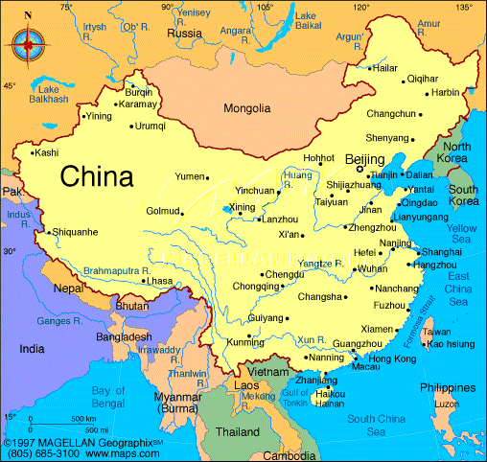
China
China had political unrest and lack of industry
China was too weak to resist foreign influence

Slide 6
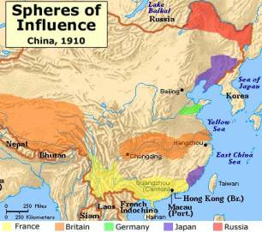
Japan and European countries made their move on China and took control of it’s different regions

Slide 7
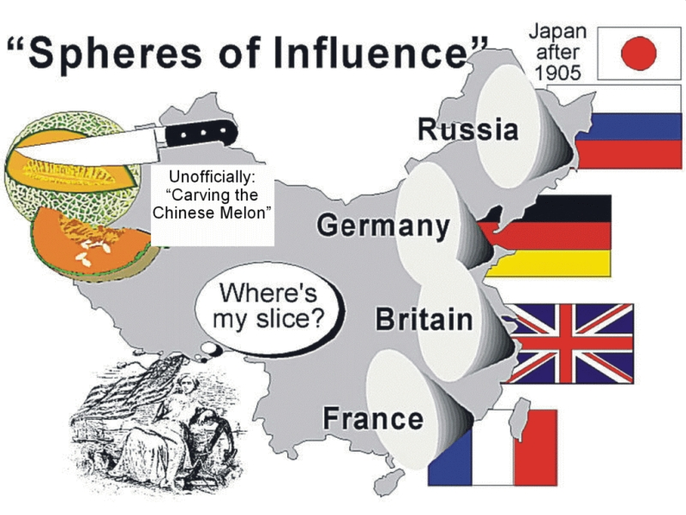
Spheres of Influence: Areas were countries enjoyed special rights and powers in China
  Formosa: Japan
  Shandong: Germany
  Various: Great Britain
  Manchuria: Russia

Slide 8
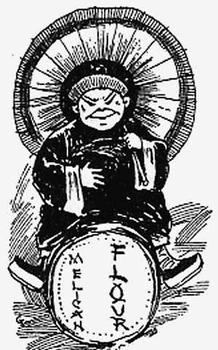
Secretary of State John Hay wanted to expand American trade in China.

Slide 9
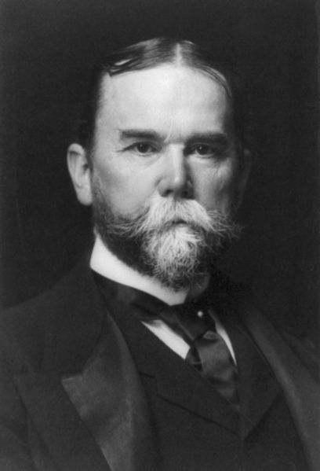
He proposed the Open Door Policy
  Called for each foreign country to be able to trade freely in the others sphere of influence.
  At first the other countries were opposed to it.

Slide 10
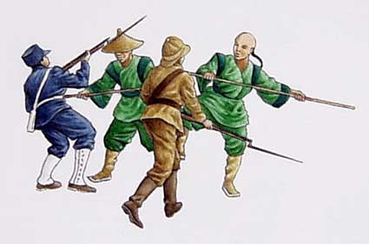
A secret Chinese martial arts society, known as the Boxers, revolted against foreign countries in China

Slide 11
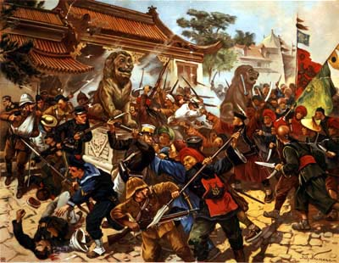
Many people died and hundreds were trapped in Beijing during the revolt

Slide 12
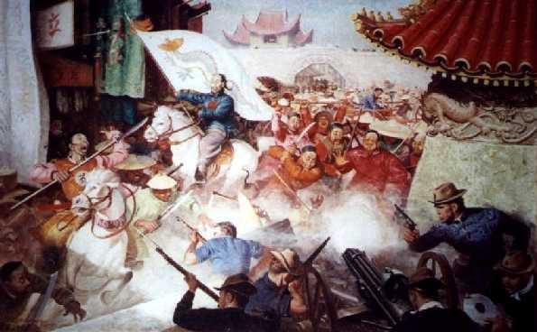
Foreign troops eventually defeated the Boxers.

Slide 13
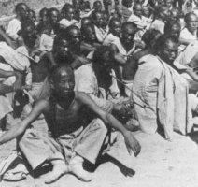
Hay’s second Open door Policy was accepted.
  It bonded the Europeans and Japan together against China
  China was able to keep its independence and borders.
  China signed new trade agreements to pay for the rebellion’s damage

Slide 14
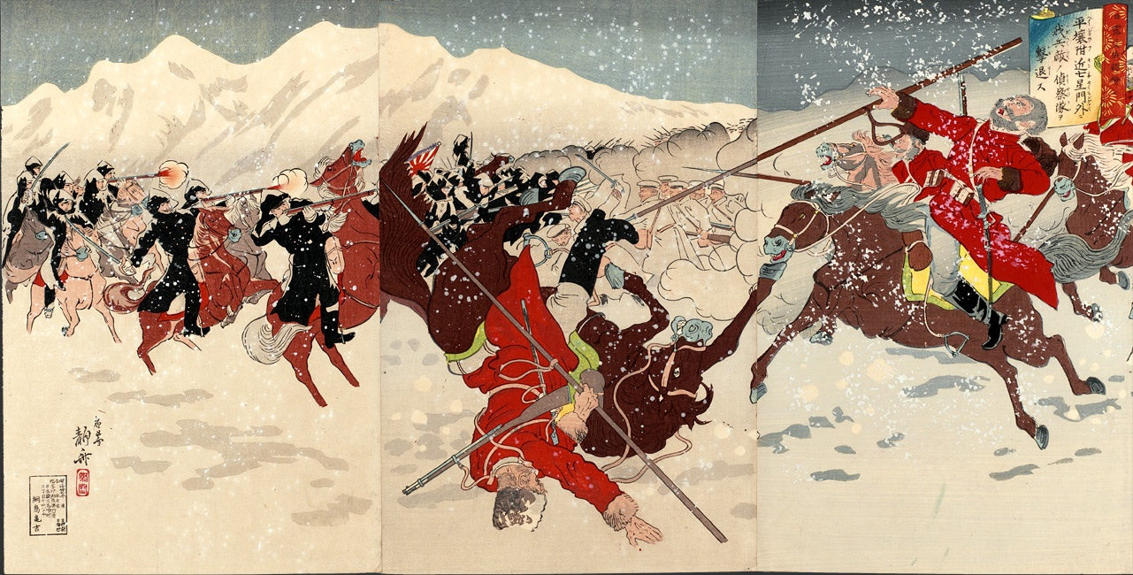
Japan
Russo-Japanese War

Slide 15
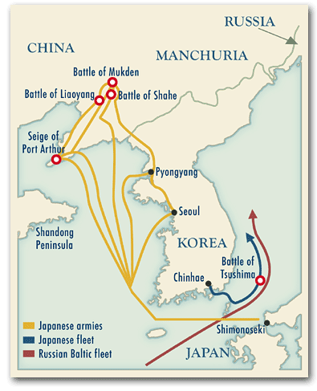
Japan attacked and destroyed a Russian fleet in southern Manchuria

Slide 16
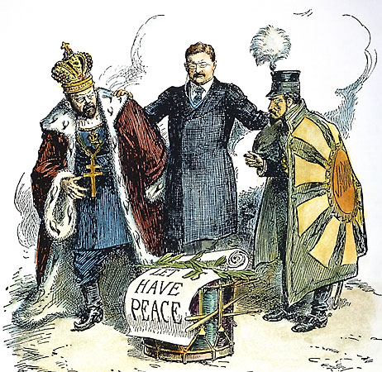
President Roosevelt helped the 2 countries achieve peace.
  Treaty of Portsmouth in 1905
    Japan gained Korea in exchange for stopping its expansion in Asia.

Slide 17
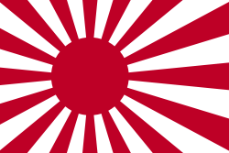
Japan became the strongest naval power in the Pacific
  Tensions grew between Japan and the U.S.
Japan became the strongest naval power in the Pacific
  Tensions grew between Japan and the U.S.

Slide 18
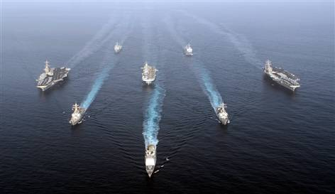
Roosevelt wanted to avoid war.
  He sent 16 warships around the world to demonstrate to the world how powerful the U.S. Navy was.
  The Japanese recognized the strength of the U.S, Navy and became more cooperative.

Slide 19
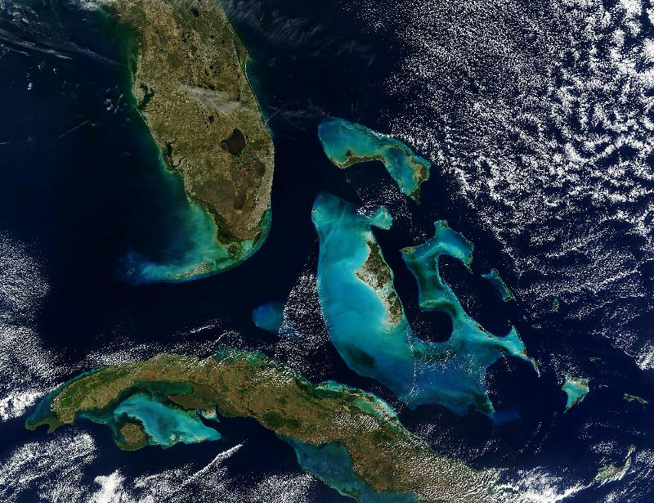
The Cuban Rebellion
Spain’s last major possession in the Western Hemisphere was Cuba.
FL
Cuba

Slide 20
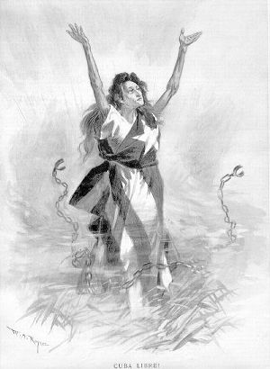
The people of Cuba rebelled against Spanish rule several times in the late 1800’s.
  The Cuban’s were always defeated,

Slide 21
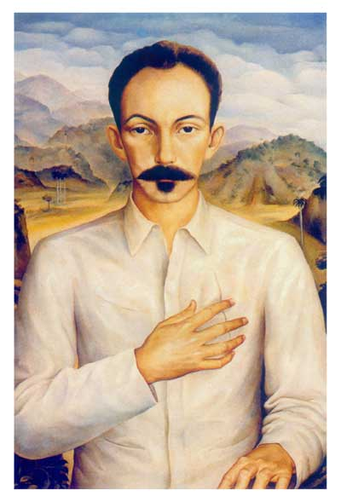
In 1895, Jose Marti led a new revolt against Spanish rule in Cuba
  He first traveled to the U.S. for money, arms, and troops to support the Cuban Independence Movement.

Slide 22
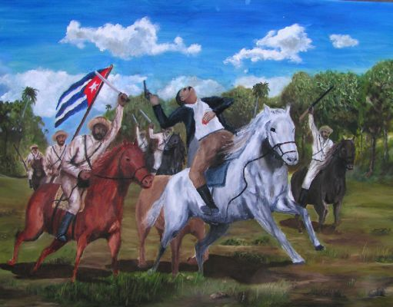

Slide 23
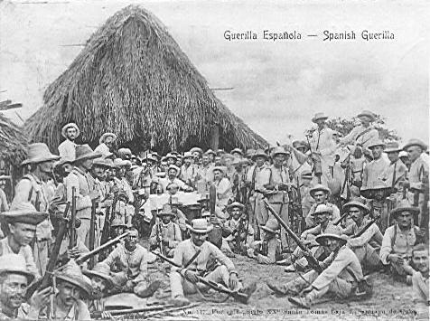
The revolt was devastatingly crushed and many lives were lost.
  The Spanish troops separated Cubans from the rebels, placing them in camps.

Slide 24
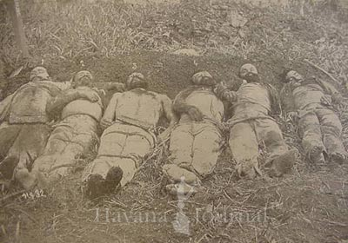
Disease and starvation took the lives of thousands of Cubans
  Many Americans opposed the inhumane treatment of Cubans at the hands of the Spanish.

Slide 25
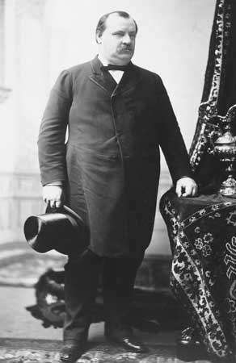
Many Americans wanted the U.S. government to help the Cubans.
  President Grover Cleveland was against interfering in Cuban affairs.

Slide 26
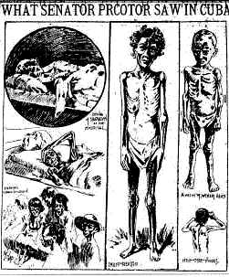
The American press and journalists covered the conditions of the Cuban people.
  Their reports were graphic and shocking.

Slide 27
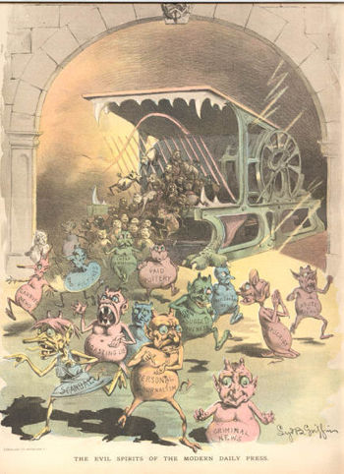
Their reports were often false, biased, and over exaggerated
  Yellow Journalism: Over exaggerated, sensationalized reporting; not necessarily true.

Slide 28
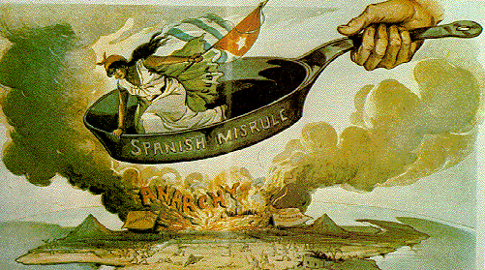
Yellow Journalism caused Americans to pressure new president McKinley to act on the Cuban situation.
  Many even pushed for war with Spain over the situation.

Slide 29
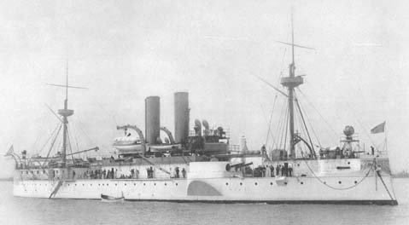
American Involvement in Cuba
  1898, McKinley sent the warship, Maine, to Cuba to protect American citizens and property in Cuba.
  It sat in Cuba’s capital city, Havana, for 3 weeks.

Slide 30
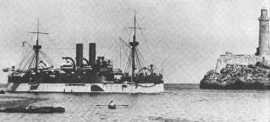
The Maine at Havana Harbor, Cuba

Slide 31
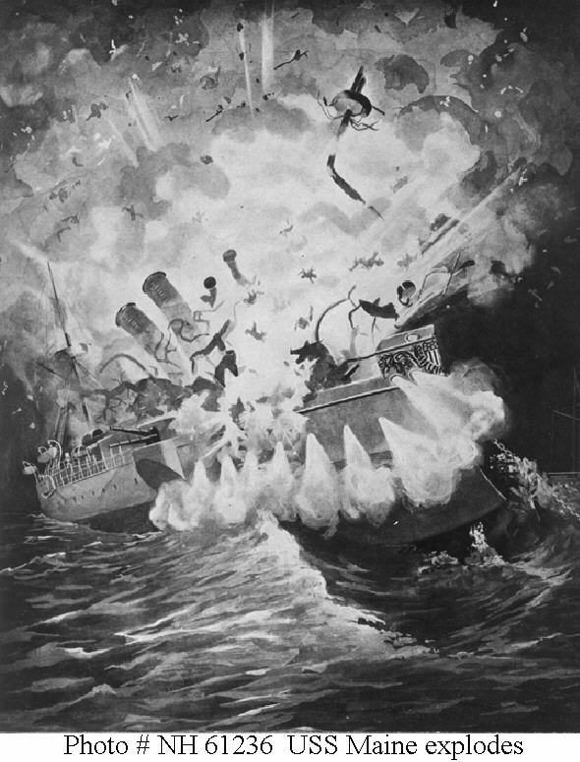
One night it exploded in Havana harbor.

Slide 32
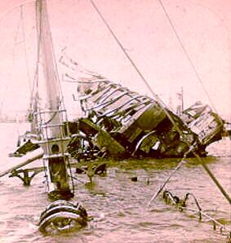
260 officers and crew were killed.

Slide 33
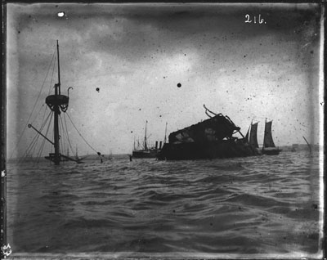

Slide 34
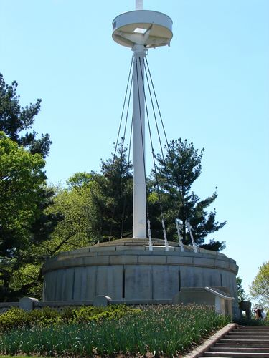
The mast of the Maine
Arlington Cemetery, Washington D.C.

Slide 35
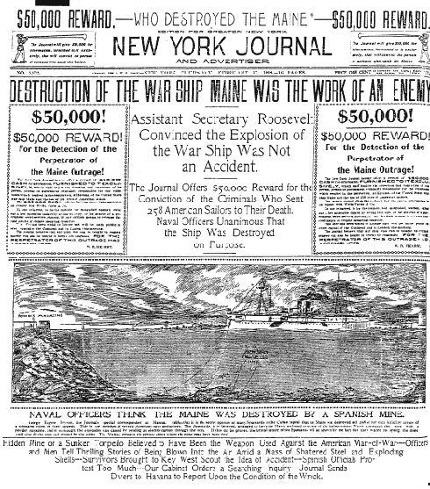
The newspapers blamed Spain, even though the explosion may had been an accident.

Slide 36
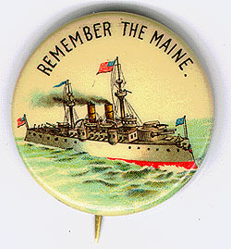
The rallying cry for revenge against Spain was, “Remember the Maine”

Slide 37
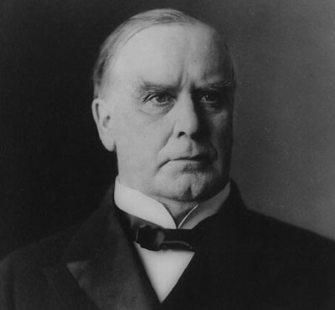
McKinley demanded Spain stop its inhumane treatment of Cubans.
Spain agreed to some, but not all, of McKinley’s demands.
Congress and the President were not satisfied and decided to officially recognize Cuba’s independence from Spain.

Slide 38
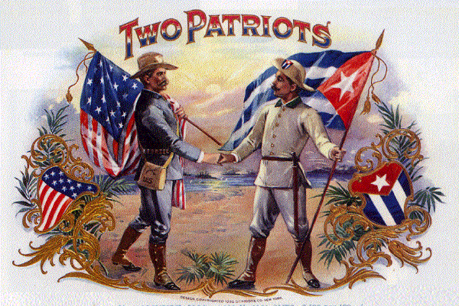
Congress approved the use of American troops to enforce the withdrawal of Spanish troops.
The U.S. declared war on Spain on April 25, 1898.

Slide 39
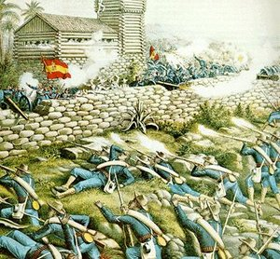
Spanish-American War

Slide 40
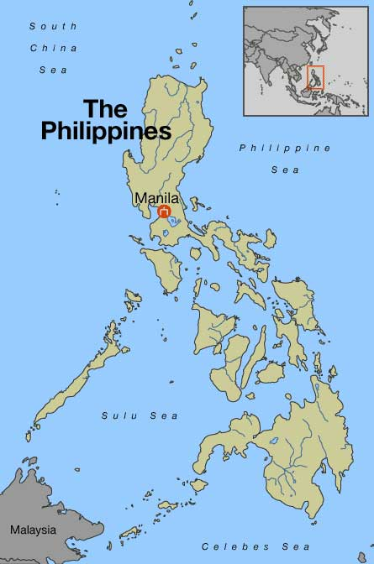
The war was not just fought in Cuba.
The first encounter of the war was in the Spanish colony of the Philippines

Slide 41
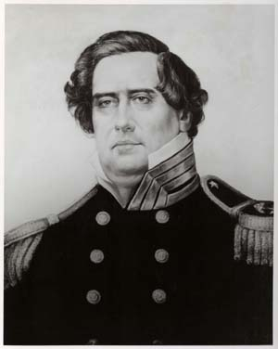
Commodore Matthew Perry led the navy in a surprise attack on Spanish ships based at Manila Bay.
American troops and Filipino rebels captured the city of Manila.

Slide 42
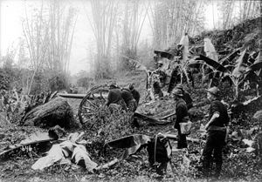

Slide 43
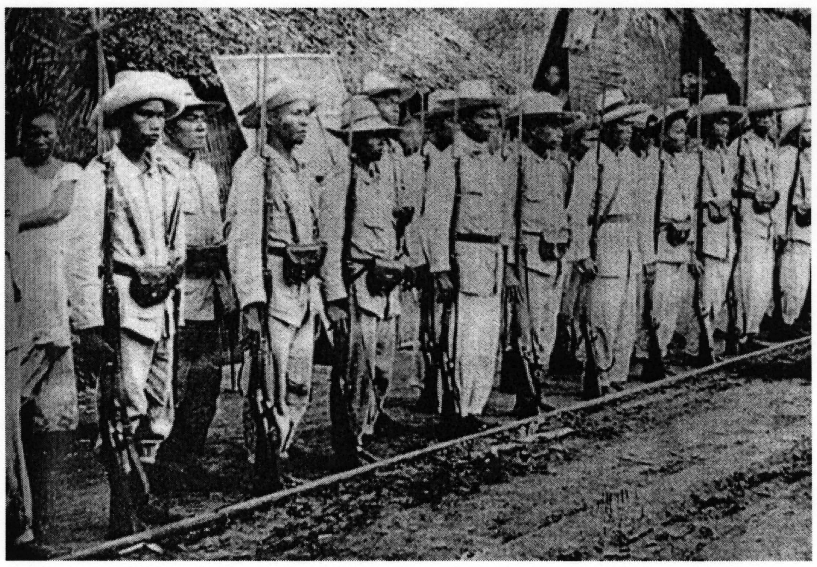

Slide 44
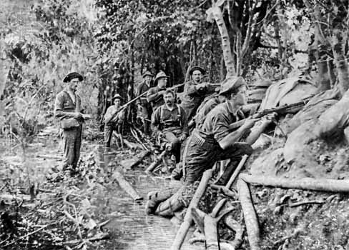

Slide 45
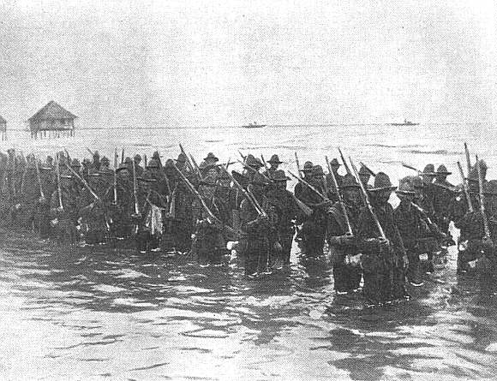

Slide 46
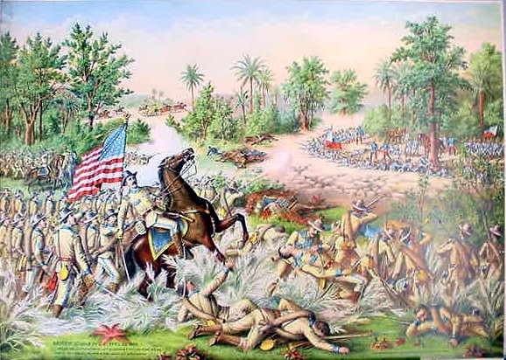
America supplied Filipino rebels with weapons.
The rebels took control of the main island, Luzon.
Filipinos declared their independence from Spain and formed a democratic republic.
They expected support from the U.S.

Slide 47
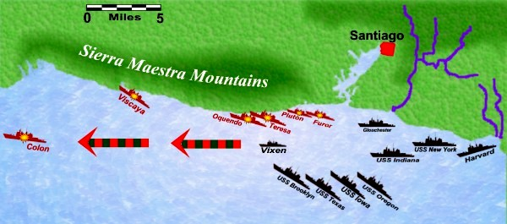
The U.S. attack on Cuba
The U.S. attacked the port town of Santiago, Cuba
The U.S. navy blockaded Spanish ships in Santiago Harbor.

Slide 48
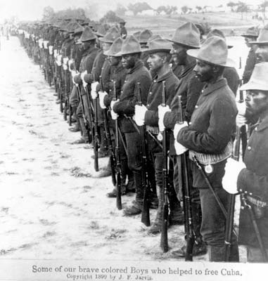
17,000 American troops landed in Santiago
¼ were African Americans
The Americans were inexperienced and unprepared

Slide 49
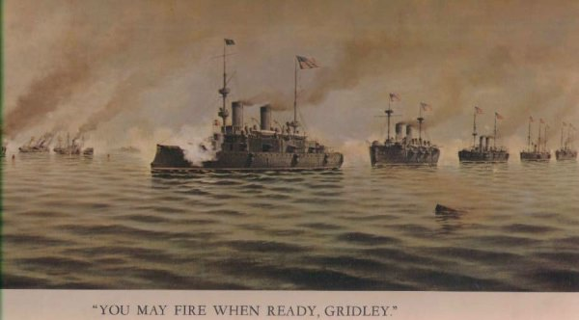
The Spanish fleet attempted to break through the blockade

Slide 50
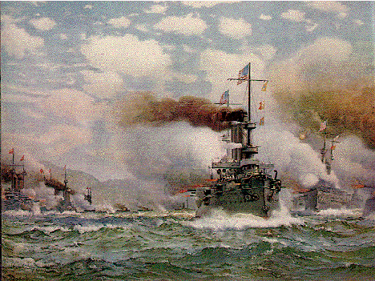
In four hours the entire Spanish fleet was destroyed.

Slide 51
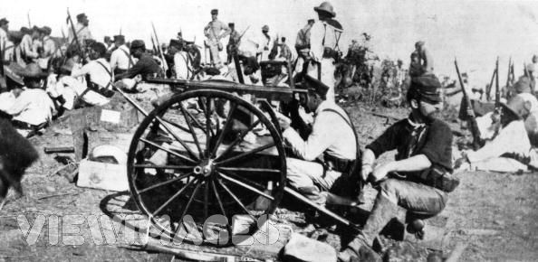
The U.S. attack at the Battle of San Juan Hill

Slide 52
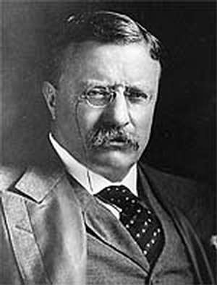
Theodore Roosevelt resigned from his job as Assistant Secretary of the Navy to join the fighting in Cuba

Slide 53
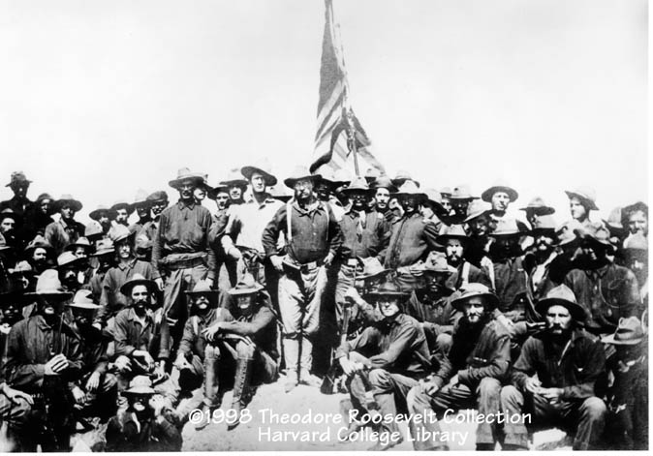
-He led the First Regiment of U.S. Cavalry Volunteers, also known as the Rough Riders
-The Rough Riders were an assorted group of college students and former cowboys.
-The Rough Riders joined the Battle of San Juan Hill already in progress
Roosevelt

Slide 54
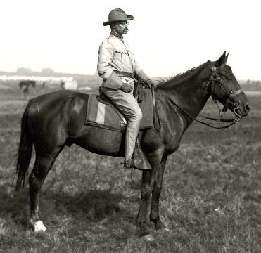

Slide 55
The Americans captured San Juan Hill after intense fighting.

Slide 56


Slide 57


Slide 58




The destruction of the Spanish fleet at Santiago and the capture of San Juan Hill ended the Spanish resistance in Cuba.
The Spanish colony of Puerto Rico was also quickly taken over too.

Slide 59

End of the War
The Spanish signed the Treaty of Paris on December 10, 1898, marking the official end of the war.

Slide 60

Details of the Treaty
Cuba became an American protectorate
Protectorate: A country that is technically independent but actually under the control of another country.
Puerto Rico, and the small Pacific islands of Guam and Wake became territories of the U.S.
The U.S. paid $20 million to Spain for the Philippines.

Slide 61


Slide 62


Slide 63


Slide 64

Details of the Spanish-American War
The war lasted fewer than 4 months
400 Americans died in combat, but 2,000 Americans died from diseases such as malaria and yellow fever.

Slide 65

80 years later, a new investigation was launched to determine the actual cause of the U.S.S. Maine explosion.
  The wall of a coal burning room heated up ammunition stored on the opposite side.
    This was the POSSIBLE cause of the explosion.

