Slide 1
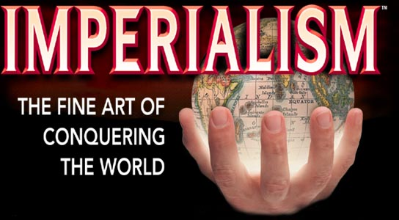
Chapter 7 Section 1
Power Point Notes

Slide 2
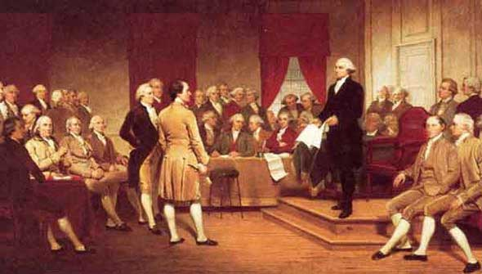
American Foreign Policy
Way back in 1796, George Washington told Americans to continue to trade with other countries, but do not get involved in their politics or affairs.

Slide 3
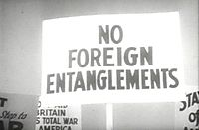
Washington strongly urged Americans to avoid making permanent relationships with other countries.
  This way of dealing with other countries is called Isolationism
    For 100 years the United States followed Washington’s rule and isolated itself politically from other countries.

Slide 4
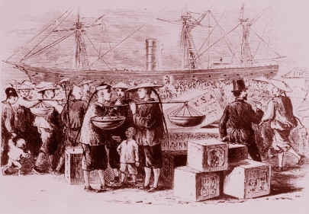
Foreign Trade
Even though the U.S. stayed out of foreign countries affairs, they did trade with some other countries.
    China was a trading partner of the U.S.

Slide 5
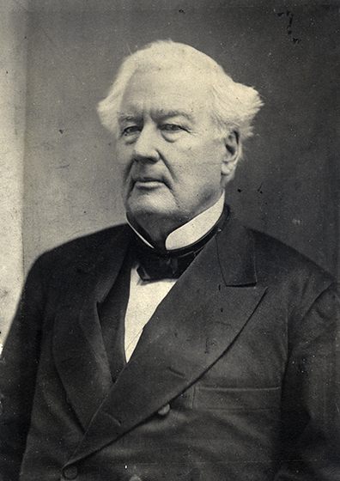
With the success of trading with China, some people wanted the U.S. to acquire more trade partners.
  This would go against Washington’s rule of isolationism.
  President Fillmore wanted to set up a trade relation with other countries, like Japan.

Slide 6
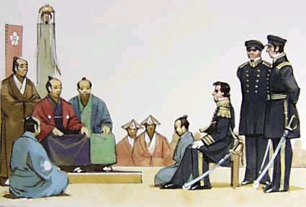
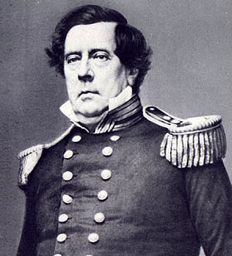
Fillmore sent Commodore Matthew Perry and 4 warships to Japan to discuss trade.
  This would be difficult because Japan isolated itself politically and economically from other countries.

Slide 7
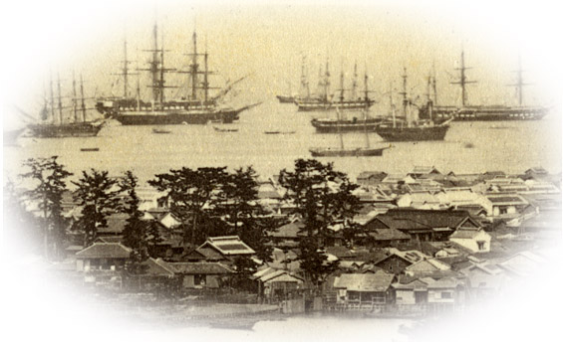
The warships intimidated the Japanese, so they agreed to trade with the U.S.
  The treaty was called the Treaty of Kanagawa.

Slide 8
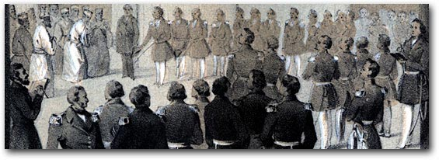
The treaty also allowed United States ships to use 2 Japanese ports for trade purposes.
  From these ports they could trade with all of Asia

Slide 9
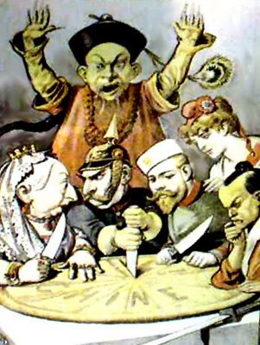
An Age of Imperialism
Powerful countries competed with one another for political and economic control in Asia and Africa

Slide 10
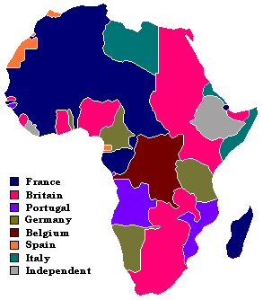
An Age of Imperialism
  Asia and Africa were full of valuable resources that powerful countries like England, France, and Germany wanted.

Slide 11
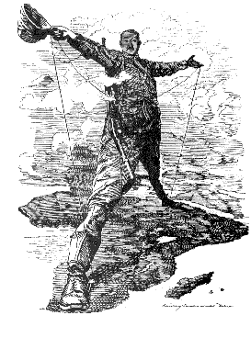

Slide 12
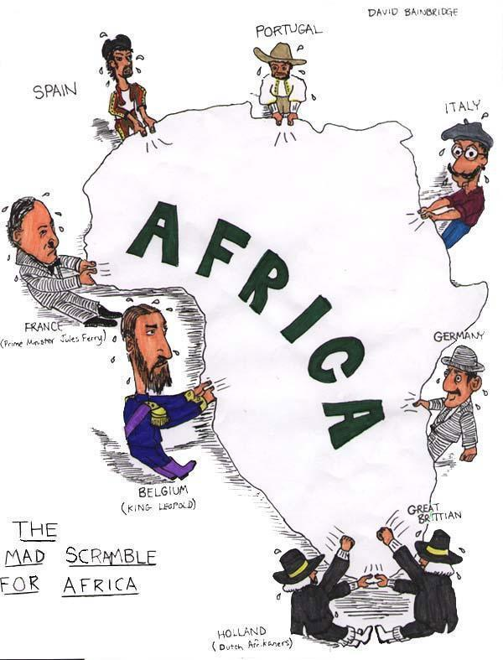

Slide 13
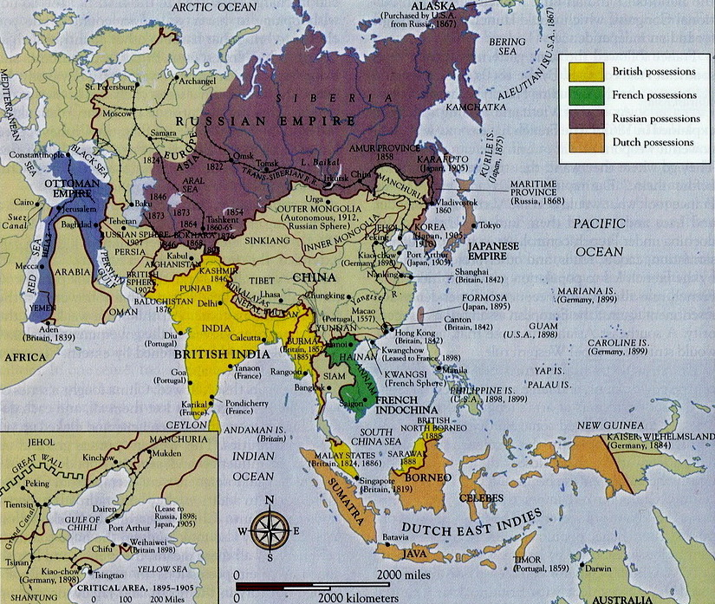
An Age of Imperialism
These countries went in and took over parts of Africa and Asia like India, Afghanistan, Vietnam, Philippines, etc.
  The take over of these weak countries was called Imperialism.

Slide 14
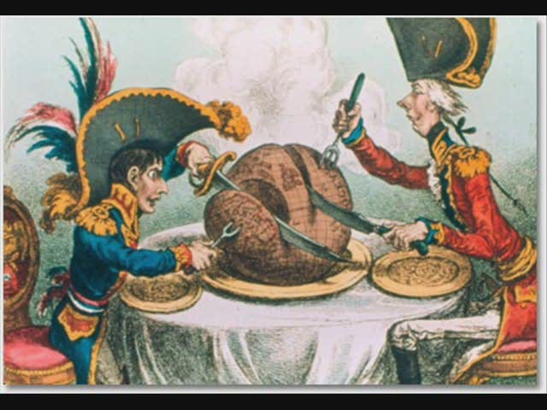

Slide 15
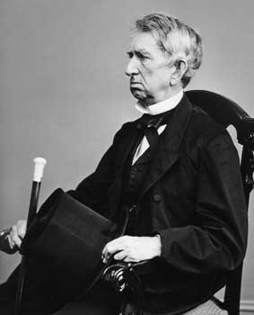
An Age of Imperialism
Many Americans believed the U.S. should get involved in imperialism and acquire foreign lands of its own.
  Secretary of State William H. Seward agreed with expanding the U.S.

Slide 16
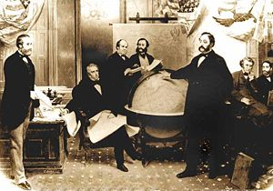
An Age of Imperialism
Seward wanted the U.S. to control the Caribbean, Central America, and the Pacific.

Slide 17
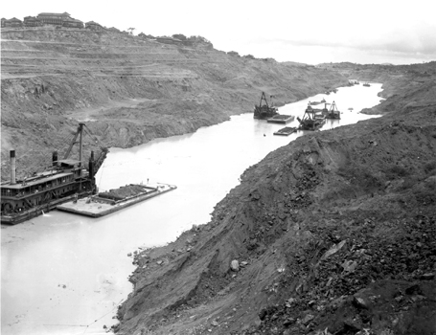
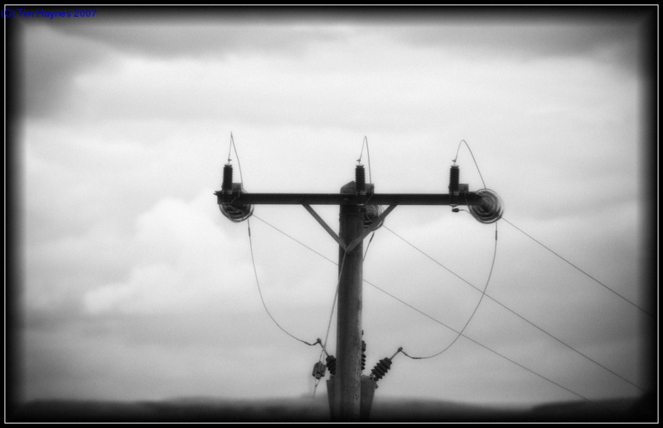
An American Empire
Seward believed an American Empire would need 3 things in order to be successful
    A canal across Central America, connecting the Pacific and the Atlantic.
    A transcontinental railroad system
    A telegraph system

Slide 18
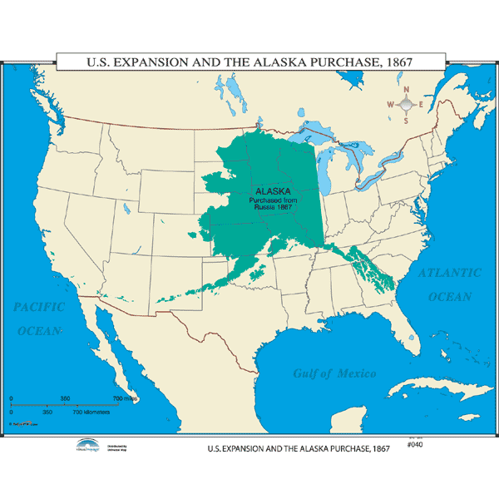
Alaska
Seward bought Alaska from Russia for $7.2 million in 1867

Slide 19
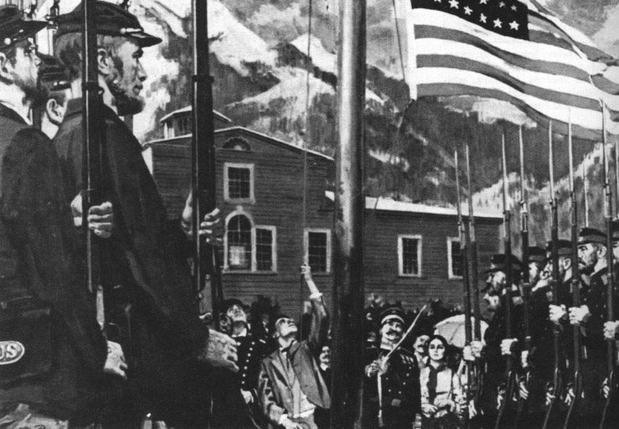
Alaska
Many people thought this was foolish. They didn’t understand why the U.S. wanted the barren, icy land.
  They changed their mind once gold was discovered in the 1890’s.
  Alaska became a United States territory in 1912.

Slide 20
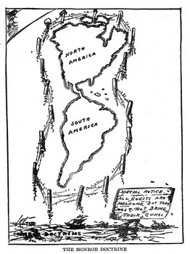
Securing the Western Hemisphere
European countries were trading with South American, Central American, and Caribbean countries.
  The possibility of European influence in those areas made the U.S. nervous and upset.

Slide 21
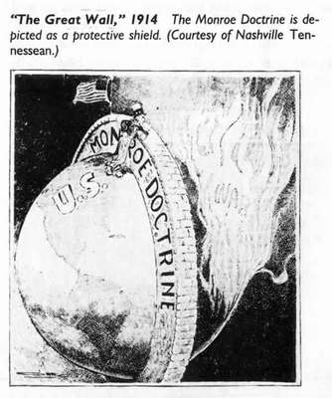
Securing the Western Hemisphere
As a result, President James Monroe issued the Monroe Doctrine in 1823

Slide 22
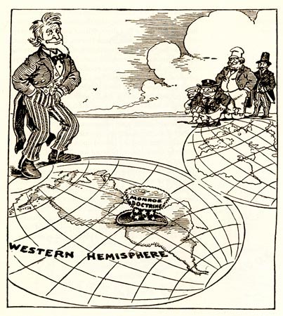
Securing the Western Hemisphere
It discouraged European countries from forming new colonies in North or South America.
  The U.S. made agreements with and began to influence the economies of Latin America.

Slide 23
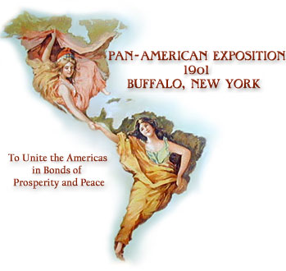
Securing the Western Hemisphere
The Pan-American Union was formed.
  The Union agreed to share information with other countries of the Union.

Slide 24
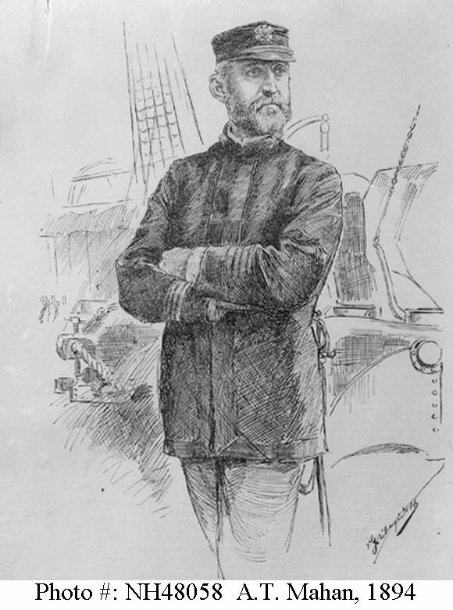
Building a Navy
Captain Alfred Thayer Mahan told Congress it needed to improve and enlarge the navy.

Slide 25
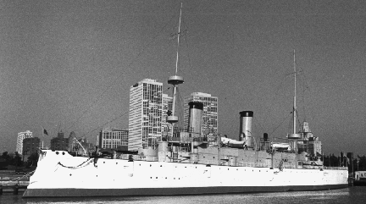
Building a Navy
The construction of steel-hulled warships was approved in 1883.
  Steam power and steel hulls replaced sails and wooden ships.
  By 1900, the naval power of the U.S. was ready for any challenge.

Slide 26
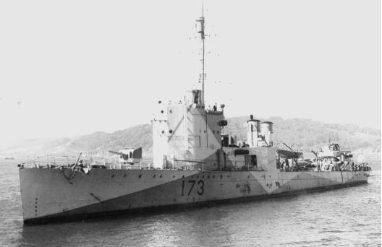
Building a Navy
Mahan advised Congress that overseas colonies would be needed where ships could refuel on long journeys.

Slide 27
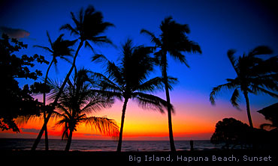
Pacific Islands

Slide 28
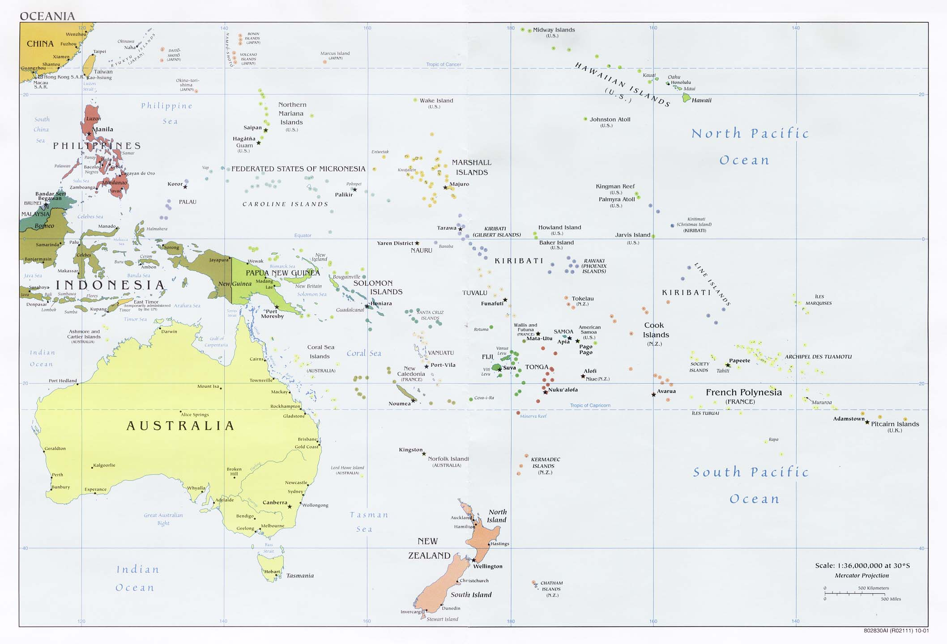
Midway Islands
Secretary of State William H. Seward looked to the Pacific Islands to build its empire.
    He purchased the two small islands of Midway.

Slide 29
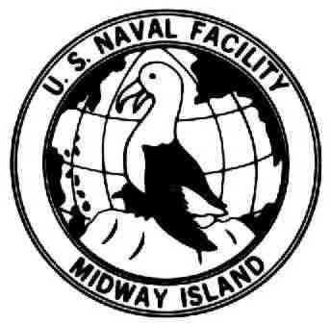
Midway Islands
Midway is located 3,000 miles west of California.
  This made a perfect place for ships to stop and refuel on their way to China.

Slide 30
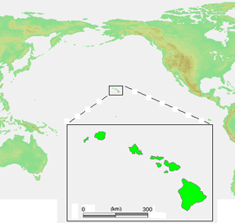
Hawaii
Midway is very close to the Hawaiian Islands, so trade between Hawaii and the U.S. increased

Slide 31
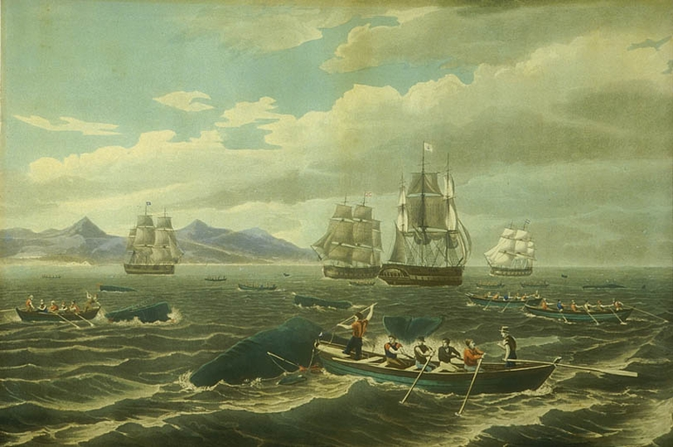
Hawaii
Americans in the whaling trade settled there.

Slide 32
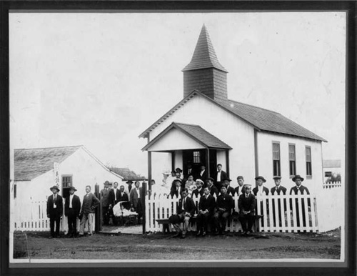
Hawaii
American Christian missionaries-built schools and churches and translated the Bible into Hawaiian.

Slide 33
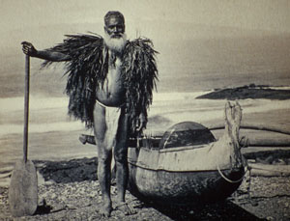
Hawaii
Unfortunately, Americans brought many infectious diseases to Hawaii.
    Hawaiians were not immune to these diseases and thousands died.

Slide 34
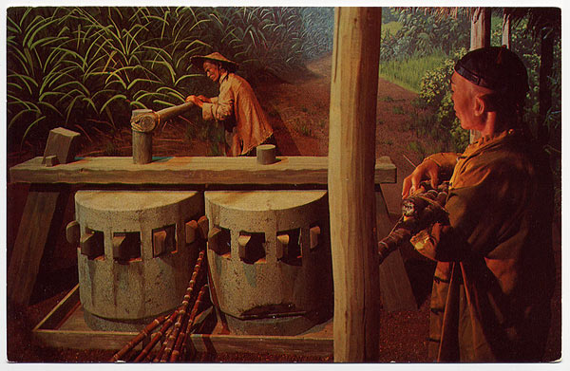
Hawaii
Traders and missionaries bought land and established sugarcane plantations
    Thousands of immigrants from China and Japan worked on the plantations

Slide 35
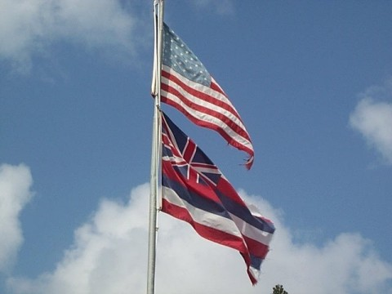
Hawaii
Americans expanded their economic and political influence over the islands.

Slide 36
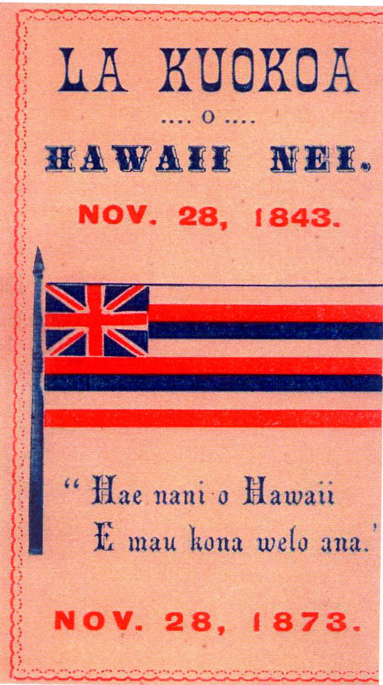
Hawaii
The U.S. encouraged Hawaii to declare its independence from England in 1842

Slide 37
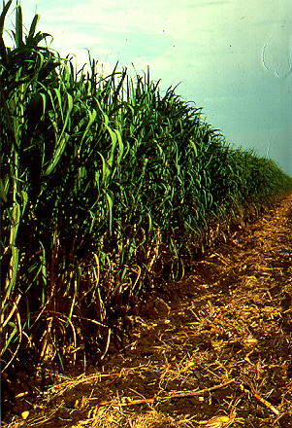
Hawaii
The U.S. allowed Hawaii to export sugar to the U.S. without being taxed.
  Exports to the U.S. greatly increased and American planters in Hawaii made a lot of money.

Slide 38
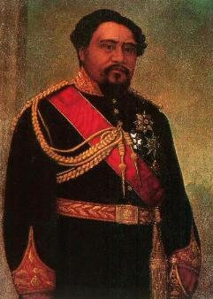
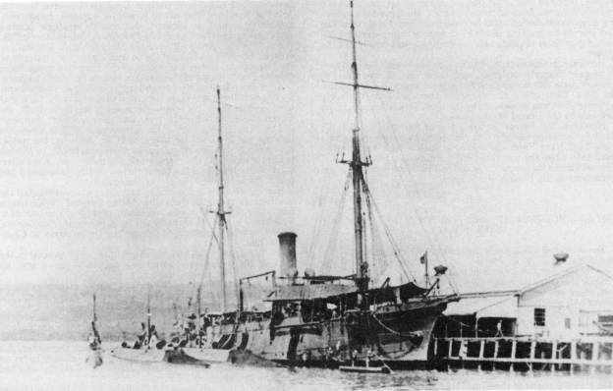
Hawaii
The U.S. persuaded King Kalakaua to permit an American naval base to be built at Pearl Harbor
  In exchange, America renewed it trade agreement with Hawaii (No taxes on Hawaiian sugar)

Slide 39
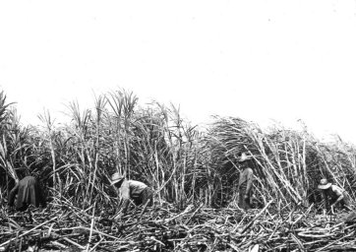
Hawaii
  American sugar producers in the States complained that Hawaiian sugar exports were not taxed.
    Congress changed the policy and charged a tariff on Hawaiian sugar

Slide 40

Hawaii
      Hawaiian sugar prices fell and exports decreased.
      American sugar plantation owners in Hawaii hoped to get around the tariff by making Hawaii a territory of the U.S.
      Native Hawaiians did not want to become a territory and wanted to take back control of their land

Slide 41
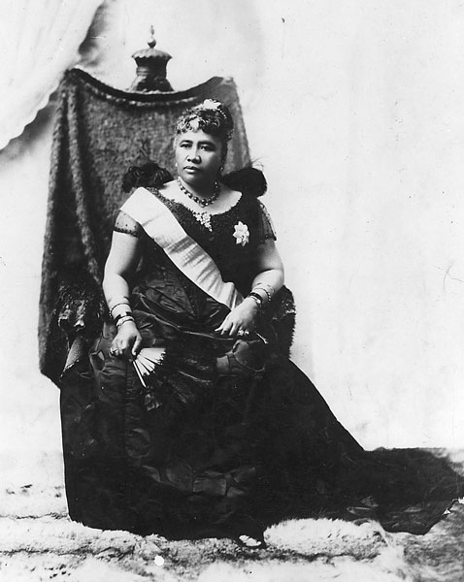
Hawaii
Queen Liliuokalani took away the special powers of the American plantation owners

Slide 42
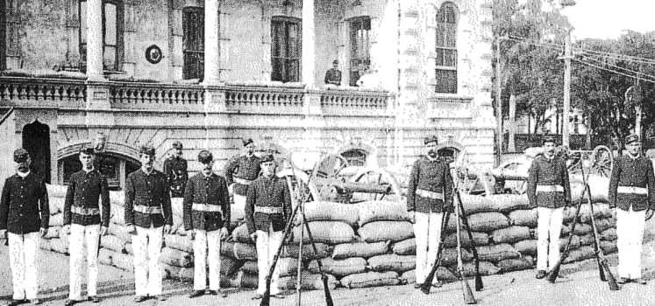
Hawaii
In return, American plantation owners revolted and overthrew Liliuokalani, setting up their own temporary, or provisional, government.

Slide 43
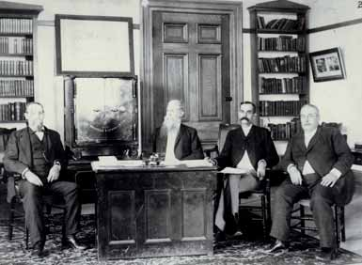
Hawaii
The plantation owners sent a representative to Washington D.C. requesting Hawaiian annexation, or the joining of the Hawaiian Islands with the U.S.

Slide 44
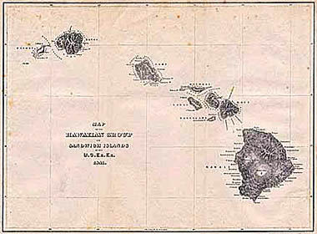
Hawaii
Congress approved the treaty in 1898 and Hawaii became a United States territory in 1900.

