Slide 1
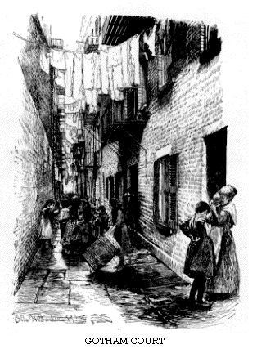
Progressive Movement
The Progressive Movement was focused on problems in society.
They wanted to help people who had no money or power.

Slide 2
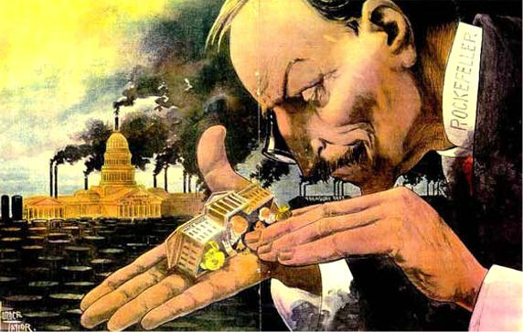
Progressive Movement
Progressives wanted the government to resist big businesses and support the working members of society.
They believed that government and big business had too much power

Slide 3
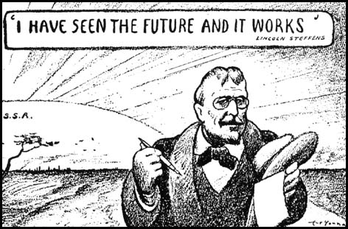
Progressive Movement

Slide 4
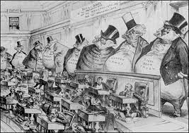
Progressive Movement
Sherman Anti-Trust Act
Passed by Congress to file lawsuits against corporations
Used often by President Theodore Roosevelt to bust up trusts

Slide 5
Progressive Movement
Journalists’ role in reforming society

Slide 6
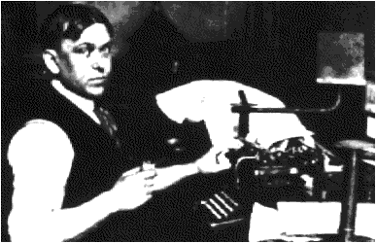
Progressive Movement
Investigative reporters brought problems to the attention of the public.
They were called muckrakers

Slide 7
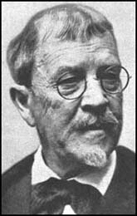
Progressive Movement
Lincoln Steffens: wrote, The Shame of Cities.
It uncovered the corrupt political machine in the big cities. Called for change in the way cities were run.

Slide 8
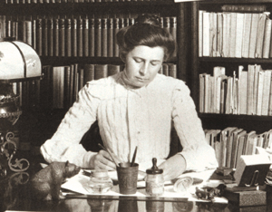
Progressive Movement
Ida Tarbell:
wrote articles about unfairness in the oil trusts.
Her articles led to more government control over oil companies.

Slide 9
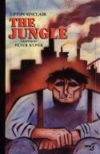
Progressive Movement
Upton Sinclair: wrote, The Jungle.
Told about the horrors in the meat packing industry.

Slide 10
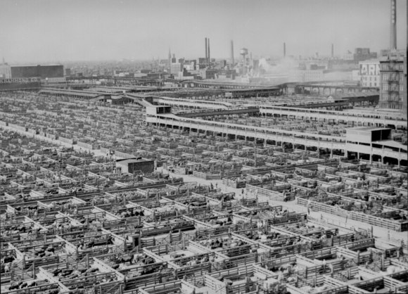

Slide 11
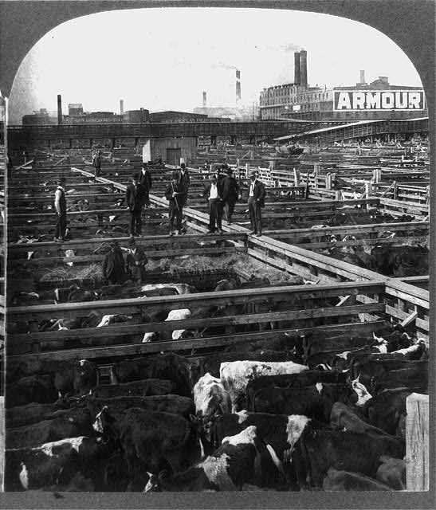

Slide 12
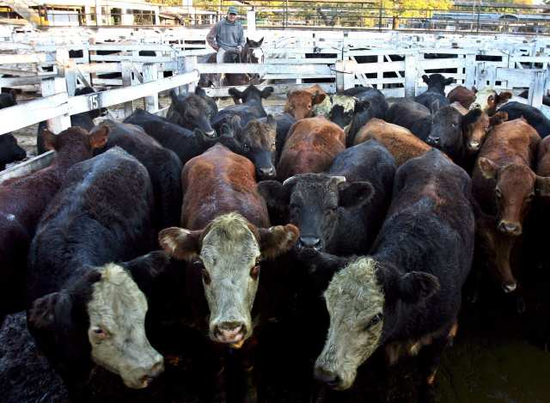

Slide 13
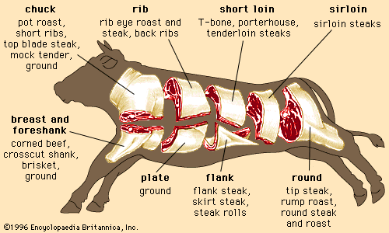

Slide 14
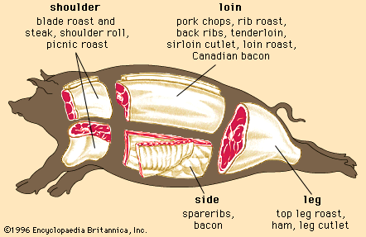

Slide 15
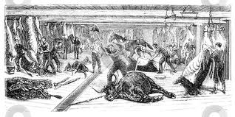

Slide 16
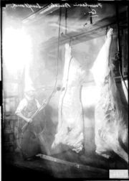
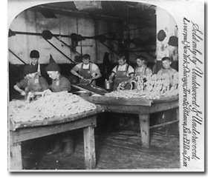
The Jungle

Slide 17
Led to the creation of both the…..
-Meat Inspection Act -Pure Food Drug Act

Slide 18
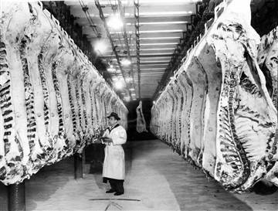
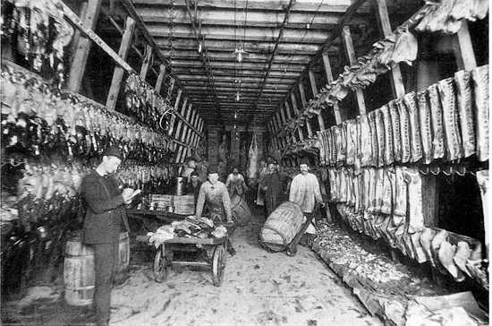
The Jungle

Slide 19
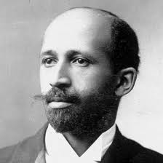
Progressive Individuals
W.E.B. Dubois helped found the National Association for the Advancement of Colored People (NAACP)
This organization was greatly influential in the fight for African-American rights throughout the 20th century.

Slide 20
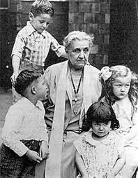
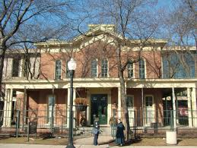
Progressive Individuals
Jane Addams opened Hull House in Chicago to provide care for assistance for immigrants and the poor.
English lessons
Medical Care
Food and Shelter

Slide 21
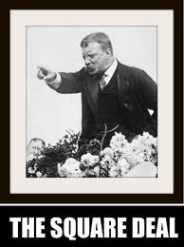
Progressive Individuals
Roosevelt's Square Deal
Promised fair and equal treatment for all
Called for regulated business
Because of the Square Deal, Roosevelt became president in 1904

Slide 22
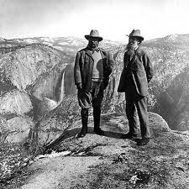
Progressive Individuals
Theodore Roosevelt was considered the first environmental president
Balanced business interests and conservation
Proposed the US Forest Service
Formed the National Conservation Commission

Slide 23
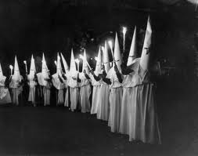
“Not So” Progressive
The Klu Klux Klan (KKK)
A group that become popular after the Civil War, especially in the South
At first, targeted African Americans (who were recently freed from slavery) with discrimination and violence
After the wave of “new immigrants” came to America, they expanded their focus on to southern and eastern Europeans, especially those that were Catholics and Jews.

Slide 24
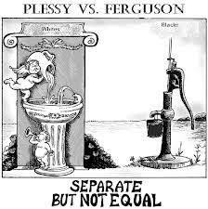
“Not So” Progressive
Plessy vs. Ferguson
This Supreme Court case legalized segregation
As long as it is “separate but equal”

Slide 25
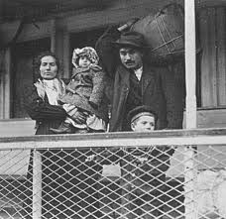
“Not So” Progressive
Immigration
Due to increasing pressure from “native-born” Americans, Congress created some laws and agreements to limit the amount of immigrants allowed into the US

Slide 26
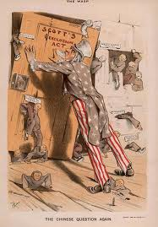
“Not So” Progressive
Quotas put a cap on the number of immigrants allowed from each country into the US
Gentlemen's Agreement
Treaty between US and Japan to slow Japanese immigration to the US
Chinese Exclusion Act
Banned Chinese workers from emigrating to the US for 10 years

