Slide 1
Ms. Rodgers’s Family Tree
1912-2017

Slide 2
Roxanne Fudacz
me
Richard “Pete” Fudacz
Father
Elna Bouton
Mother
Matthew Fudacz Grandfather
Helen Rudak
Grandmother
Floyd Bouton II
Grandfather
Dorothy Spruth
Grandmother
Mary Mroz
Great Grandmother
Francis Sobczak
Great Grandmother
Valborg Christofferen
Great Grandmother
Minnie Dehn
Great Grandmother
Paul Fudacz
Great Grandfather
Frank Rudak
Great Grandfather
Floyd Bouton I
Great Grandfather
Charles Spruth
Great Grandfather

Slide 3
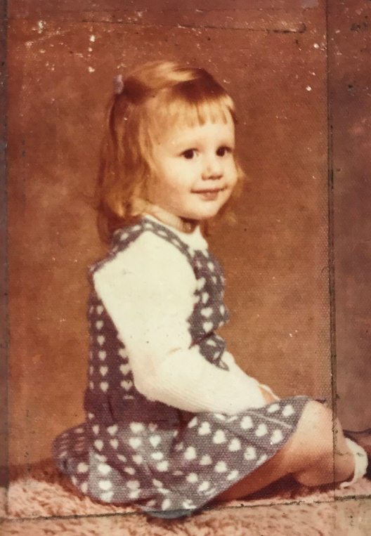
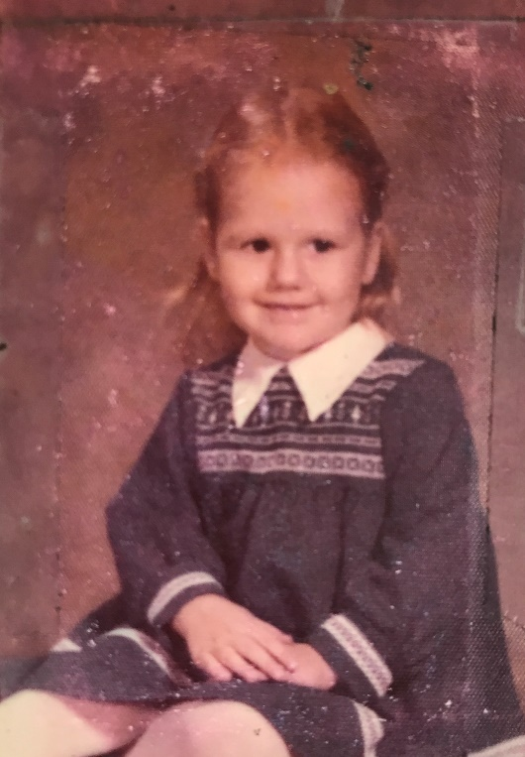
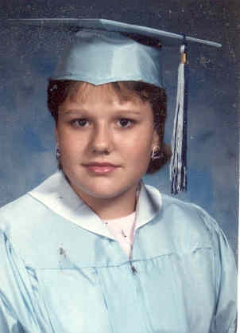
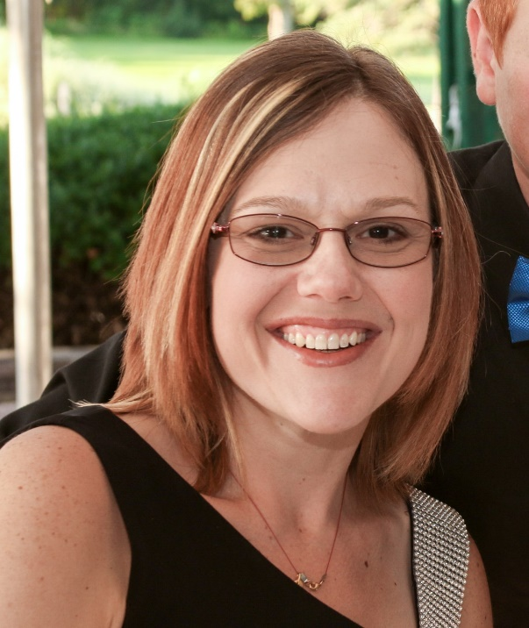
Roxanne Lynn Fudacz Rodgers
I was born to Richard and Elna Fudacz. I married and had three children of my own: Tyler, Alexis, and Ryan. I became a middle school teacher and have taught, Language Arts, Social Studies, and Science.

Slide 4
Roxanne Fudacz
me
Richard “Pete” Fudacz
Father
Elna Bouton
Mother
Matthew Fudacz Grandfather
Helen Rudak
Grandmother
Floyd Bouton II
Grandfather
Dorothy Spruth
Grandmother
Mary Mroz
Great Grandmother
Francis Sobczak
Great Grandmother
Valborg Christofferen
Great Grandmother
Minnie Dehn
Great Grandmother
Paul Fudacz
Great Grandfather
Frank Rudak
Great Grandfather
Floyd Bouton I
Great Grandfather
Charles Spruth
Great Grandfather

Slide 5
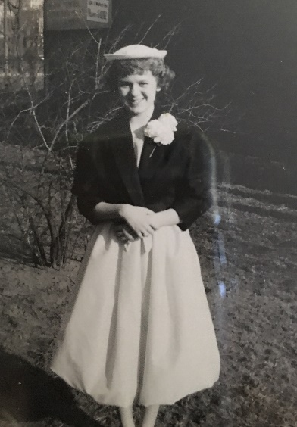
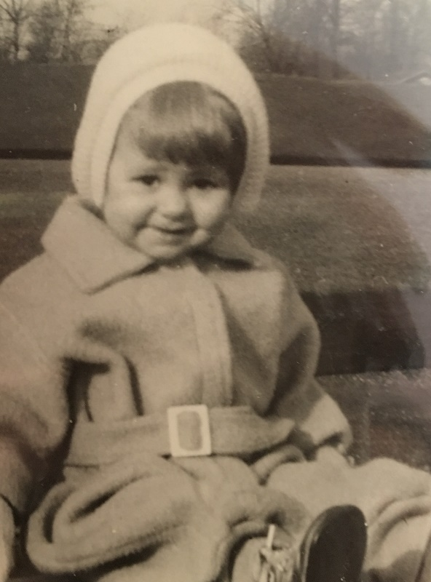
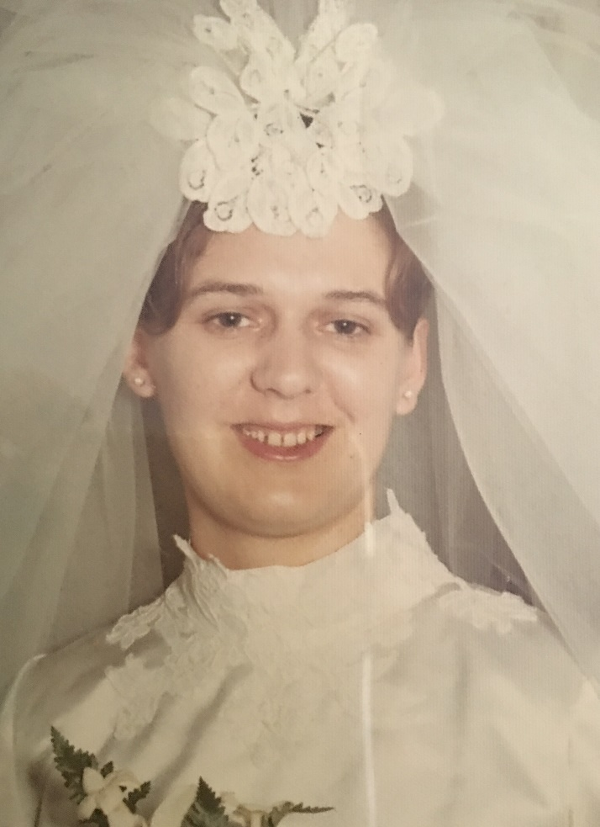
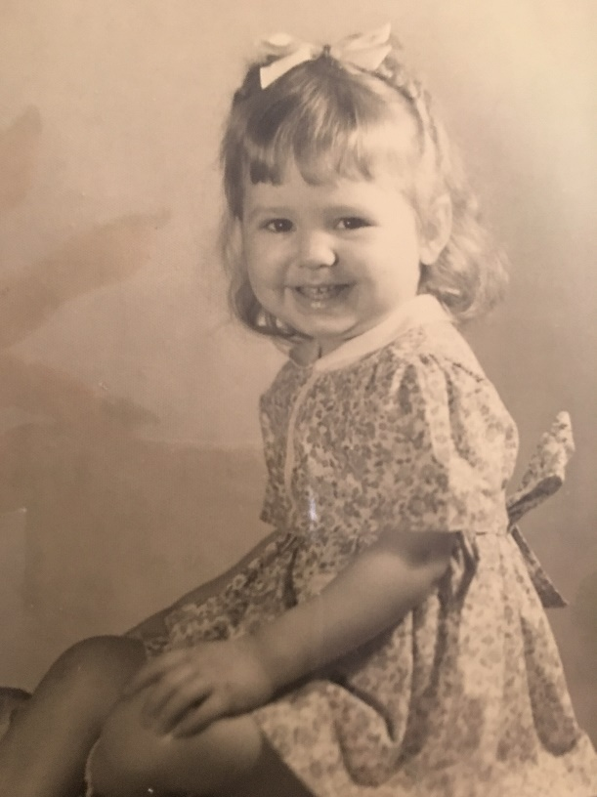
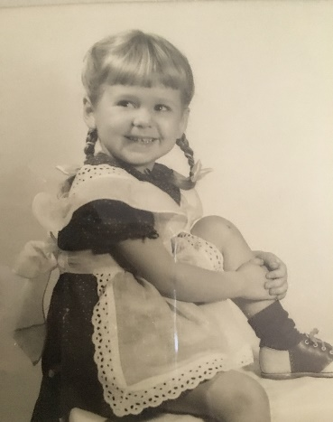
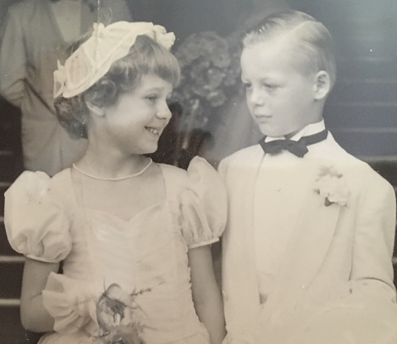
Elna Bouton Mother
Elna was born May 12, 1944 and is the oldest of four children. Elna had four children of her own: Richard, Roxanne, Peter, and Donald. Elna was a stay at home mom where she attended every event her child was involved in. When her children were a bit older she got a job at "L Fish" furniture company doing payroll. She now is a proud grandmother of six and attends as many of their events as she possibly can.

Slide 6
Roxanne Fudacz
me
Richard “Pete” Fudacz
Father
Elna Bouton
Mother
Matthew Fudacz Grandfather
Helen Rudak
Grandmother
Floyd Bouton II
Grandfather
Dorothy Spruth
Grandmother
Mary Mroz
Great Grandmother
Francis Sobczak
Great Grandmother
Valborg Christofferen
Great Grandmother
Minnie Dehn
Great Grandmother
Paul Fudacz
Great Grandfather
Frank Rudak
Great Grandfather
Floyd Bouton I
Great Grandfather
Charles Spruth
Great Grandfather

Slide 7
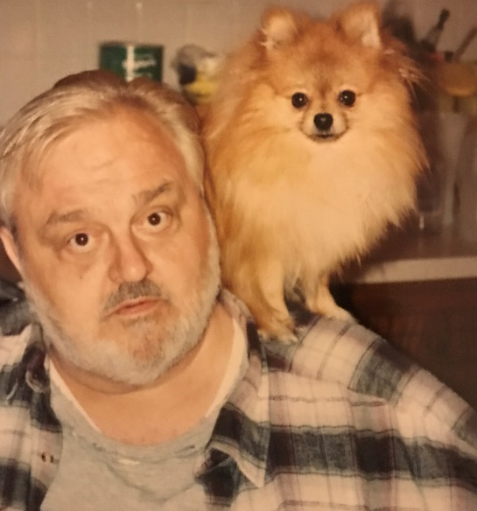
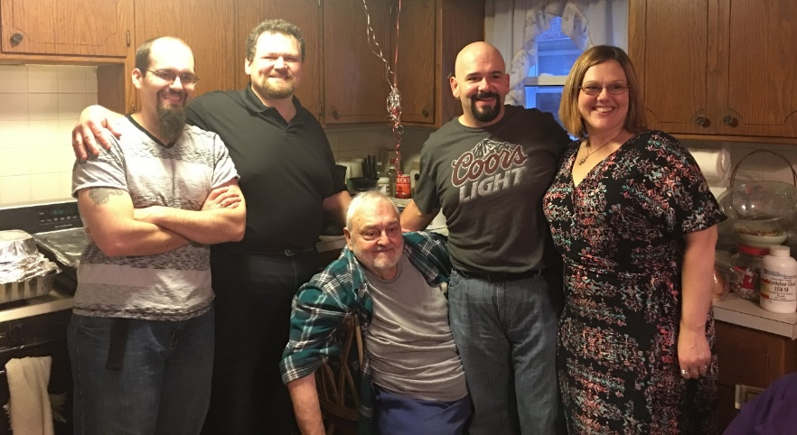
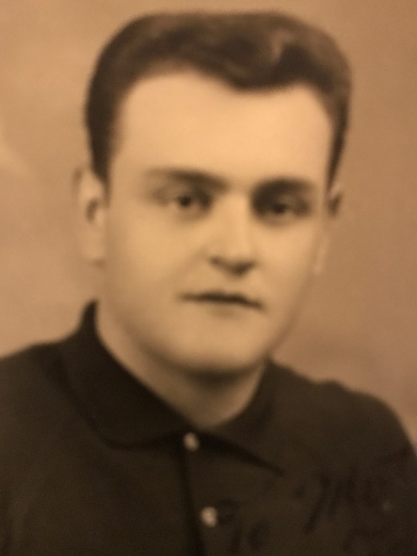
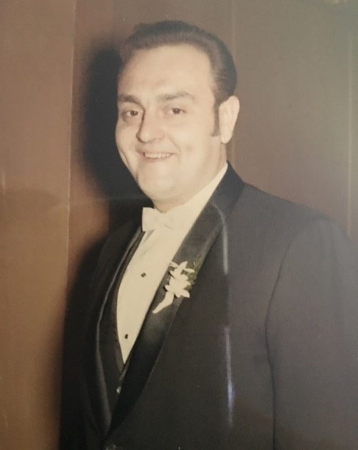
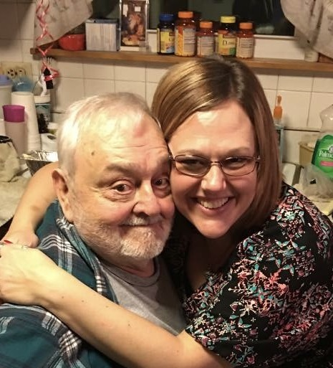
Richard “Pete” Fudacz Father
Richard John was born on Feb. 28, 1941. He served in the army during the Vietnam war, but was lucky enough to be stationed in Europe at the time. Richard married Elna and had four children. He worked for the City of Chicago for 30 years where he worked for the department of streets and sanitation.

Slide 8
Roxanne Fudacz
me
Richard “Pete” Fudacz
Father
Elna Bouton
Mother
Matthew Fudacz Grandfather
Helen Rudak
Grandmother
Floyd Bouton II
Grandfather
Dorothy Spruth
Grandmother
Mary Mroz
Great Grandmother
Francis Sobczak
Great Grandmother
Valborg Christofferen
Great Grandmother
Minnie Dehn
Great Grandmother
Paul Fudacz
Great Grandfather
Frank Rudak
Great Grandfather
Floyd Bouton I
Great Grandfather
Charles Spruth
Great Grandfather

Slide 9
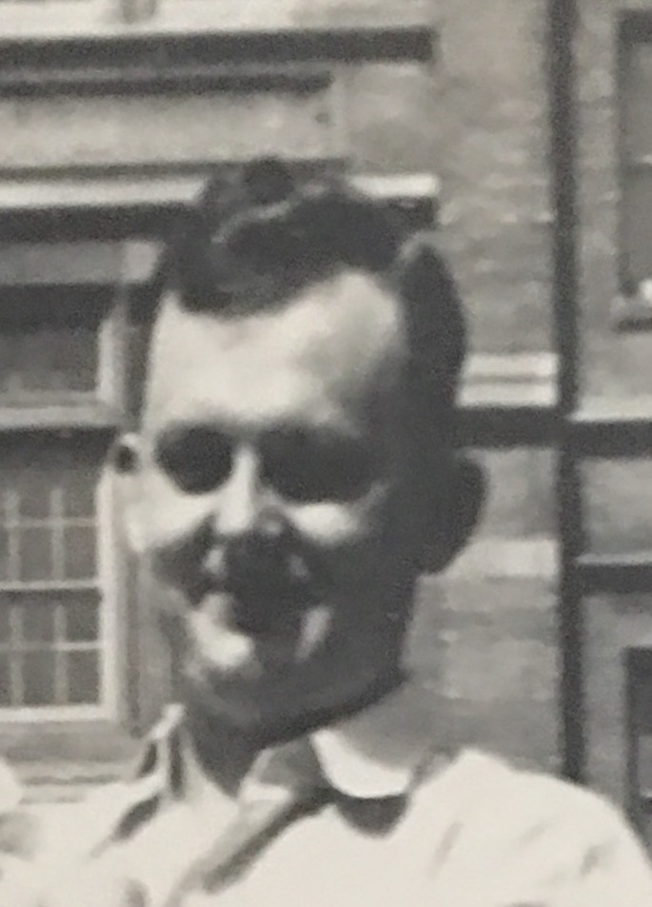
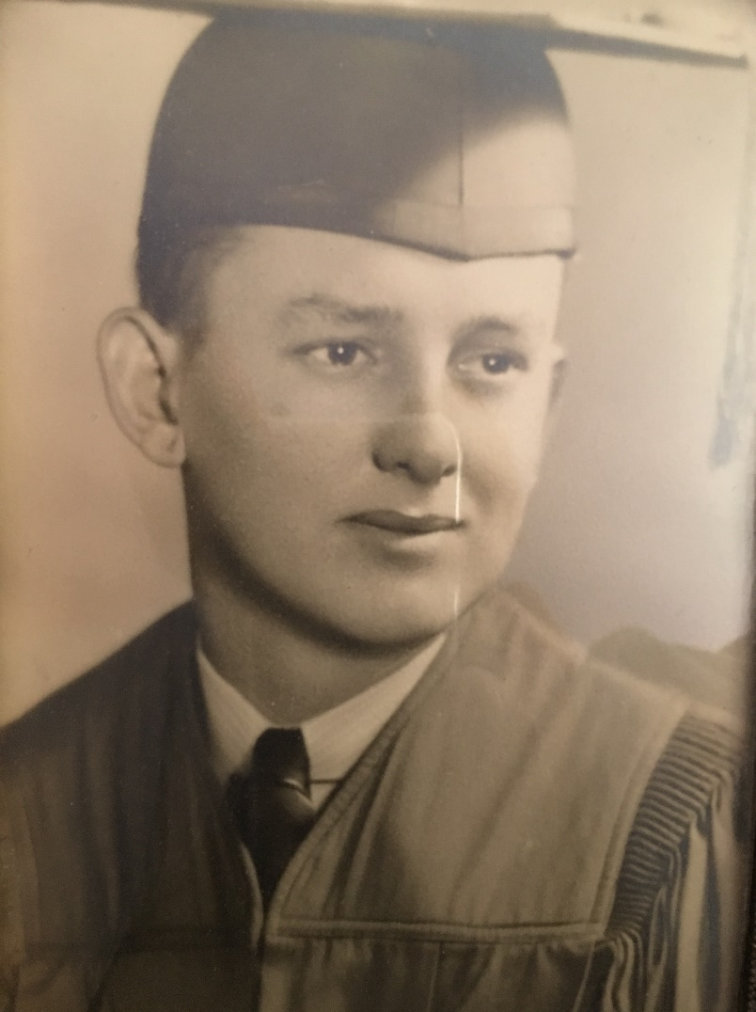
Floyd Bouton II Grandfather
Floyd worked at International Harvestor and was a tool and dye maker where it met his 1st wife Dorothy. They had two children together: Elna and Floyd III. After his divorce to Dorothy he married Dolores and had four children: Barry, Ricky, Nancy, and Janet. Floyd died of brain cancer when my mother Elna was 14 years old.

Slide 10
Roxanne Fudacz
me
Richard “Pete” Fudacz
Father
Elna Bouton
Mother
Matthew Fudacz Grandfather
Helen Rudak
Grandmother
Floyd Bouton II
Grandfather
Dorothy Spruth
Grandmother
Mary Mroz
Great Grandmother
Francis Sobczak
Great Grandmother
Valborg Christofferen
Great Grandmother
Minnie Dehn
Great Grandmother
Paul Fudacz
Great Grandfather
Frank Rudak
Great Grandfather
Floyd Bouton I
Great Grandfather
Charles Spruth
Great Grandfather

Slide 11
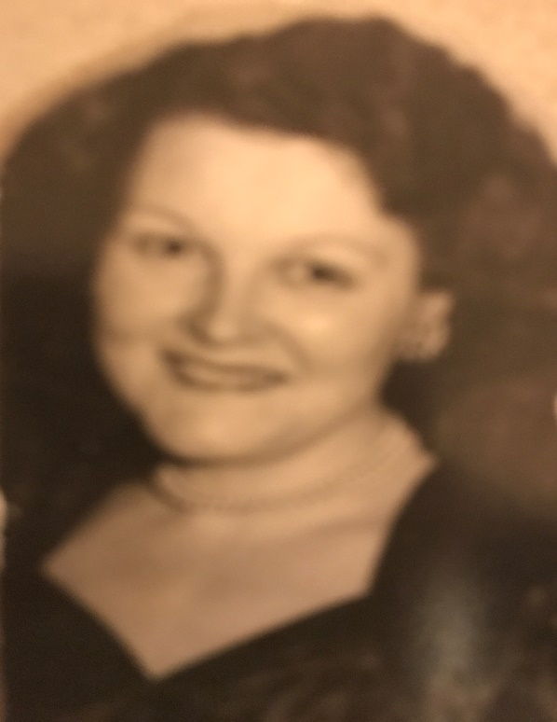
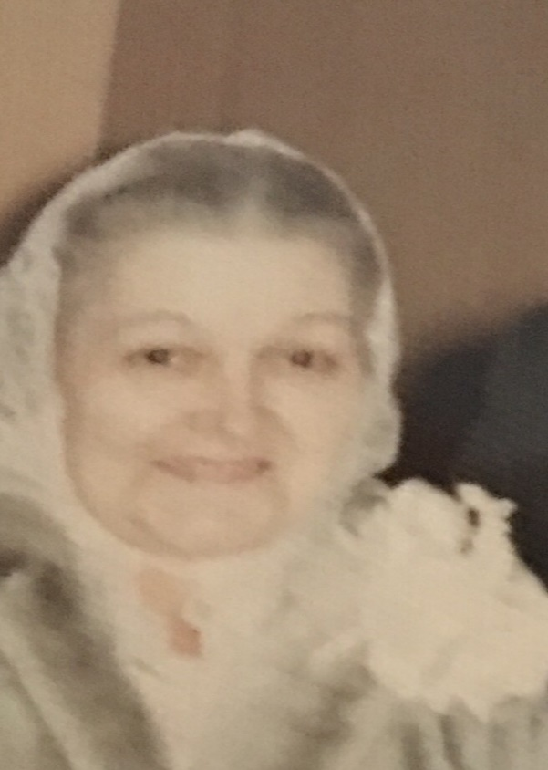
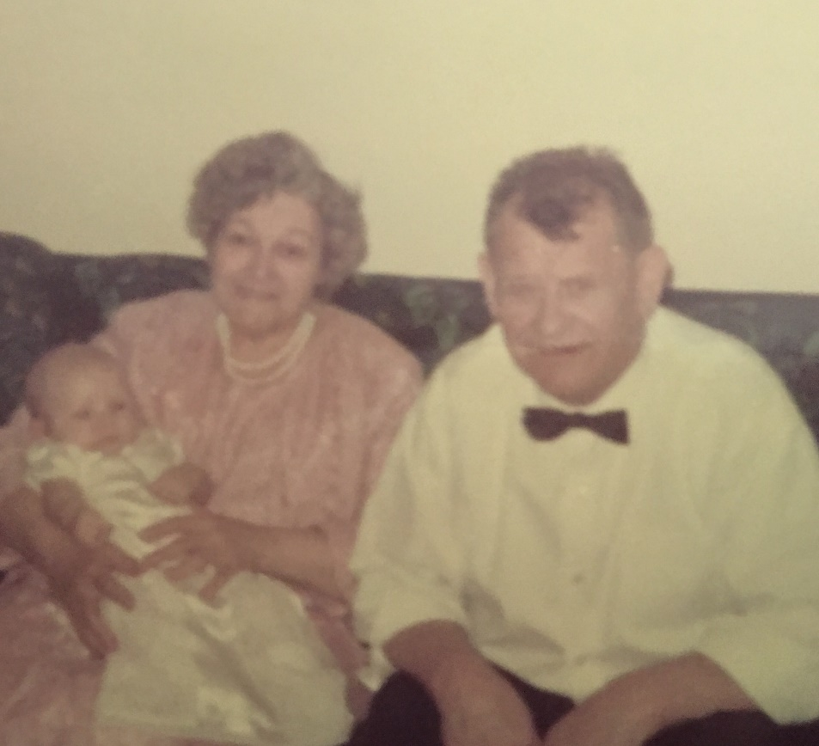
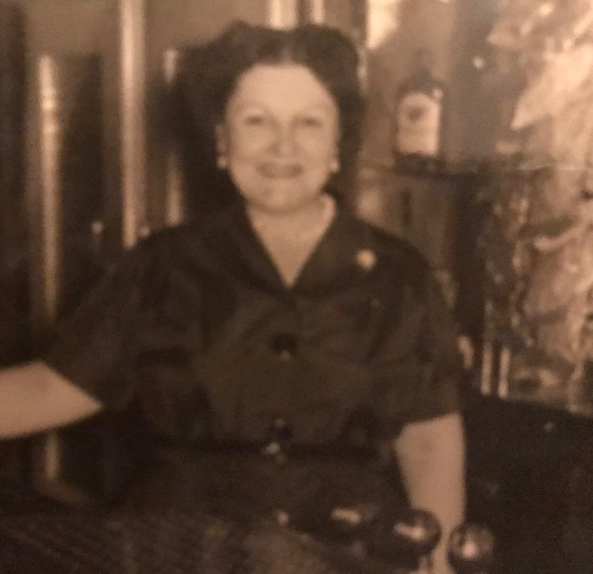
Helen Rudak Grandmother
Helen married the boy next door, well actually down the block. They had two boys: Richard and Matthew. She worked very hard side by side next to her husband in the family business.

Slide 12
Roxanne Fudacz
me
Richard “Pete” Fudacz
Father
Elna Bouton
Mother
Matthew Fudacz Grandfather
Helen Rudak
Grandmother
Floyd Bouton II
Grandfather
Dorothy Spruth
Grandmother
Mary Mroz
Great Grandmother
Francis Sobczak
Great Grandmother
Valborg Christofferen
Great Grandmother
Minnie Dehn
Great Grandmother
Paul Fudacz
Great Grandfather
Frank Rudak
Great Grandfather
Floyd Bouton I
Great Grandfather
Charles Spruth
Great Grandfather

Slide 13
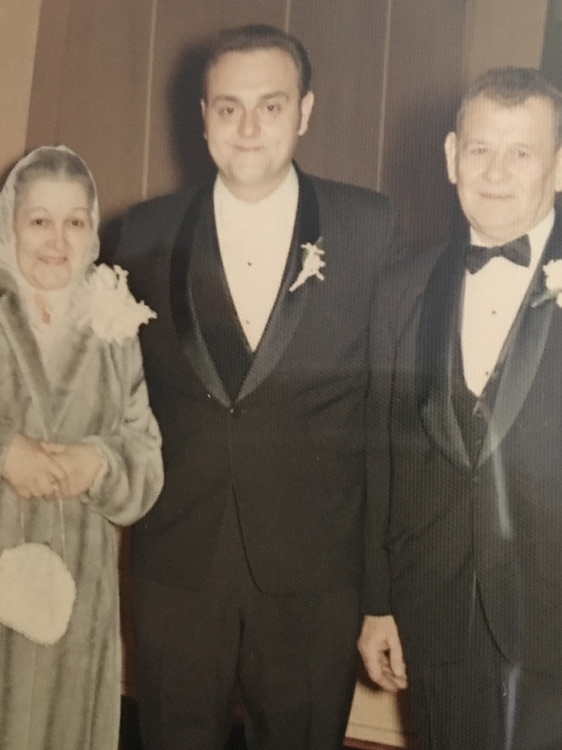
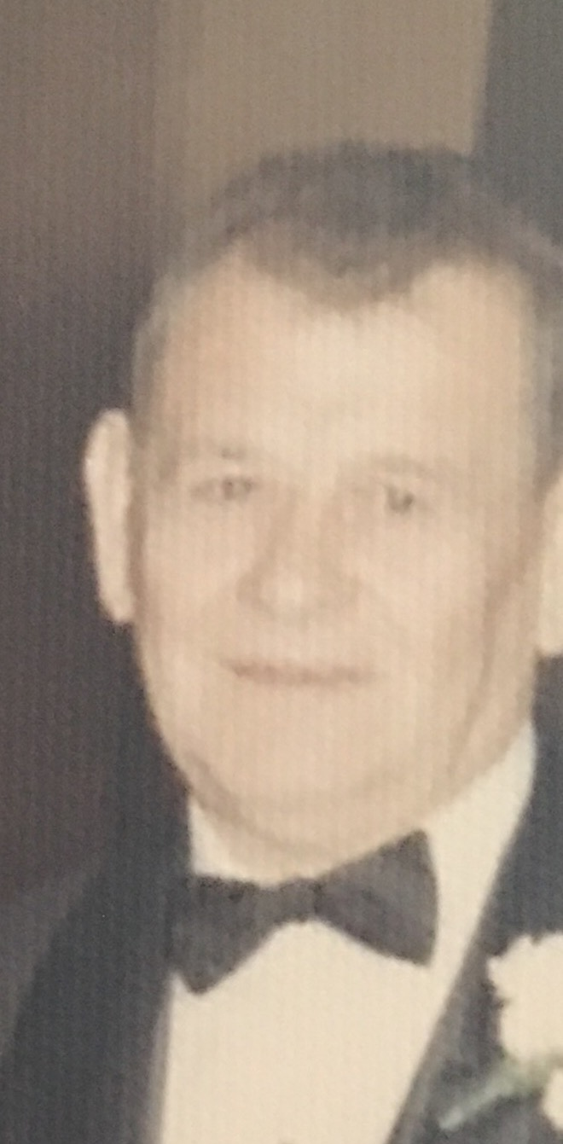
Matthew Fudacz Grandfather
In 1931, when my Grandfather, was 18, he came to America with his brother, Adolph. They entered the United States in New York, both coming to America with the American dream of a better life. After entering the United States they traveled right to Chicago where they had friends who would help them start their American dream. My Grandfather, Matthew and his brother Adolph took jobs at the Crane Company. He later lived on the same block as his future wife, Helen Rudak. Matthew and Helen married and had two children: Richard and Matthew Jr. Matthew and Helen achieved thier American dream of owning their own business, the "Fudacz Tavern" for many years.

Slide 14
Roxanne Fudacz
me
Richard “Pete” Fudacz
Father
Elna Bouton
Mother
Matthew Fudacz Grandfather
Helen Rudak
Grandmother
Floyd Bouton II
Grandfather
Dorothy Spruth
Grandmother
Mary Mroz
Great Grandmother
Francis Sobczak
Great Grandmother
Valborg Christofferen
Great Grandmother
Minnie Dehn
Great Grandmother
Paul Fudacz
Great Grandfather
Frank Rudak
Great Grandfather
Floyd Bouton I
Great Grandfather
Charles Spruth
Great Grandfather

Slide 15
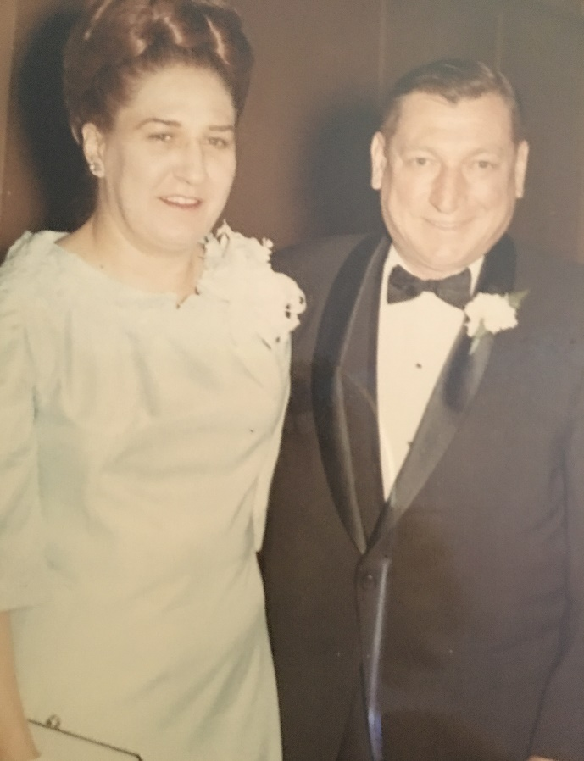
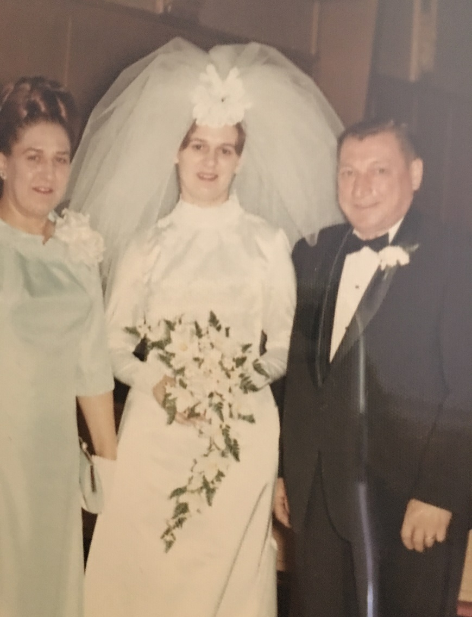
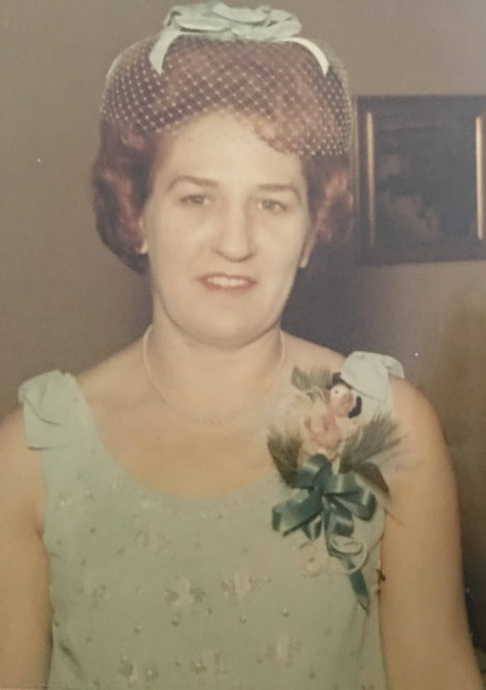
Dorothy Spruth Grandmother
Dorothy worked at International Harvestor in the offices where she met Floyd Bouton I. They married and had two children: Elna and Floyd III. Dorothy divorced and later married Joseph Buchina and they had two children: Lois and Joseph.

Slide 16
Roxanne Fudacz
me
Richard “Pete” Fudacz
Father
Elna Bouton
Mother
Matthew Fudacz Grandfather
Helen Rudak
Grandmother
Floyd Bouton II
Grandfather
Dorothy Spruth
Grandmother
Mary Mroz
Great Grandmother
Francis Sobczak
Great Grandmother
Valborg Christofferen
Great Grandmother
Minnie Dehn
Great Grandmother
Paul Fudacz
Great Grandfather
Frank Rudak
Great Grandfather
Floyd Bouton I
Great Grandfather
Charles Spruth
Great Grandfather

Slide 17
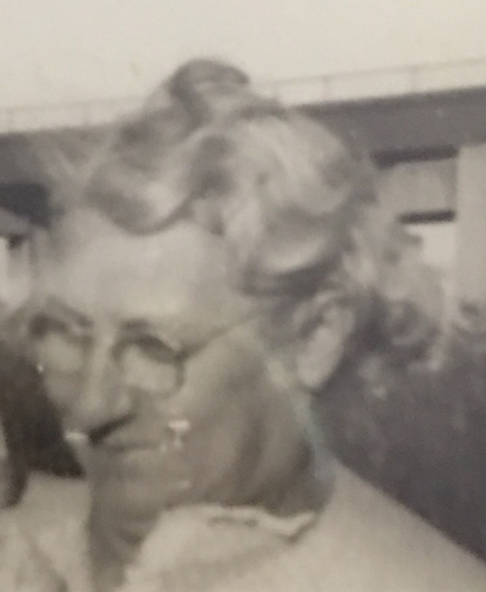
Minnie Dehn Great-Grandmother
Minnie was born in the United States and her parents, whose names are unknown, emigrated from Germany in about 1877, to live in the United States. They came to the United States to have a better way of life and where it was much easier for them to practice their religion. After entering in New York they both traveled to Chicago where they already had relatives to help them, Minnie’s father was a teacher and taught for many years. Minnie married Charles Spruth and they had nine children: Alfred, Bertha, Harold, Gert, Clara, Bill, Dorothy, Carl, and Lucille.

Slide 18
Roxanne Fudacz
me
Richard “Pete” Fudacz
Father
Elna Bouton
Mother
Matthew Fudacz Grandfather
Helen Rudak
Grandmother
Floyd Bouton II
Grandfather
Dorothy Spruth
Grandmother
Mary Mroz
Great Grandmother
Francis Sobczak
Great Grandmother
Valborg Christofferen
Great Grandmother
Minnie Dehn
Great Grandmother
Paul Fudacz
Great Grandfather
Frank Rudak
Great Grandfather
Floyd Bouton I
Great Grandfather
Charles Spruth
Great Grandfather

Slide 19
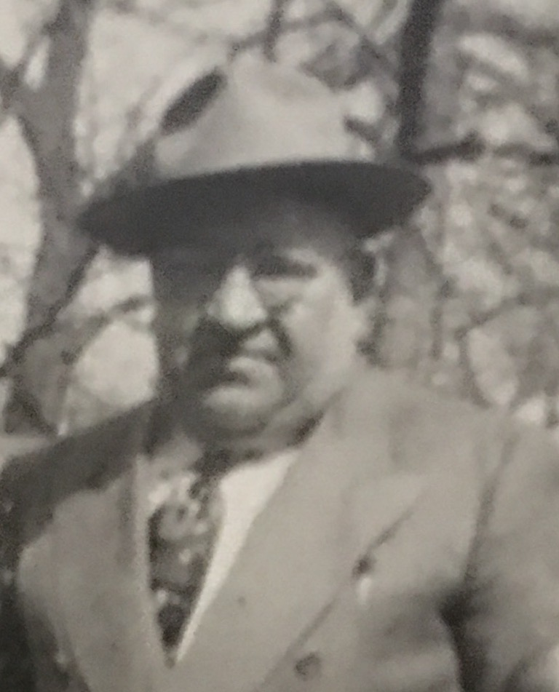
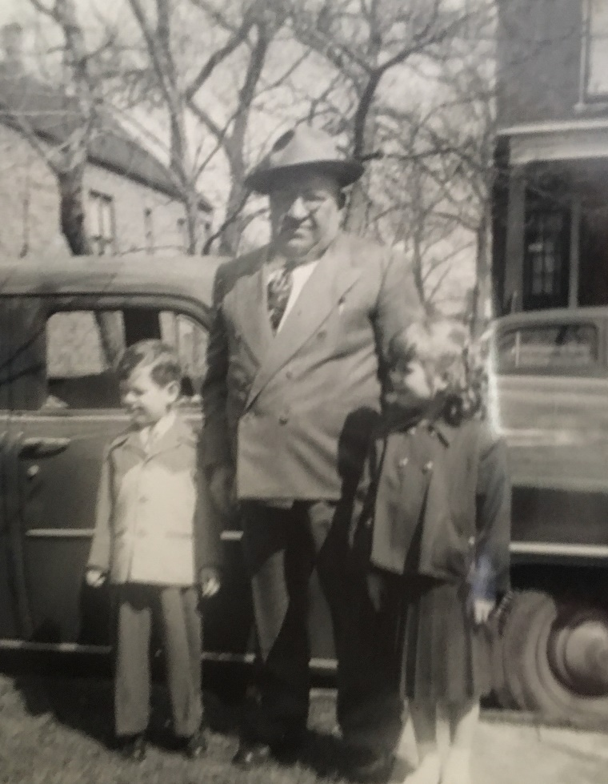
Charles Spruth Great-Grandfather
Charles was German, but lived in Austria, His Aunt and Uncle were immigrating in 1889 to the United States. Charles's parents were too poor and could not afford it, but they sent Charles who was only two at the time. His Aunt and Uncle took him to have a better life and better living in America. They entered the United States in New York. From there they traveled to Chicago to live with relatives who would help them start out. His Uncle found work in the construction business and Charles later followed in the same line of work.

Slide 20
Roxanne Fudacz
me
Richard “Pete” Fudacz
Father
Elna Bouton
Mother
Matthew Fudacz Grandfather
Helen Rudak
Grandmother
Floyd Bouton II
Grandfather
Dorothy Spruth
Grandmother
Mary Mroz
Great Grandmother
Francis Sobczak
Great Grandmother
Valborg Christofferen
Great Grandmother
Minnie Dehn
Great Grandmother
Paul Fudacz
Great Grandfather
Frank Rudak
Great Grandfather
Floyd Bouton I
Great Grandfather
Charles Spruth
Great Grandfather

Slide 21
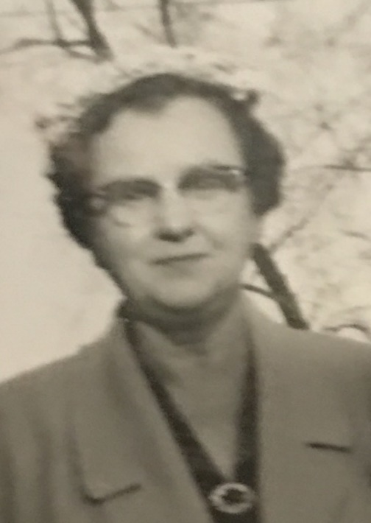
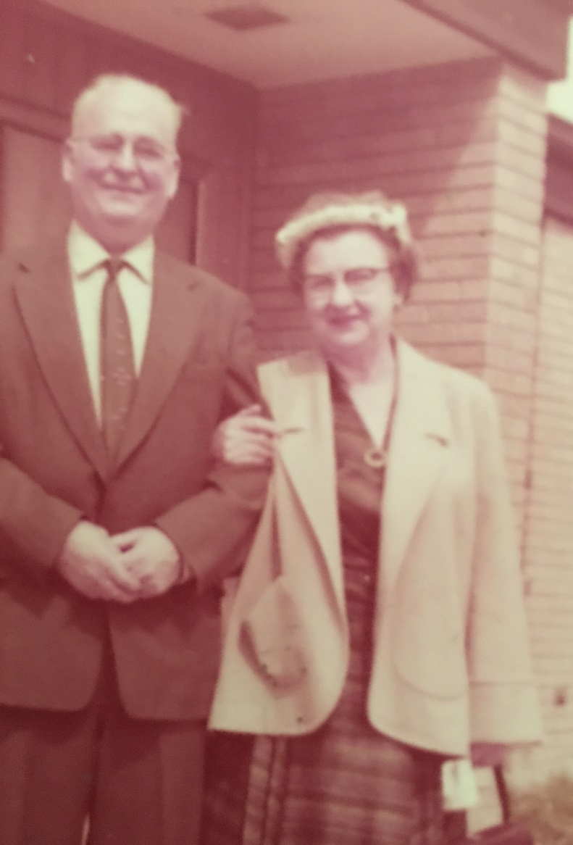
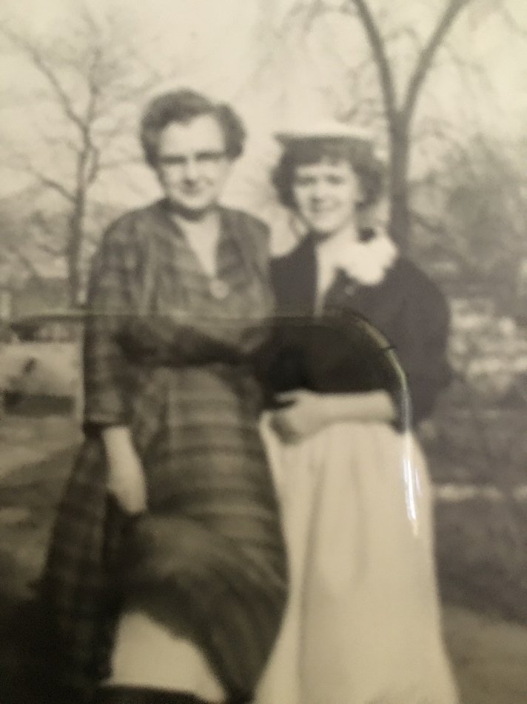
Valborg Christoffersen Great-Grandmother
Valborg was from Copenhagen, Denmark. She immigrated with her sister Elna in 1915 when she was fifteen and her sister was seventeen. They entered the United States in New York. From there they traveled to Oslo, Minnesota where they lived with their brother Hans who owned a farm. When Elna was about nineteen and Valborg was seventeen they moved to Chicago to meet Elna's boyfriend from Denmark. Later Elna was married to him. In Chicago Valborg and Floyd met and were also married, they had three children: Floyd, Carl, and Gary.

Slide 22
Roxanne Fudacz
me
Richard “Pete” Fudacz
Father
Elna Bouton
Mother
Matthew Fudacz Grandfather
Helen Rudak
Grandmother
Floyd Bouton II
Grandfather
Dorothy Spruth
Grandmother
Mary Mroz
Great Grandmother
Francis Sobczak
Great Grandmother
Valborg Christofferen
Great Grandmother
Minnie Dehn
Great Grandmother
Paul Fudacz
Great Grandfather
Frank Rudak
Great Grandfather
Floyd Bouton I
Great Grandfather
Charles Spruth
Great Grandfather

Slide 23
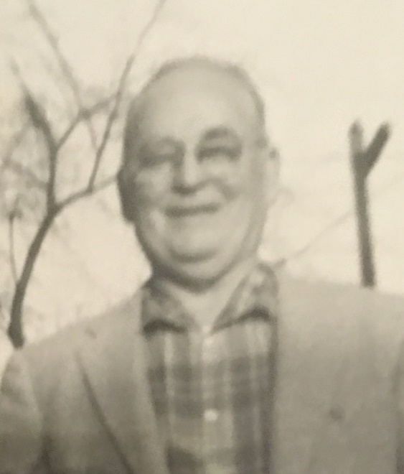
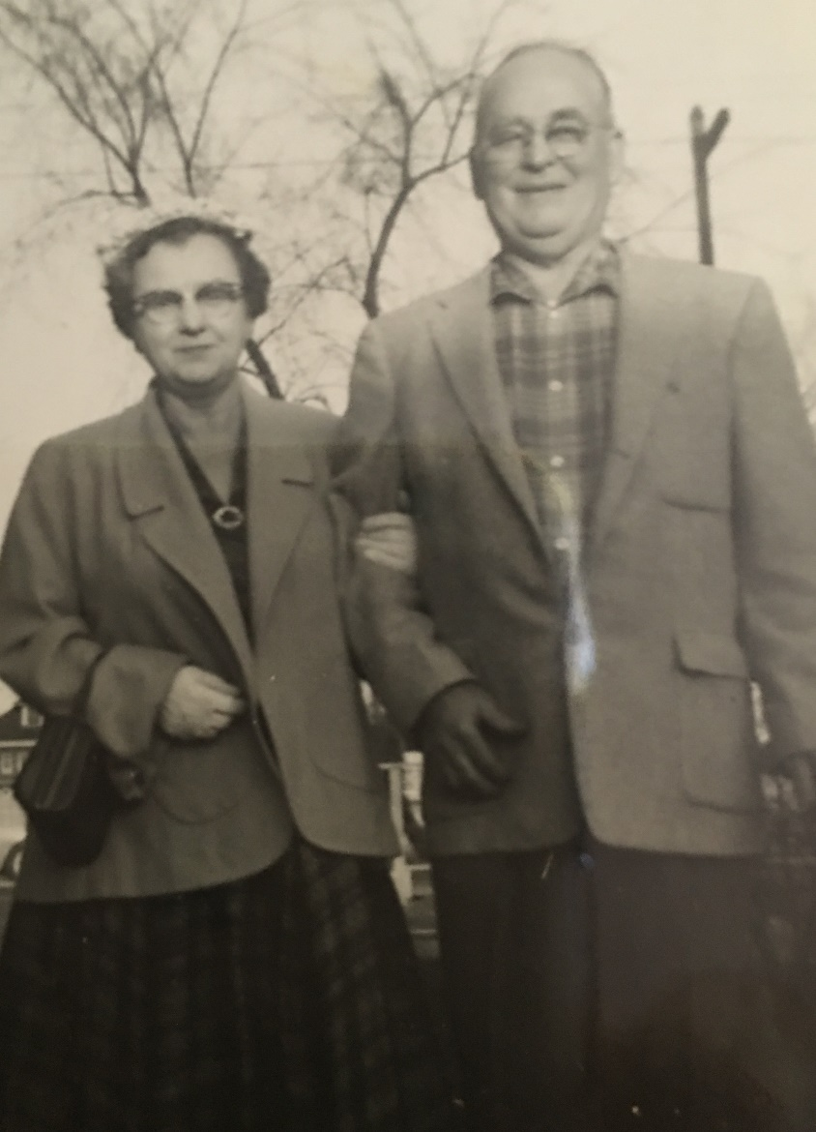
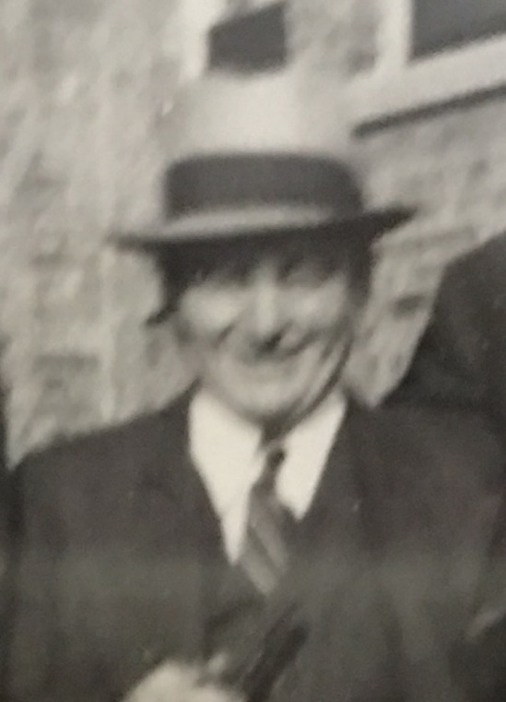
Floyd Bouton I Great-Grandfather
Floyd Bouton I was an orphan and lived in an orphanage in Carbondale, Illinois. All that the orphange knew about his ancestry was that his Father was French and that his mother was Irish.When he was about 25, he left the farmland in Carbondale and came to Chicago. He worked in a factory and later met Valborg and married her.

Slide 24
Roxanne Fudacz
me
Richard “Pete” Fudacz
Father
Elna Bouton
Mother
Matthew Fudacz Grandfather
Helen Rudak
Grandmother
Floyd Bouton II
Grandfather
Dorothy Spruth
Grandmother
Mary Mroz
Great Grandmother
Francis Sobczak
Great Grandmother
Valborg Christofferen
Great Grandmother
Minnie Dehn
Great Grandmother
Paul Fudacz
Great Grandfather
Frank Rudak
Great Grandfather
Floyd Bouton I
Great Grandfather
Charles Spruth
Great Grandfather

Slide 25
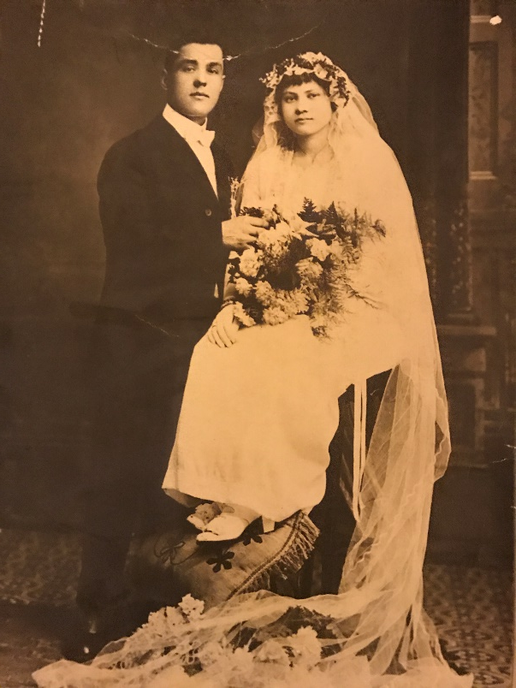
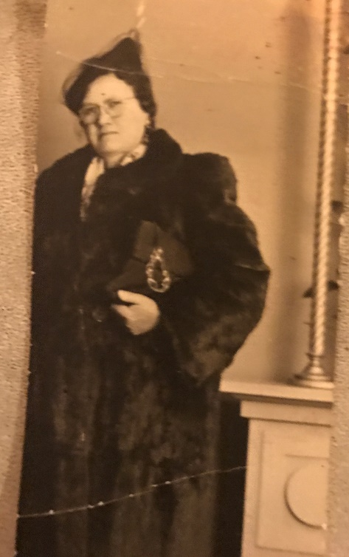
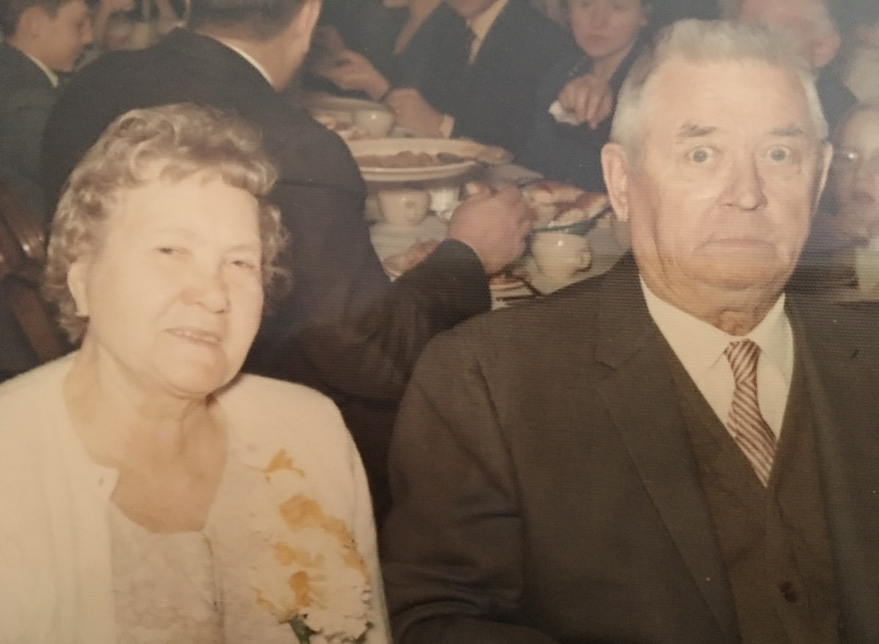
Francis Sobczak Great-Grandmother
Francis was Polish and was born in the United States. She married Frank Fudacz. She had three children with Frank. Helen, Mary "Bootsie", and Virginia. Frank died and she remarried Mr. Brus who had four children of his own: Chester, Edward, Florence, and Jean. They then had one of their own, Hank.

Slide 26
Roxanne Fudacz
me
Richard “Pete” Fudacz
Father
Elna Bouton
Mother
Matthew Fudacz Grandfather
Helen Rudak
Grandmother
Floyd Bouton II
Grandfather
Dorothy Spruth
Grandmother
Mary Mroz
Great Grandmother
Francis Sobczak
Great Grandmother
Valborg Christofferen
Great Grandmother
Minnie Dehn
Great Grandmother
Paul Fudacz
Great Grandfather
Frank Rudak
Great Grandfather
Floyd Bouton I
Great Grandfather
Charles Spruth
Great Grandfather

Slide 27
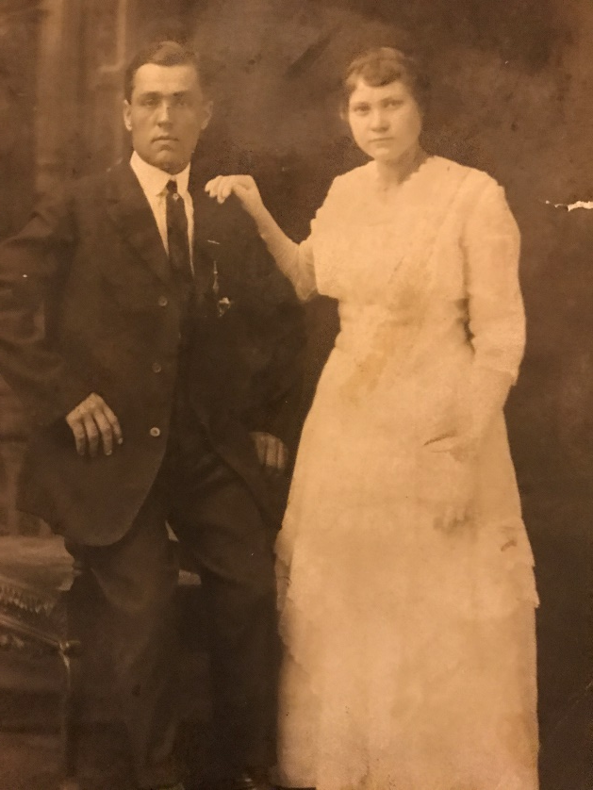
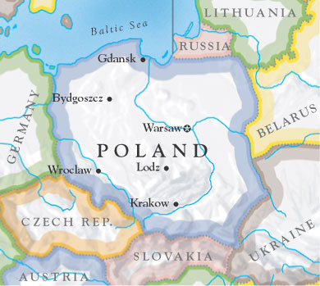
Frank Rudak Great-Grandfather
Frank was born in the United States and married Francis Sobczak and had three children. I was not able to trace his ancestry any further. I know that they he was Polish and that he came from Poland.

Slide 28
Roxanne Fudacz
me
Richard “Pete” Fudacz
Father
Elna Bouton
Mother
Matthew Fudacz Grandfather
Helen Rudak
Grandmother
Floyd Bouton II
Grandfather
Dorothy Spruth
Grandmother
Mary Mroz
Great Grandmother
Francis Sobczak
Great Grandmother
Valborg Christofferen
Great Grandmother
Minnie Dehn
Great Grandmother
Paul Fudacz
Great Grandfather
Frank Rudak
Great Grandfather
Floyd Bouton I
Great Grandfather
Charles Spruth
Great Grandfather

Slide 29
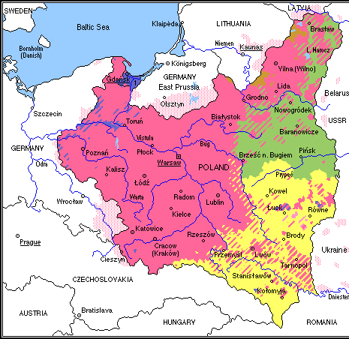
Mary Mroz Great Grandmother
Mary was born in Poland and came to America with her husband Paul. While in America they had two children: Adolph and Matthew. They returned to Poland where they later had a daughter whose name is unknown.

Slide 30
Roxanne Fudacz
me
Richard “Pete” Fudacz
Father
Elna Bouton
Mother
Matthew Fudacz Grandfather
Helen Rudak
Grandmother
Floyd Bouton II
Grandfather
Dorothy Spruth
Grandmother
Mary Mroz
Great Grandmother
Francis Sobczak
Great Grandmother
Valborg Christofferen
Great Grandmother
Minnie Dehn
Great Grandmother
Paul Fudacz
Great Grandfather
Frank Rudak
Great Grandfather
Floyd Bouton I
Great Grandfather
Charles Spruth
Great Grandfather

Slide 31
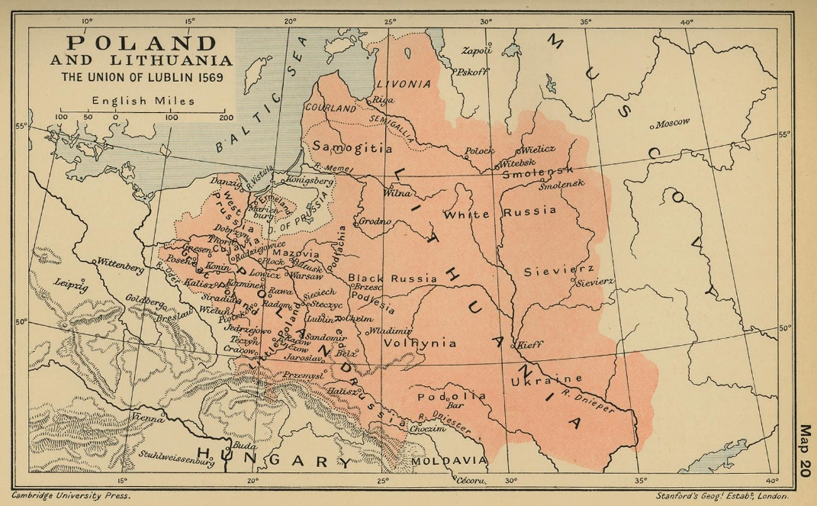
Paul Fudacz Great-Grandfather
Paul Fudacz and Mary Mroz Fudacz were married in Poland and came to the United States in 1912, but it was just for a visit. In that time my Grandfather, Matthew, was born on Jan, 1, 1913. Three years later, in 1915, they went back to their home near Krakow, Poland. In Poland they lived in the hills and are known as hillbillies.

Slide 32
Roxanne Fudacz
me
Richard “Pete” Fudacz
Father
Elna Bouton
Mother
Matthew Fudacz Grandfather
Helen Rudak
Grandmother
Floyd Bouton II
Grandfather
Dorothy Spruth
Grandmother
Mary Mroz
Great Grandmother
Francis Sobczak
Great Grandmother
Valborg Christofferen
Great Grandmother
Minnie Dehn
Great Grandmother
Paul Fudacz
Great Grandfather
Frank Rudak
Great Grandfather
Floyd Bouton I
Great Grandfather
Charles Spruth
Great Grandfather

