Slide 1
Irony occurs when an outcome is contrary or opposite to what was, or might have been, expected.
© Presto Plans

Slide 2
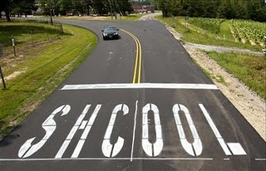
© Presto Plans

Slide 3
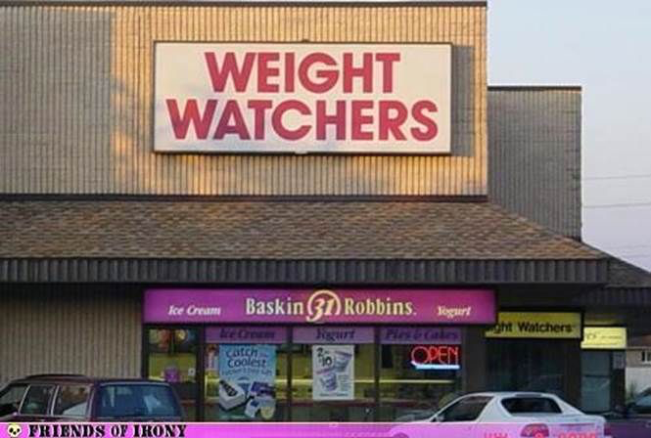
© Presto Plans

Slide 4
© Presto Plans

Slide 5
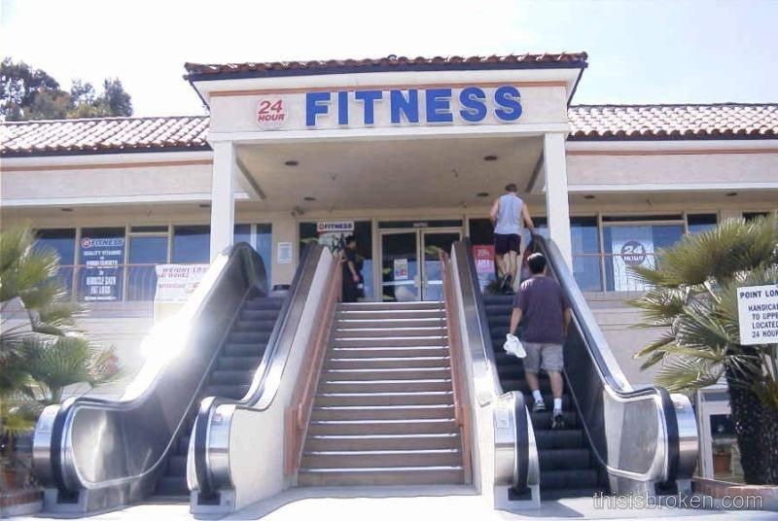
© Presto Plans

Slide 6
© Presto Plans

Slide 7
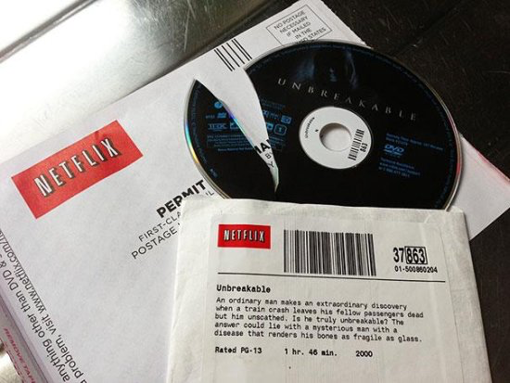
© Presto Plans

Slide 8
© Presto Plans

Slide 9
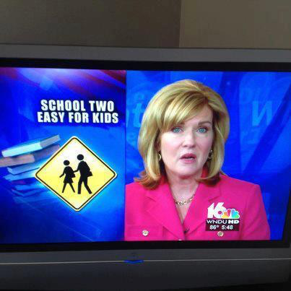
© Presto Plans

Slide 10
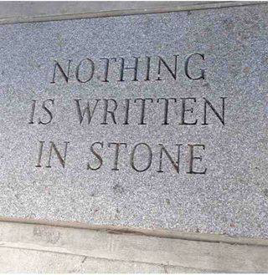
© Presto Plans

Slide 11
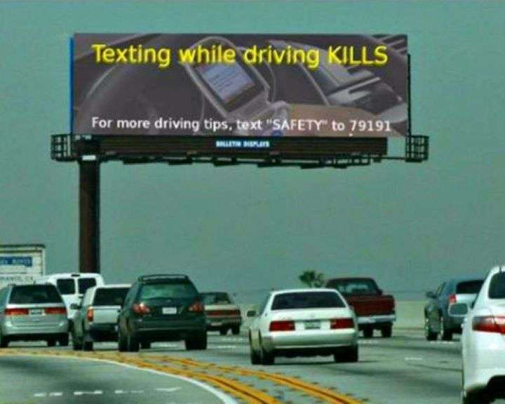
© Presto Plans

Slide 12
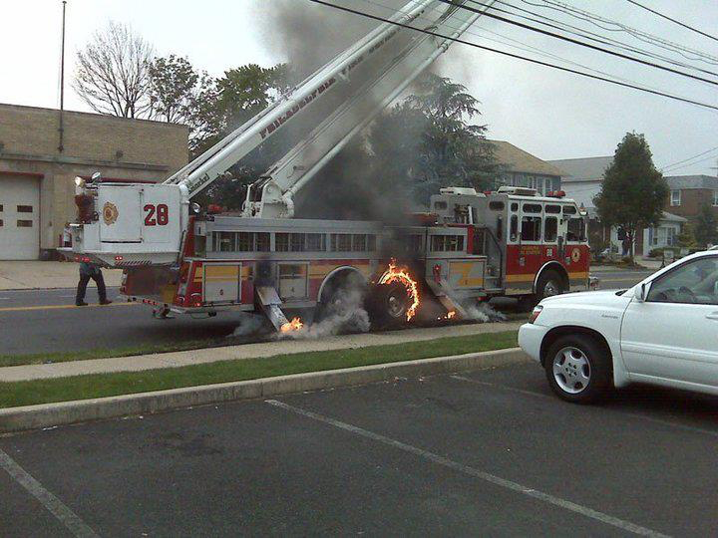
© Presto Plans

Slide 13
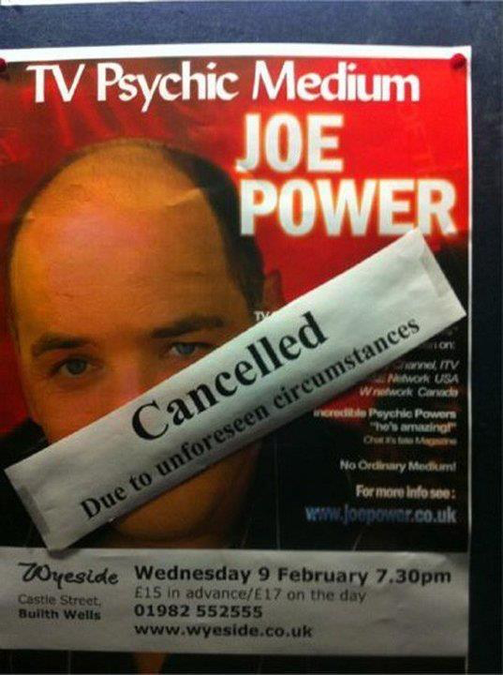
© Presto Plans

Slide 14
© Presto Plans

Slide 15
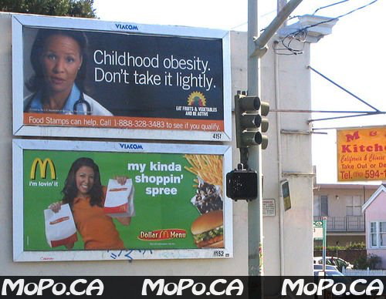
© Presto Plans

Slide 16
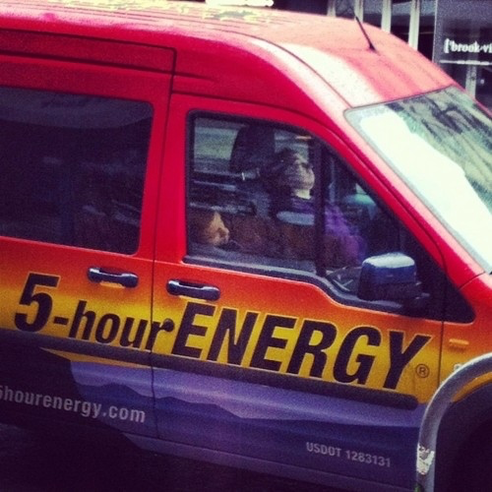
© Presto Plans

Slide 17
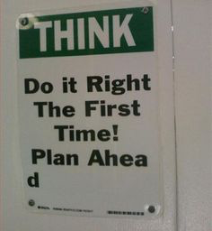
© Presto Plans

Slide 18
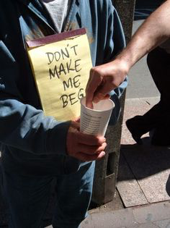
© Presto Plans

Slide 19
© Presto Plans

Slide 20
© Presto Plans

Slide 21
© Presto Plans

