Slide 1
Vocabulary Workshop Unit 14

Slide 2
Amplify
To make stronger, larger, greater, louder, or the like

Slide 3
Armistice
A temporary peace

Slide 4

Arrogant
Too convinced of one's own importance

Slide 5
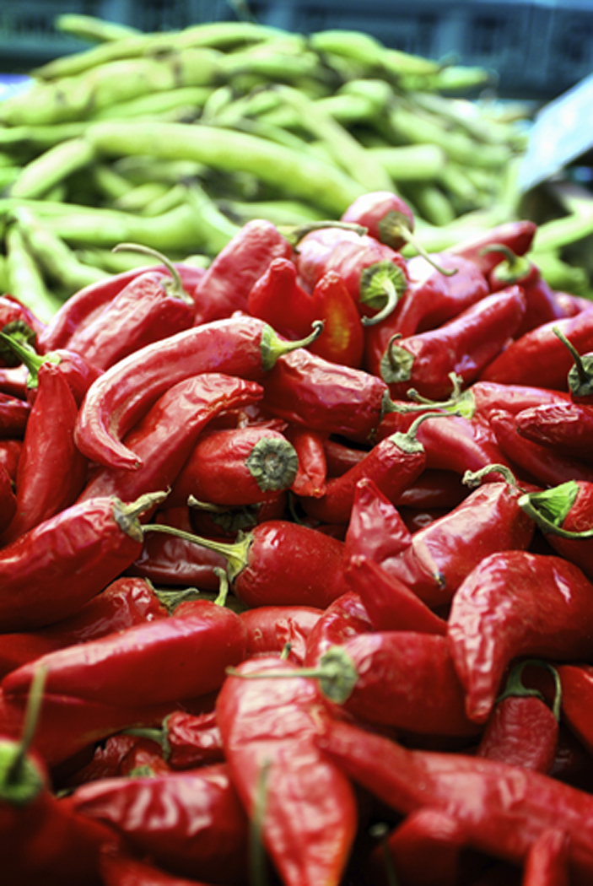
Bland
Gentle, soothing, mild

Slide 6
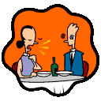
Disclaim
To deny interest in

Slide 7
Epoch
A distinct period of time

Slide 8
Estrange
To drift apart

Slide 9
Gratify
To please, satisfy

Slide 10

Infinite
Exceedingly great

Slide 11
Irascible
Easily made angry, hot tempered

Slide 12
Kindred
A person's relatives

Slide 13

Naive
Showing lack of worldly knowledge

Slide 14
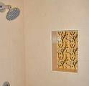
Niche
A decorative recess in a wall; a suitable place or position

Slide 15

Obliterate
To blot out completely

Slide 16
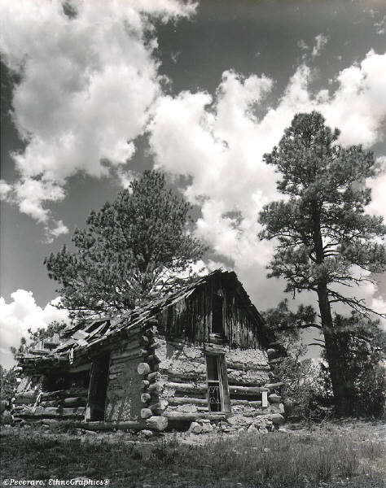
Ramshackle
Appearing ready to collapse

Slide 17
Ransack
To search or examine thoroughly

Slide 18
Rote
Unthinkingly routine

Slide 19
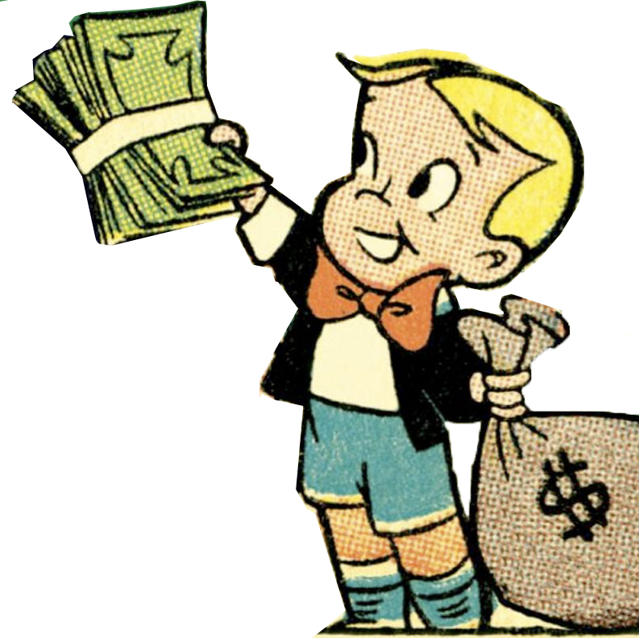
Solvent
Able to meet one's financial obligations

Slide 20
Tedious
Long and tiresome

Slide 21

Vendor
A person who sells something

Slide 22
amplify
kindred
armistice
niche
arrogant
naive
bland
obliterate
disclaim
ramshackle
epoch
ransack
estrange
rote
gratify
solvent
infinite
tedious
irascible
vendor

