Slide 1
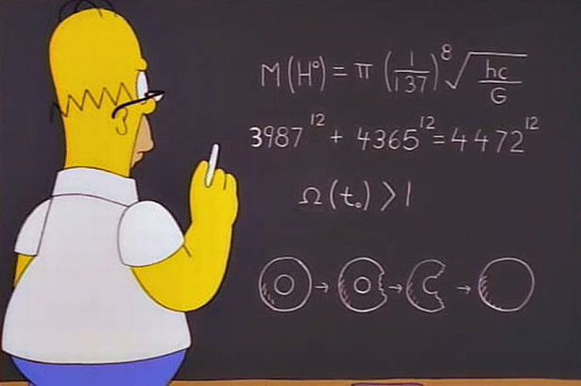
Curriculum Night 8th Grade Mathematics

Slide 2
Resources:
Engage NY and Utah Middle School Math Project are sites that provide additional resources that are consistent with the Common Core Standards.
Go Math: Middle School Grade 8. Published by Houghton Mifflin
Harcourt.
The textbook can be found online at http://my.hrw.com. Students will have a given username and password to access the textbook and other features such as real-life videos as well as concept review videos to help with homework. Some homework assignments can also be done online as well.
Video lessons from Khan Academy and videos that I have created to implement in the classroom.

Slide 3
CLASSROOM RULES
If you haven’t done so yet, please review the classroom rules from my syllabus with your child. These rules are important to ensure that class runs productively and that each student gets the proper education they deserve.

Slide 4
Student Expectations:
2. View the assigned videos and take accurate notes. The videos are intended to introduce a concept, so that class time can be spent on applying these skills. If a student fails to view the assigned videos, they may not be able to participate during these activities.
In addition,
This allows students to come to class prepared with the basic content knowledge, and with questions for the teacher or classmates.
Teachers will then be able to spend class time meeting the needs of individual students, having students work in groups, and apply their learning.

Slide 5
Students who do not have computer access at home…
Will be permitted to use computers in school in order to complete their video homework assignments. This should be done during advisory or intramural studyhall.
I would highly recommend that students go to their local library to view these videos before class the next day.
Otherwise, they would have to watch the video during class and fall behind.

Slide 6
HOMEWORK:
All homework will be posted daily on my webpage, under the Downloads List
http://www.summithill.org/teacherpage?section=home&teacher=223&page=149
Students will be responsible for grading their own assignments. It is important that they are honest when checking their work and to ask questions when necessary. Once again, failure to do so may result in students struggling with the assessments.
Students can do corrections on homework. Students are to complete corrections on a separate sheet of paper with appropriate work. Students are to attach the original assignment to the corrections and turn it in by the next school day. Homework corrections will not be accepted beyond that time.
All homework and classwork will be kept in a three-ring binder, separating each unit with a subject divider. Students are NOT allowed to throw these assignments out until they are directed to do so. NO EXCEPTIONS

Slide 7
SUMMATIVE ASSESSMENTS:
For each assessment given, students will be expected to document the amount of time they spent, within that week, preparing for this assessment. Based on the amount, students will also give a prediction of what they think they will earn on that assessment. This will allow students to reflect and take responsibility for their learning.
For corrections on a summative…

Slide 8
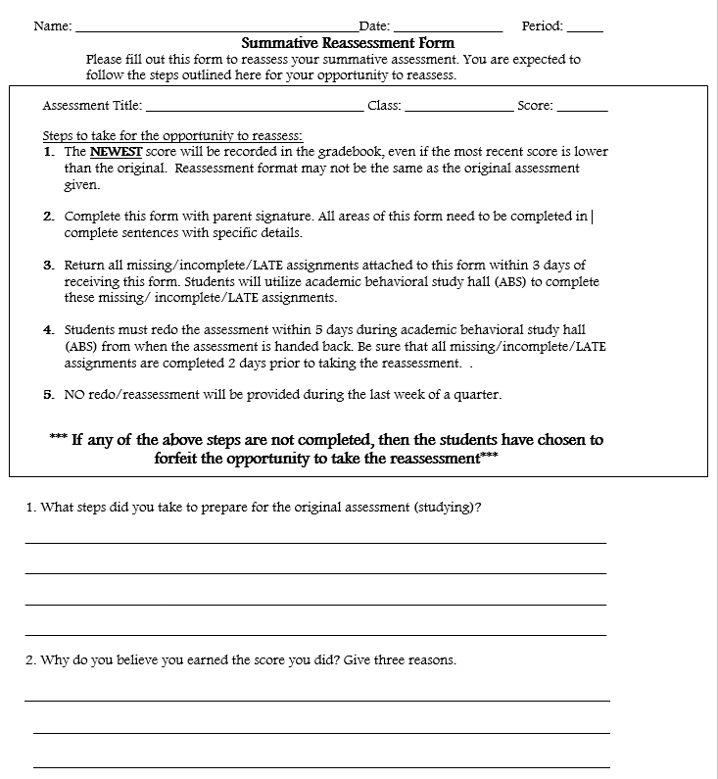
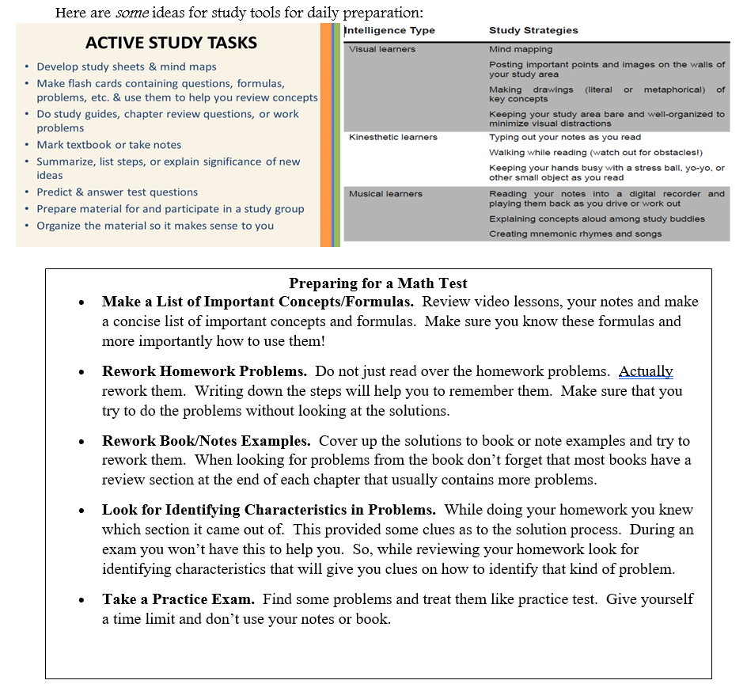
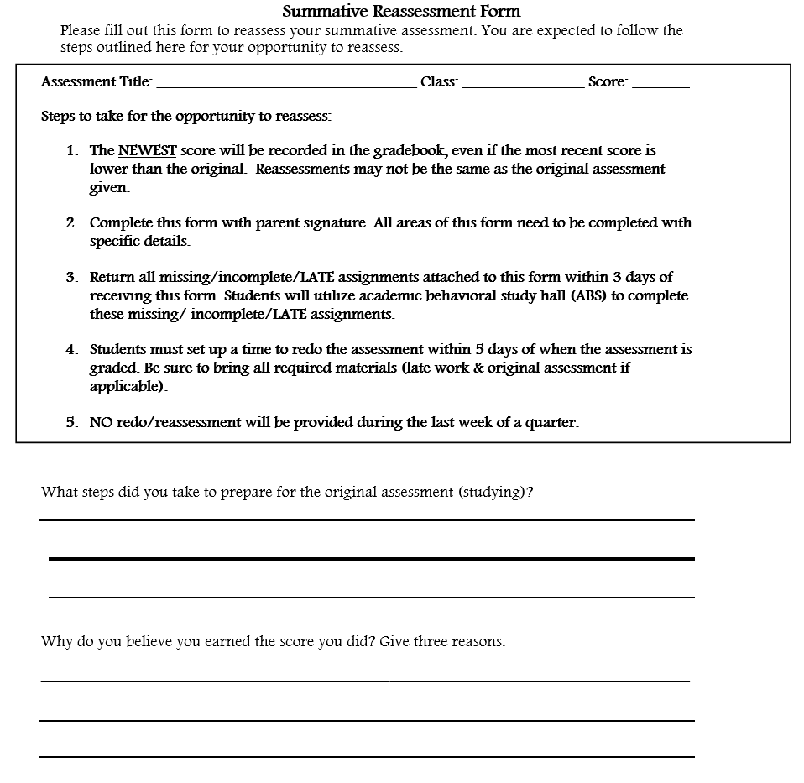

Slide 9
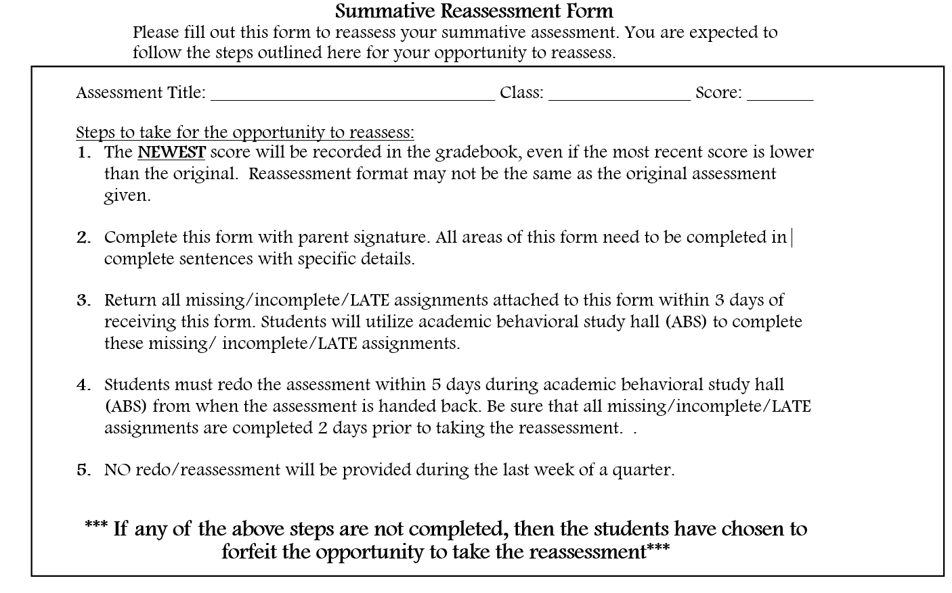

Slide 10
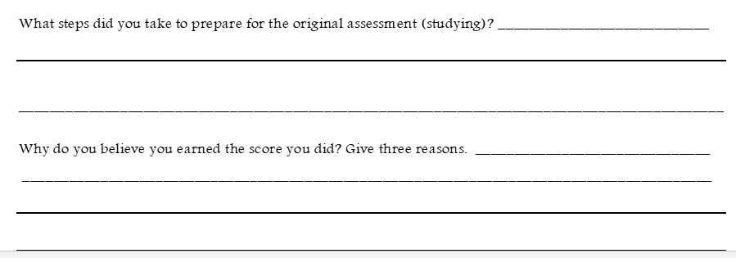

Slide 13
EXTRA HELP
If your child is having difficulty understanding a concept:
Academic Assistance – M-F from 2:25-3:25 Student needs a ride home or able to walk.
My.hrw.com, the textbook’s online component which offers Math on the Spot and Personal Math Trainer. These provide students with an opportunity to view lessons from one of the authors of the textbook and provide additional practice.

Slide 14
EXTRA HELP
If your child is having difficulty understanding a concept:
My teacher page offers useful websites that will help students that are not understanding a concept. Some of these sites will also reinforce concepts.
I am available for help before school at about 7am, or afterschool until 2:40pm. If your child is going to meet with me, please give me at least one day’s notice.

Slide 15
Contact Information:
You may contact me via e-mail at mzayed@summithill.org or at 815-469-4330 between the times below:
7:00-7:30am
8:15-8:55am
2:20-2:40pm
(The best way to contact me will be by e-mail)

Slide 16
We are looking forward to a great school year!

Slide 17
Materials
Students must bring the following to class on a daily basis.
Pencils (sharpened before class begins)
Red or blue pens for grading
3 ring binder with subject dividers
Spiral devoted only to math
Loose leaf paper
Calculator
Graph paper
Daily planner/assignment notebook
Positive attitude

Slide 18
Tentative List of Concepts to be Covered:
Unit 1: Numbers, Expressions, Equations and Functions
Unit 2: Linear and Exponential Relationships
Unit 3: Statistics
Unit 4: Polynomial Expressions and Equations
Unit 5: Functions and Modeling

