Slide 1
Math – Lesson 7.9 Remote Learning Day 3
Multiplying mixed numbers

Slide 2
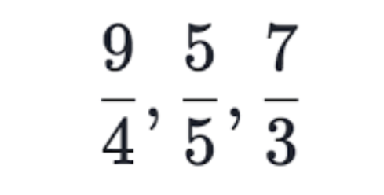
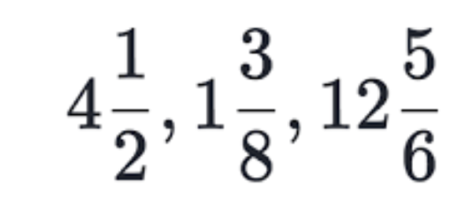
Terms Refresher
(These should also be in your Math spirals from before.)
Improper fraction – a fraction where the numerator is bigger than the denominator
Mixed Number – a whole number and a fraction combined

Slide 3
Mixed numbers improper fractions Improper fractions mixed numbers

Slide 4
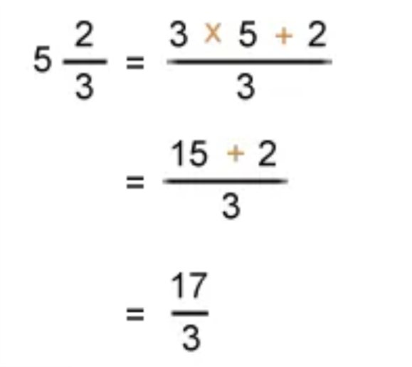
Notes
Goal: Take your mixed numbers and create improper fractions so you can multiply.
STEP ONE – Multiply the denominator by the whole number. (3 x 5 = 15)
STEP TWO – Add the numerator to it. (3 x 5 = 15 + 2 = 17) Put that new numerator (17) over the current denominator (3). This will be your new improper fraction. $\frac{17}{3}$
Example:
Note: You will need to change both mixed numbers into improper fractions before you can multiply.
This is what we did before we left school. It should be in your Math spiral notes. ☺

Slide 5
Notes
Goal: Take your mixed numbers and create improper fractions so you can multiply.
STEP THREE – Once you have changed both mixed numbers into improper fractions, multiply the numerators straight across and the denominators straight across.
STEP FOUR – Turn it back into a mixed number and simplify if possible.
All steps in order…

Slide 6
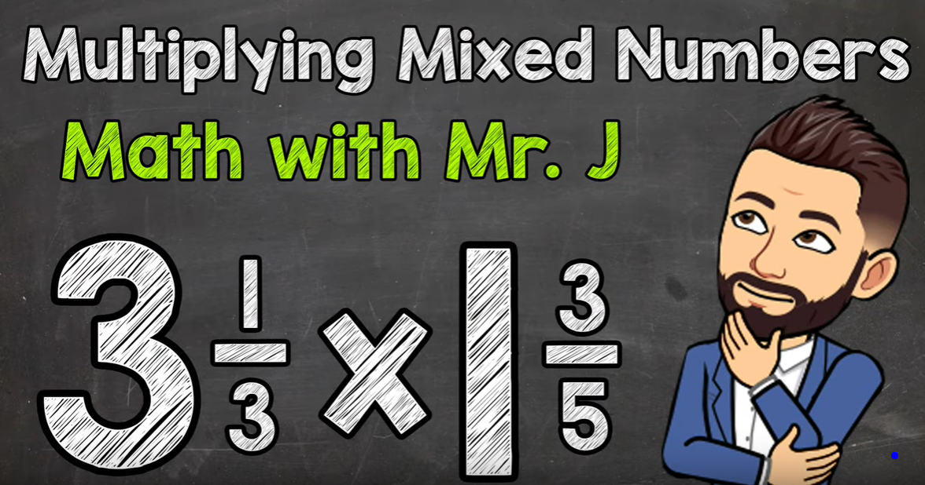
Video time!
Click on the link below to see how Mr. J multiplies mixed numbers.
https://youtu.be/gMJBu8BXhgU

Slide 7
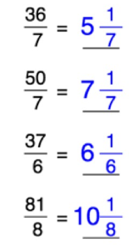
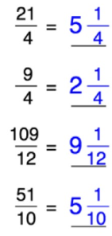
Examples

Slide 8
You try

Slide 9
How did you do?

Slide 10
Let’s try some more!

Slide 11
How did you do?
Even though it says “or” on the answers, you always need to change the improper fraction back into a mixed number!
On your formative assessment, I will be looking for your answers as a mixed number or whole number only.

Slide 12
Formative time!
Goal: Get a 7/10 or higher on the formative assessment!
Once you feel comfortable with this lesson, please go to my web page and find the link to take the formative assessment. It will be labeled as Math – Lesson 7.9
If you get a 6/10 or lower, you will be asked to try again. I know you can do it! ☺
If you have any questions, please reach out to me on our Math Teams page and I will do my best to help you!

