Slide 1
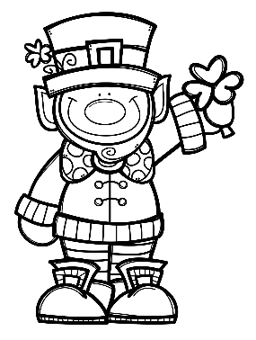
Mrs. Schimke’s Class Newsletter
March 2-6, 2020
 | What are we learning this week?
Reading | We will read an informational text called “Aero and Officer Mike”. Our story skills are: author’s purpose, point of view summarizing, and prefixes in-/im- Our story summative will be next week.
Language Arts | We will begin our next chapter called Capitalization and Punctuation. This week we will write correct sentences and review how to capitalize proper nouns.
Math | We will review equivalent fractions on Monday. We will then review chapter 9 and take the summative on Wednesday.
Social Studies & Science | Science-we will continue with our Social and Group Behavior unit. Social Studies-we will begin chapter 4 Government, Landmarks, and Symbols.
Teacher Notes
*Remember to initial or sign the student planner each night so that I know you’ve seen the nightly homework.
*All test, quiz, and assignment dates are subject to change.
*Your child should be reading every night for our 24 Book Challenge.
Dates to Remember
2/28 Spelling Contracts Due
and SHEF Bingo Night
3/3 Dr. Seuss homework due
3/12 Treat Day
3/19 3rd Quarter ends and 1st day Spring
3/26 Hot Lunch
3/27 Early Release
MARCH BIRTHDAYS
22-Ellie
31-Nora
Weekly Specials
M-Music & PE
T-PE (Art every other week)
W-Technology & PE
Th-Music & PE
Friday-Library & PE

