Slide 1
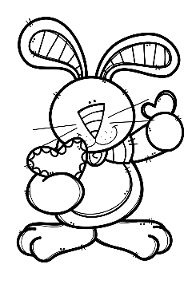
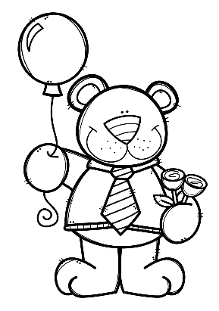
Mrs. Schimke’s Class Newsletter
February 17-21, 2020
 | What are we learning this week?
Reading | We will read a Cherokee legend called “Yonder Mountain”. Our story skills will be: compare/contrast, story message, homophones/homographs, and contractions. Our story summative will be next week. Book Reports are due by February 25th.
Language Arts | We will learn about adverbs this week.
Math | We will begin our next chapter on fractions. We will learn how to compare fractions. MULTIPLICATION DRAGON CHALLENGE-we are almost there! A few students started division now!!
Social Studies & Science | Science-our next unit will be Social and Group Behavior. Social Studies-we will take our summative over chapter 3 this week. A study guide will come home.
Teacher Notes
*Remember to initial or sign the student planner each night so that I know you’ve seen the nightly homework.
*All test, quiz, and assignment dates are subject to change.
*Your child should be reading every night for our 24 Book Challenge.
Dates to Remember
2/17 Presidents’ Day – No School
2/18 Spirit Stick Sale
2/25 Book Reports Due
2/27 Hot Lunch
2/28 Spelling Contracts Due
FEBRUARY BIRTHDAYS
14-Leah
19-Mateo
22-Cooper
Weekly Specials
M-Music & PE
T-PE (Art every other week)
W-Technology & PE
Th-Music & PE
Friday-Library & PE

