Slide 1
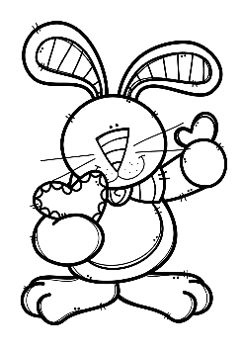
Mrs. Schimke’s Class Newsletter
February 10-14, 2020
 | What are we learning this week?
Reading | We will spend our 2nd week reading “Tops and Bottom”. Our story skills are: theme, point of view, visualizing, idioms, and homophones. Our story summative will be Thursday. Book Reports are due by February 25th.
Language Arts | We will learn how to compare with adjectives and then we will learn about adverbs. Our summative will be next week.
Math | We will solve fraction word problems. Then we will review and take the Chapter 8 summative on Wednesday. MULTIPLICATION DRAGON CHALLENGE-we are almost there! A few students started division now!!
Social Studies & Science | Science-we’ll finish up environmental traits. Social Studies-we had so much fun learning about Roanoke, Jamestown, and the Pilgrims. This week we will learn what started the Revolutionary War.
Teacher Notes
*Remember to initial or sign the student planner each night so that I know you’ve seen the nightly homework.
*All test, quiz, and assignment dates are subject to change.
*Your child should be reading every night for our 24 Book Challenge.
Dates to Remember
2/13 Treat Day & Valentine’s
Day Carnival
2/14 Early Dismissal
2/17 Presidents’ Day – No School
2/25 Book Reports Due
2/27 Hot Lunch
2/28 Spelling Contracts Due
FEBRUARY BIRTHDAYS
14-Leah
19-Mateo
22-Cooper
Weekly Specials
M-Music & PE
T-PE (Art every other week)
W-Technology & PE
Th-Music & PE
Friday-Library & PE

