Slide 1
The U.S. Constitution
https://play.kahoot.it/#/?quizId=9141ab0c-351e-4524-bf40-b0177211c901
How the United States Government works

Slide 2
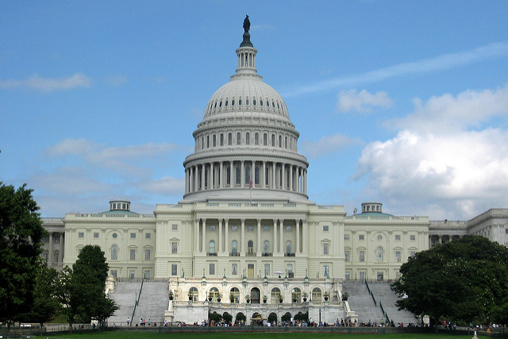
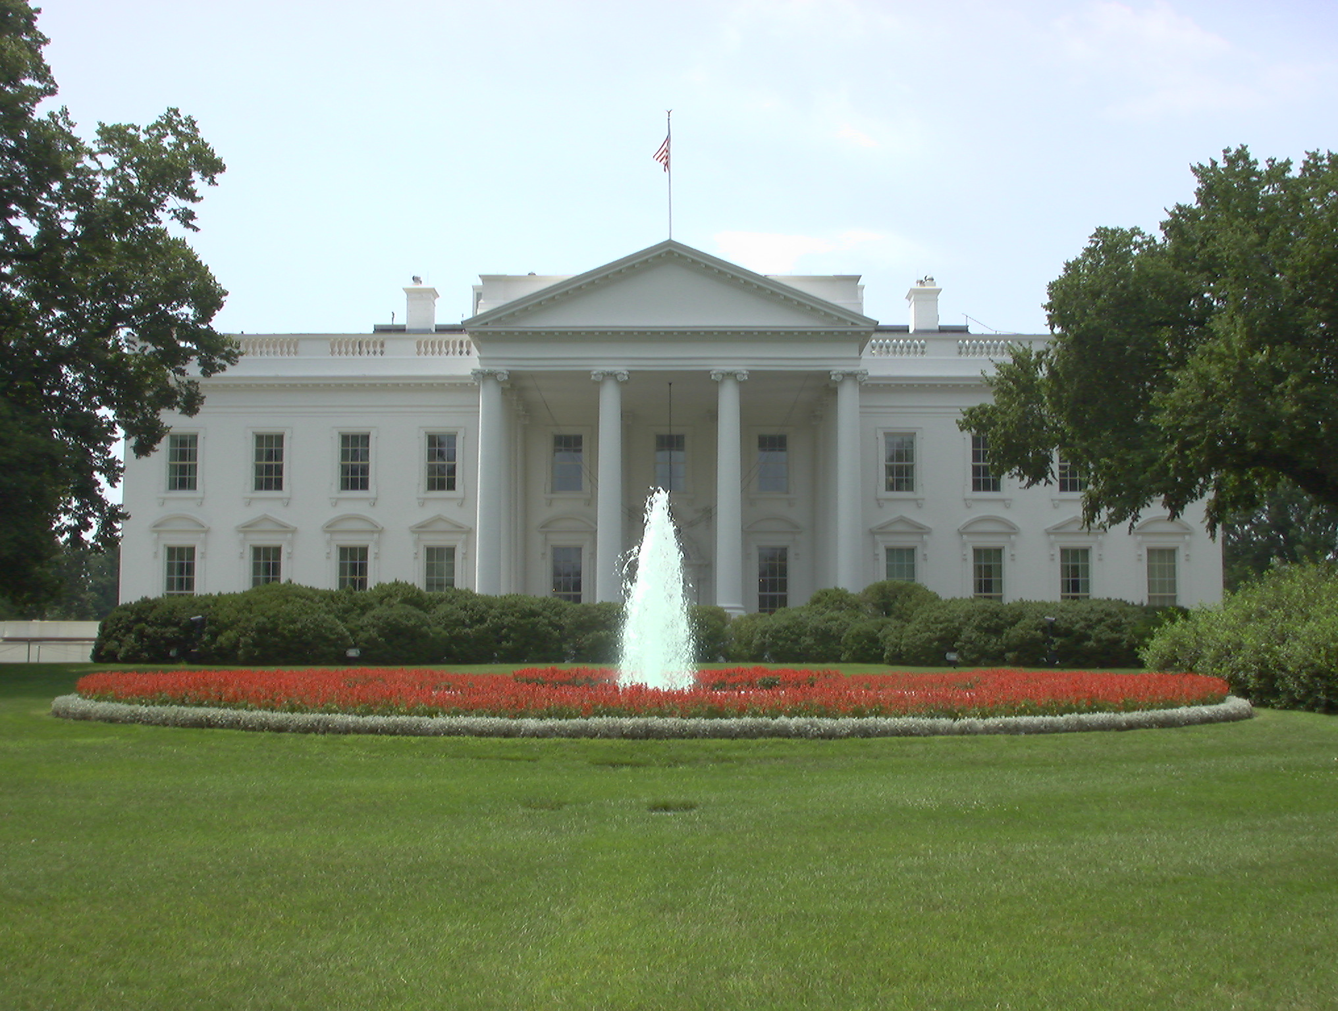
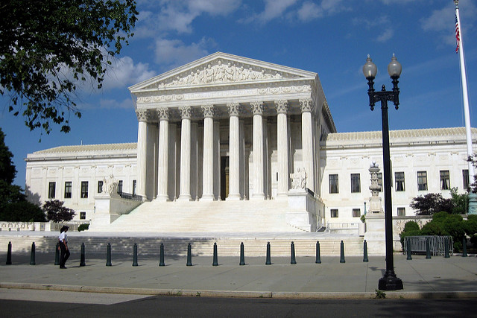
3 Branches of Government Legislative Executive Judicial Branch Branch Branch

Slide 3
Legislative Branch (Makes the Laws) Congress (535 People)
House of Senate
Representatives (100)
(435)

Slide 4
Executive Branch (Enforces the law)
President
Vice President
President’s Cabinet

Slide 5
Judicial Branch (Interprets the Laws)
Supreme Court
Other Federal Courts

Slide 6
Legislative branch (Makes the Laws)
There are 2 houses
House of Representatives Senate
(lower house) (upper house)
Based on population 2 per state

Slide 7
House of Representatives
Number of Representatives in your state depends on the state’s population
Every state has at least 1 representative
Serve 2 year terms
Can be elected UNLIMITED times
Are directly elected by thepeople

Slide 8
In order to be a Representative you must:
Be 25 years old
Be a U.S. citizen for 7 years
Live in the state that you are representing

Slide 9
Leader of the House:
The Speaker of the House – Paul Ryan
Powers of the House of Reps:
1. All money (tax) bills must start in the House.
2. Impeaches government officials (accuses them of doing something wrong)

Slide 10
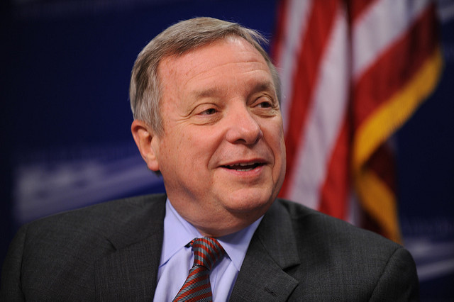
Senate
2 Senators from each state
Senators serve 6 year terms
Can be elected unlimited times
Are directly elected by the people
Tammy Duckworth Richard Durbin

Slide 11
To be a Senator you must:
Be 30 years old
Be a U.S. Citizen for 9 years
Live in the state you are representing

Slide 12
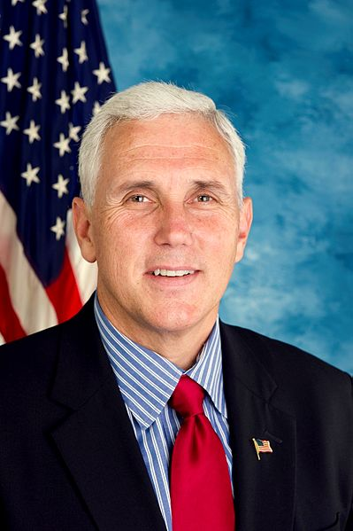
The Leader of the Senate:
The Senate President (Vice President of the U.S.)
Mike Pence
Powers of the Senate:
*Approve treaties made by the
President.
*Approve Judges picked by the President.
*Holds Impeachment Trials (decides
If the person is guilty or innocent)

Slide 13
Powers of Both the House of Representatives and the Senate
Declare War
Print Money
Pass Bills

Slide 14
How a Bill Becomes a Law
1.Bills can start in the House or in the Senate
(Money/Tax Bills MUST be started in the House of Reps)
2. The Bill is introduced in the House or the Senate
*If the Bill starts in the House, it must be voted on in the House first. If it is passed it goes to the Senate.
*If the bill originates in the Senate, it must be voted on in the Senate first. If it is passed it goes to the House.

Slide 15
How a bill becomes a law continued……
Then…..
Once on the President’s Desk……..
The Bill MUST be passed by the House of Representatives and the Senate, before it can go to the President.
The President can SIGN THE BILL or VETO THE BILL.
OR POCKET VETO-a method that the President can use to prevent a bill from becoming a law by not signing the bill before the session of Congress ends
IF the President SIGNS the bill, it will become a law
IF the President VETOS the bill, it will go back to Congress..

Slide 16
How a bill becomes a law continued…….
If the President Vetos the bill then……
The bill is sent back to Congress and IF 2/3rd’s of both the House and the Senate approve the Bill, they can OVERRIDE the President and the Bill will become a law.
*****So technically, only the House and Senate need to pass a Bill in order for it to become a law.*****

Slide 18
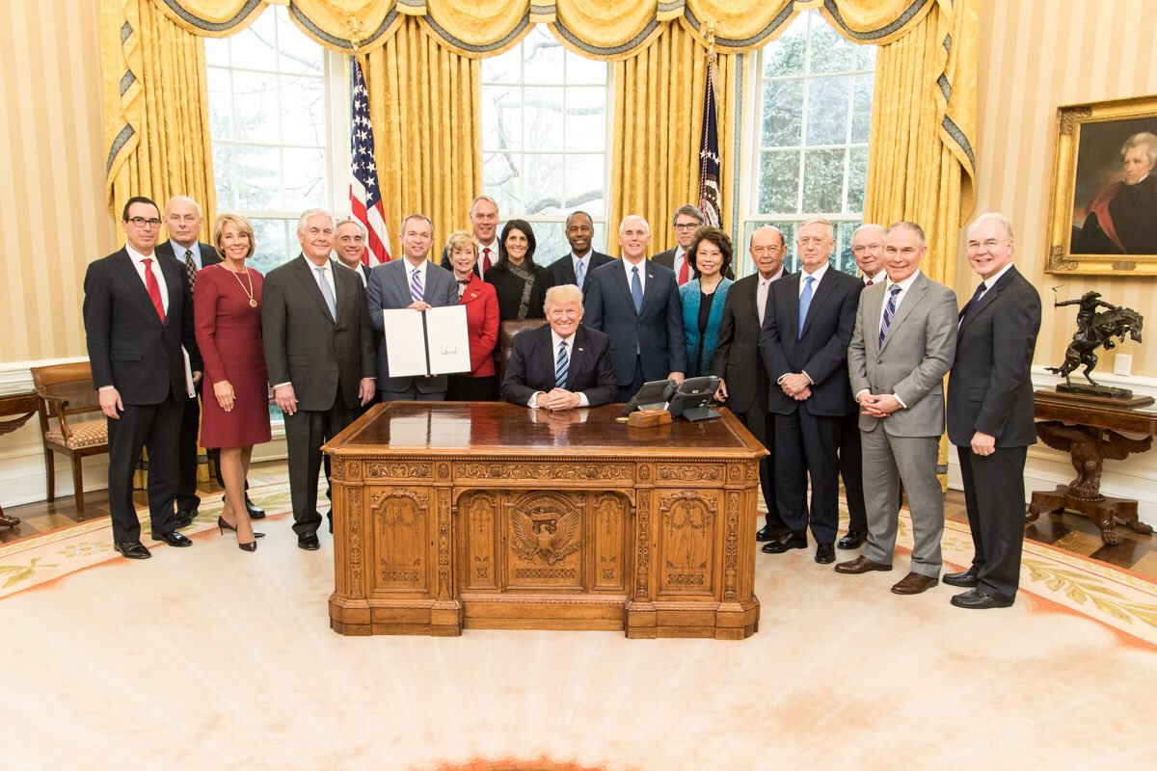
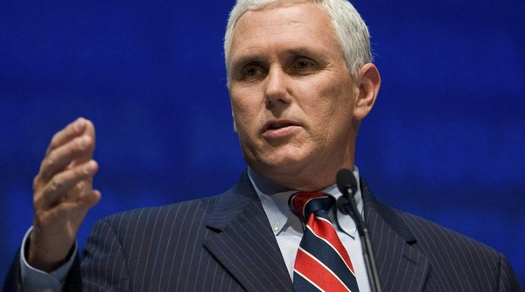
EXECUTIVE BRANCH
The President, Vice President, and the President’s Cabinet make up this branch
Enforces the laws

Slide 19
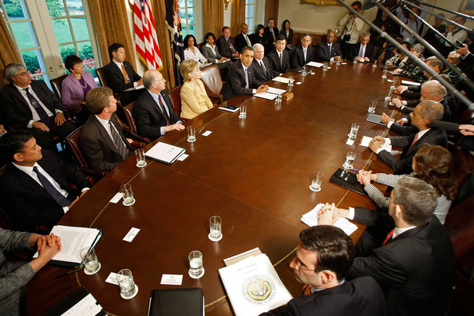
The Cabinet of the United States is part of the executive branch of the U.S. government that normally acts as an advisory body to the President of the United States. It is composed of the most senior appointed officers of the executive branch of the U.S. government serving under the President. Among those are the Vice President and the heads of the federal executive departments, all of whom are by federal law (3 U.S.C. § 19) in the line of succession to the Presidency and have duties under the 25th Amendment to the Constitution. Members of the Cabinet (except for the Vice President) serve at the pleasure of the President, who can dismiss them at will for no cause. All federal public officials, including Cabinet members, are also subject to impeachment by the House of Representatives and trial in the Senate for "treason, bribery, and other high crimes and misdemeanors".

Slide 20
To be President, you must……..
Be at least 35 years old
Live in the U.S. for 14 years
Be a natural born citizen (born in the U.S.)

Slide 21
President’s Powers and Duties
Main job: ENFORCE THE LAWS
Veto bills passed by Congress
Makes treaties with other nations (approved by Senate)
Appoints/Picks Supreme Court Judges
Commander – in – Chief of the Armed Forces

Slide 22
President’s Term
The President serves a 4-year term
The President can be elected 2 times (2 terms)
Example: Obama was elected in 2008 and 2012.
A President can serve for a total of 10 years
The President is elected in November, but can’t take office until January.
Presidential Succession
If the President dies, these are the next people in line to take his spot:
1. The Vice-President
2. The Speaker of the House
President Pro Tempore of the Senate
This is laid out in Article II Section 1 Clause 6

Slide 23
How Do we elect a president?
1. We elect the President through popular vote and The Electoral College.
2. Each state has a certain number of electoral votes. (538 electoral votes)
Number of electoral votes in each state = #of Representatives and # of Senators
Example: Illinois has 20 electoral votes
(18 Reps+ 2 Senators)
While California has 55 Electoral Votes
(53 Reps+2Senators)

Slide 24
How do we elect a president continued…
* People go and vote for their favorite person
The person that gets the most votes in that state, gets the electoral votes for the state
Example: Obama got the most votes in Illinois in 2008 and 2012, so got the electoral vote for our state
The candidate that gets 270 electoral votes WINS!!!!!

Slide 25
Census
Every 10 years the government takes a CENSUS which is a poll of questions that Americans answer including; how many people live in the house, what their income is, race, gender, etc.
This is how the government determines the number of reps each state will have.
How do we determine the number of electors?

Slide 26
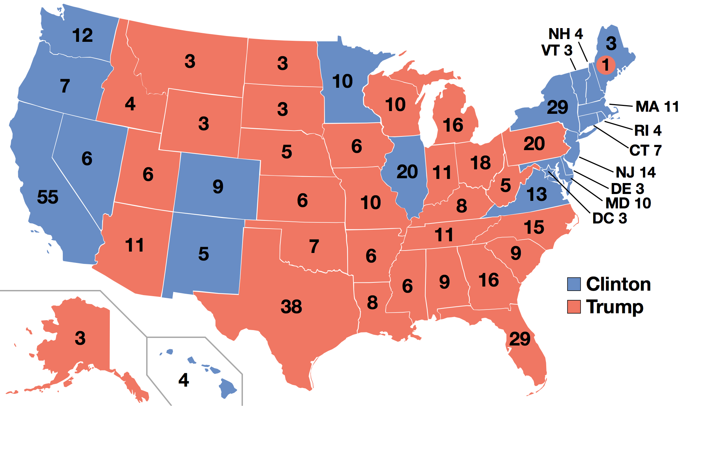

Slide 27
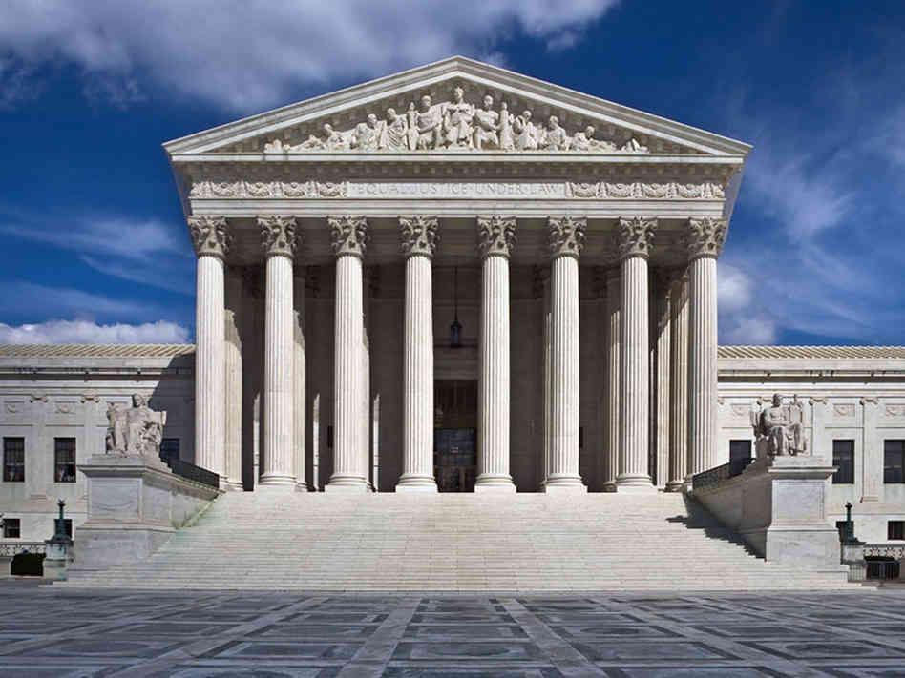
The Judicial Branch (interprets the Laws)
The Judicial Brach is made up of Supreme and Federal Courts

Slide 28
The Judicial Branch
SUPREME COURT!
The Supreme Court is the SUPREME
Law of the land.
There are 9 Supreme Court Justices (Judges) on the Supreme Court
Supreme Court Justices serve a LIFE term

Slide 29
Supreme Court Continued ……..
Supreme Court Justices are:
APPOINTED by the President
They have the power to declare
laws unconstitutional

Slide 30
Checks and balances
The System in which each branch of government “checks” each other to balance the power.
This ensures that one branch does not become stronger than the others.

Slide 31
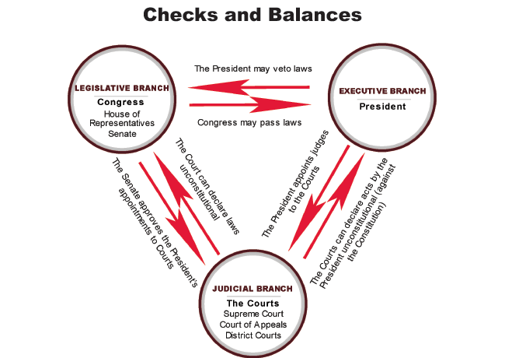

Slide 32
