Slide 1
The Cell in action
Diffusion, Osmosis, Transport, Endocytosis and Exocytosis

Slide 2
All Organisms MUST:
Be able to obtain energy
Obtain raw materials
Get rid of waste

Slide 3
What do these functions do?
They enable to the cell to remain healthy and divide.
Cell division allows organisms to grow and repair injuries.
The exchange of the material between a cell and its environment takes place in the cell membrane.
To better understand how materials move in and out of the cell you need to know about diffusion.

Slide 4
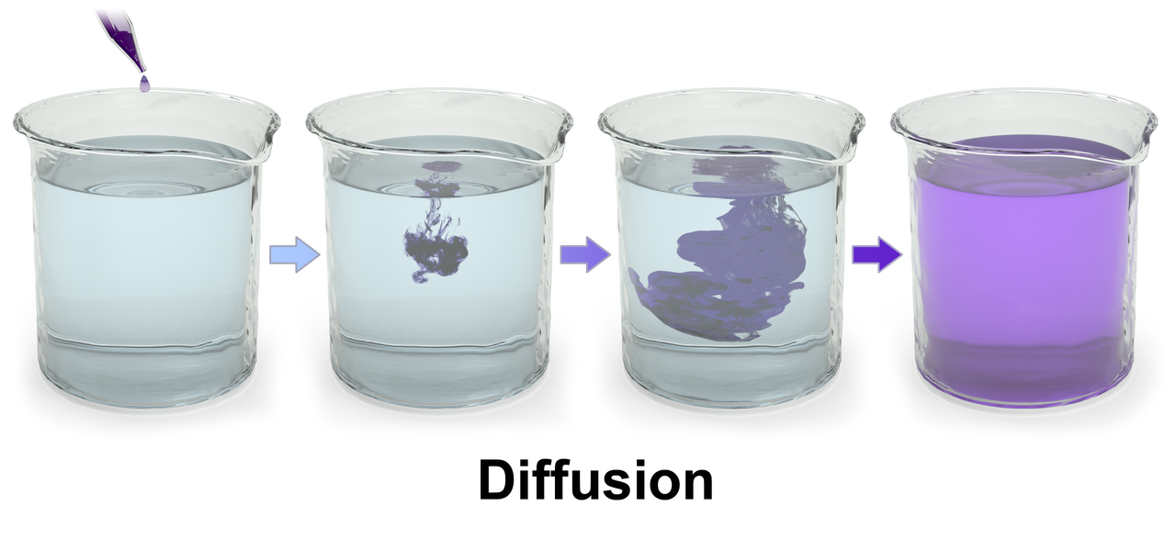
Diffusion
Diffusion is the moving of high concentration to low concentration
Cells do NOT need energy for diffusion

Slide 5
We’ve all witnessed diffusion
What are some examples of where and how you’ve seen diffusion at work?
You can smell perfume because it diffuses into the air and makes its way into your nose
Stirring sugar in tea will help it diffuse faster
When you cook pasta, the water diffuses into the noodles, making them bigger and moister
A helium balloon will deflate a small amount every day as helium diffuses through the balloon into the air
Leaving a soda bottle open and the carbon dioxide bubble will diffuse leaving the soda flat
Heat is also diffused during heating conduction, such as a mug getting hot when you place a hot liquid into it .

Slide 6
Osmosis
Osmosis is the diffusion of water through a semi permeable membrane
The cells of organisms are surrounded by and filled with fluids that are made mostly of water
The diffusion of this water through a cell membrane is called osmosis

Slide 7
Osmosis
The side that holds only pure water has the higher concentration of water particles
During osmosis, water particles move to where they are less concentrated

Slide 8
Diffusion of water
Water is made up of particles, called molecules.
Pure water has the highest concentration of water molecules
When you mix something such as sugar or food dye into water you lower the concentration of water molecules.
SEMIPERMEABLE- means that only certain substances can pass through it. In general oxygen, food and water are allowed to enter; waste products are allowed to exit and harmful substances are kept out!
For example - it is like a net or a screen door or your skin…..

Slide 9
Compare and contrast

Slide 10
Stop and start our egg experiment
To demonstrate what diffusion and osmosis are we will be conducting a whole class lab.
In the first part of the lab we will be placing 2 eggs (raw eggs) into vinegar.
What do you suppose will happen?
When we expose the VERY FRAGILE semipermeable membrane of the egg we will then conduct this experiment further into investigating how the semipermeable membrane allows different solutions to pass through it. (osmosis)
We will watch what solutions move into or out of the egg which will explain if the solution is hypertonic or hypotonic ----we’re getting there, not to worry

Slide 11
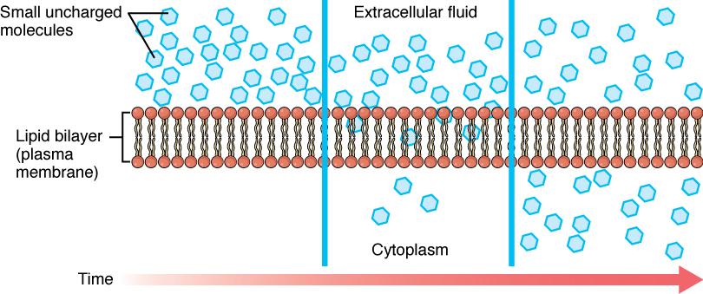
The Cell and Osmosis
Osmosis is vital to the cells functions
Red blood cells are surrounded by plasma
Plasma is made up of water, salts and sugar
The concentration of these particles is kept in balance by osmosis

Slide 12
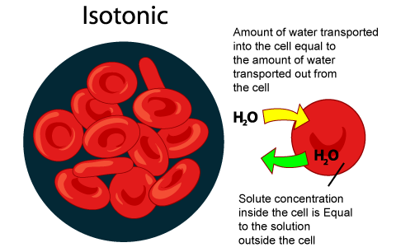
When Everything is in balance Dynamic Equilibrium
When all is well and everything is in balance this is called Isotonic
Isotonic means when solutes in the solution = solutes in the cell and water molecules move EQUALLY – Everything is well

Slide 13
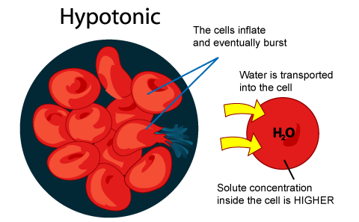
Hypotonic
What would happen if red blood cells were in pure water???
Well…… when solutes in the solution less than solutes in the cell…. The cell will burst!!! The water will rush INTO the cell to equalize the concentrations. The cell will inflate and eventually burst. Example: Fresh water is a hypotonic solution for salt water fish…why???
Their gills have a much higher salt
concentration than the fresh water
which causes water to rush into them.
This will cause the cells to burst

Slide 14
Hypertonic
Hypertonic happens when solutes in have a higher concentration than that of the solutes in the cell. The water inside the cell will rush out to equalize the concentrations.
This would happen when red blood cells are put into a salty solution.
Ever wonder why after a good ham dinner or sometimes eating at an Italian restaurant you are SOOOOO thirsty afterwards………This is why… the concentration of salt was too high

Slide 15
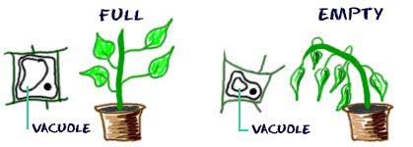
Osmosis also occurs in plants
What happens when a wilted plant is watered???
Osmosis makes the plant firm again.
Soooooo with that being said…. Time to think???? What happens to plants that come into contact with a salt truck plowing the street???

Slide 16
Making sense of it all – predictions with the egg???

Slide 17
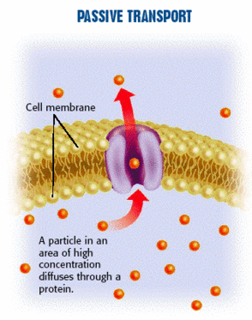
Moving Particles
Small particles such as sugar cross the cell membrane through passageways called channels
The channels are made up of proteins in the cell membrane
The movement is done through either passive or active transport
Let’s think of what the word passive means? Do you suppose it requires energy???
Passive transport – It is the movement of particles across the cell membrane WITHOUT the use of energy. During passive transport the particles move from an area of high concentration to an area of low concentration…..SOUND FAMILIAR??? IT SHOULD- This is diffusion and osmosis

Slide 18
Active Transport
Let’s think about when you’re active…. It requires energy right??
Active transport is the process of transporting particles from an area of LOW concentration to an area of HIGH concentration. THIS TAKES ENERGY!! This goes against the gradient
This happens in endocytosis and exocytosis…. Don’t worry we are getting there

Slide 19
What is endocytosis ????
Endocytosis is ACTIVE TRANSPORT where a cell surrounds a large particle such as protein, and encloses the particle into the cell.
Easy way to remember – ENDO= ENTER
Step1- The cell comes into contact
Step 2- The cell membrane begins to wrap around the particle
Step 3 – Once the particle is completely surrounded, a vesicle pinches off
Step 4 – it is completely within the cell

Slide 20
What is Exocytosis????
This is a process that uses ACTIVE TRANSPORT when large particles LEAVE the cell such as waste.
During exocytosis a vesicle forms around a large particle within the cell. The vesicle carries the particle to the cell membrane and releases the particle outside of the cell.
REMEMBER- EXO- EXIT! Remember your Fed Ex trucks in cell city?
Step1- Large particle – packaged up
Step2- vesicle travels to cell membrane
Step3- The cell releases the particle outside of the cell.

