Slide 1
Naper Settlement Field Trip
Mrs. Cullen’s Class
2017-2018

Slide 2
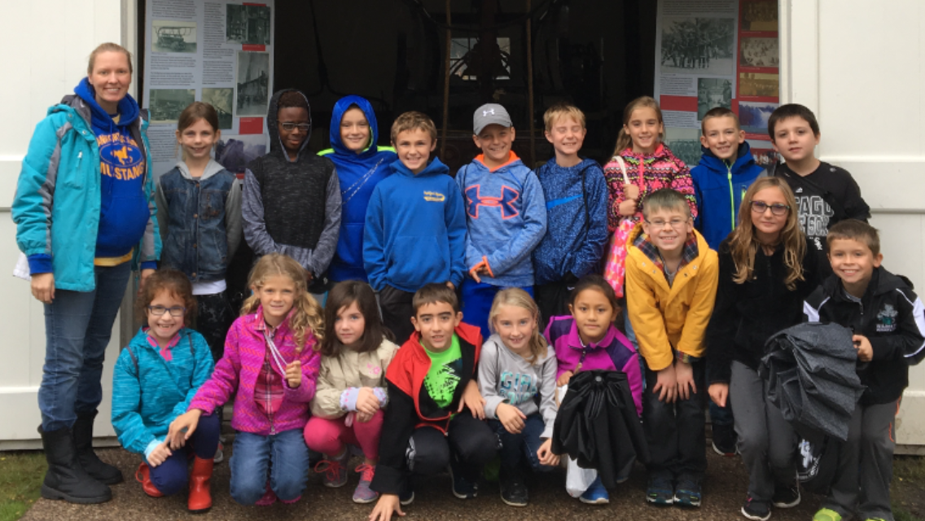

Slide 3
One Room Schoolhouse

Slide 4
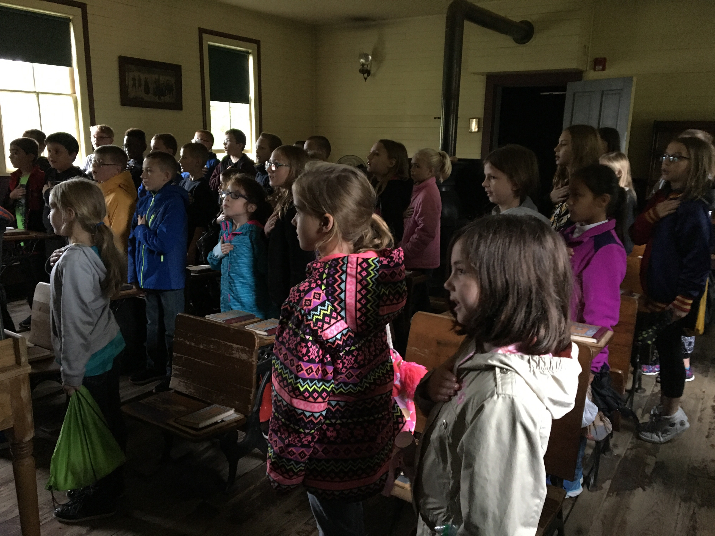

Slide 5
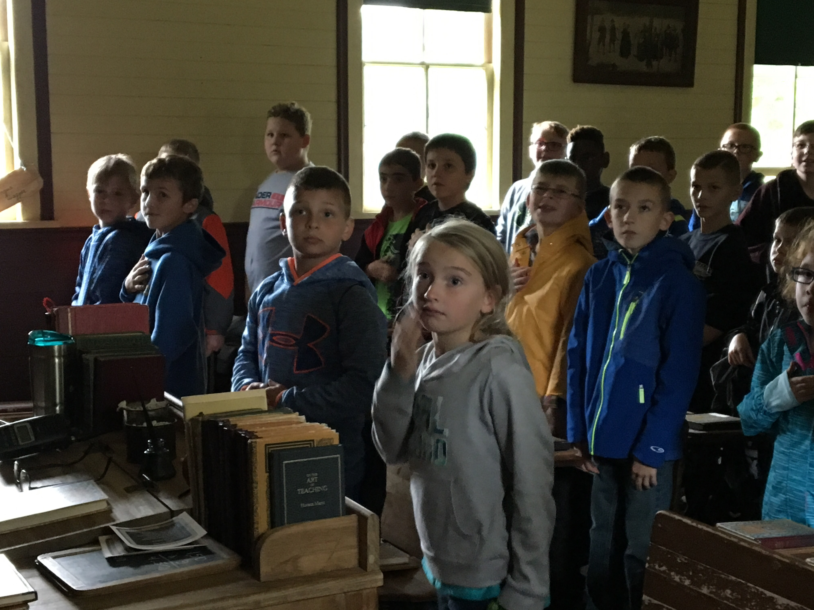

Slide 6
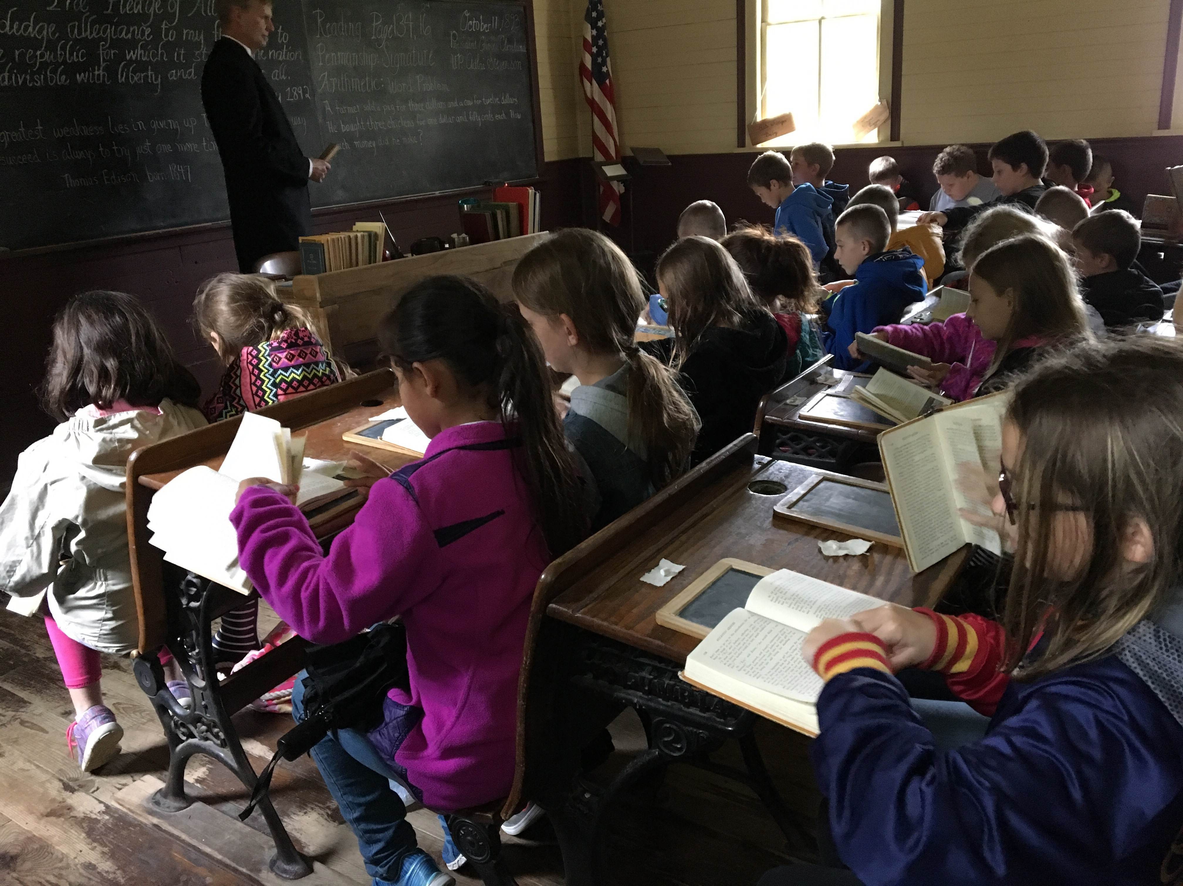

Slide 7
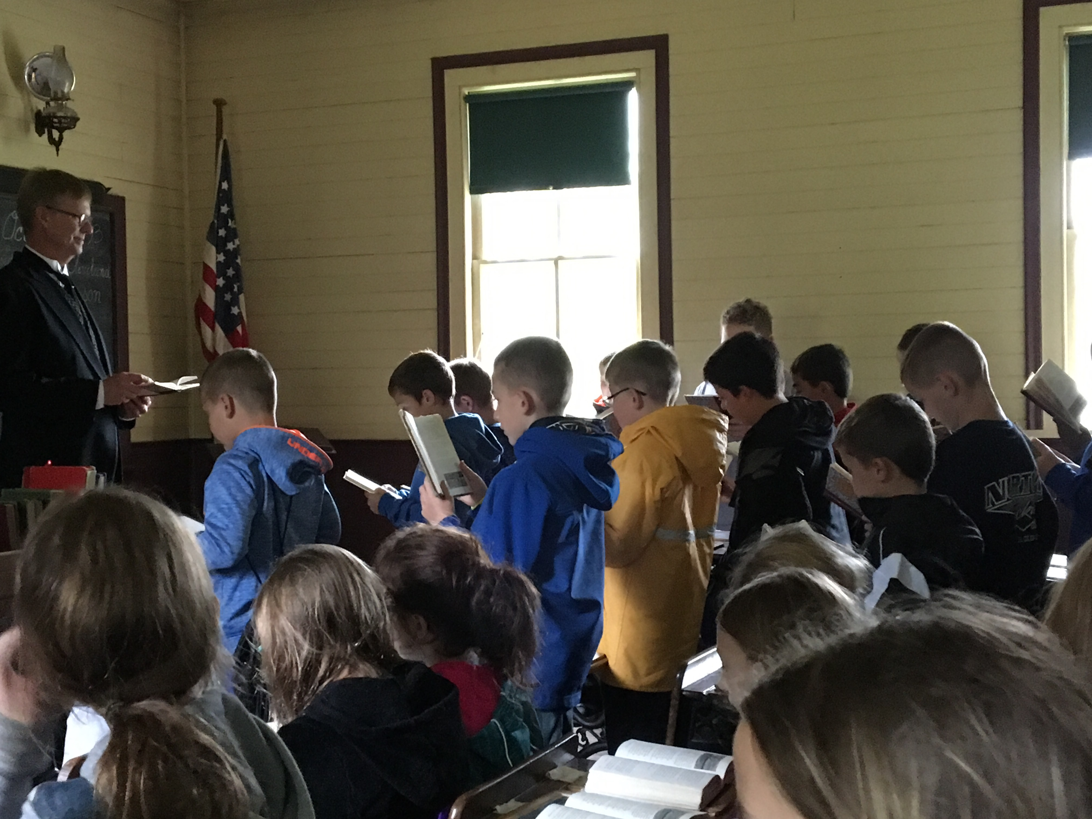

Slide 8
Blacksmith Shop

Slide 9
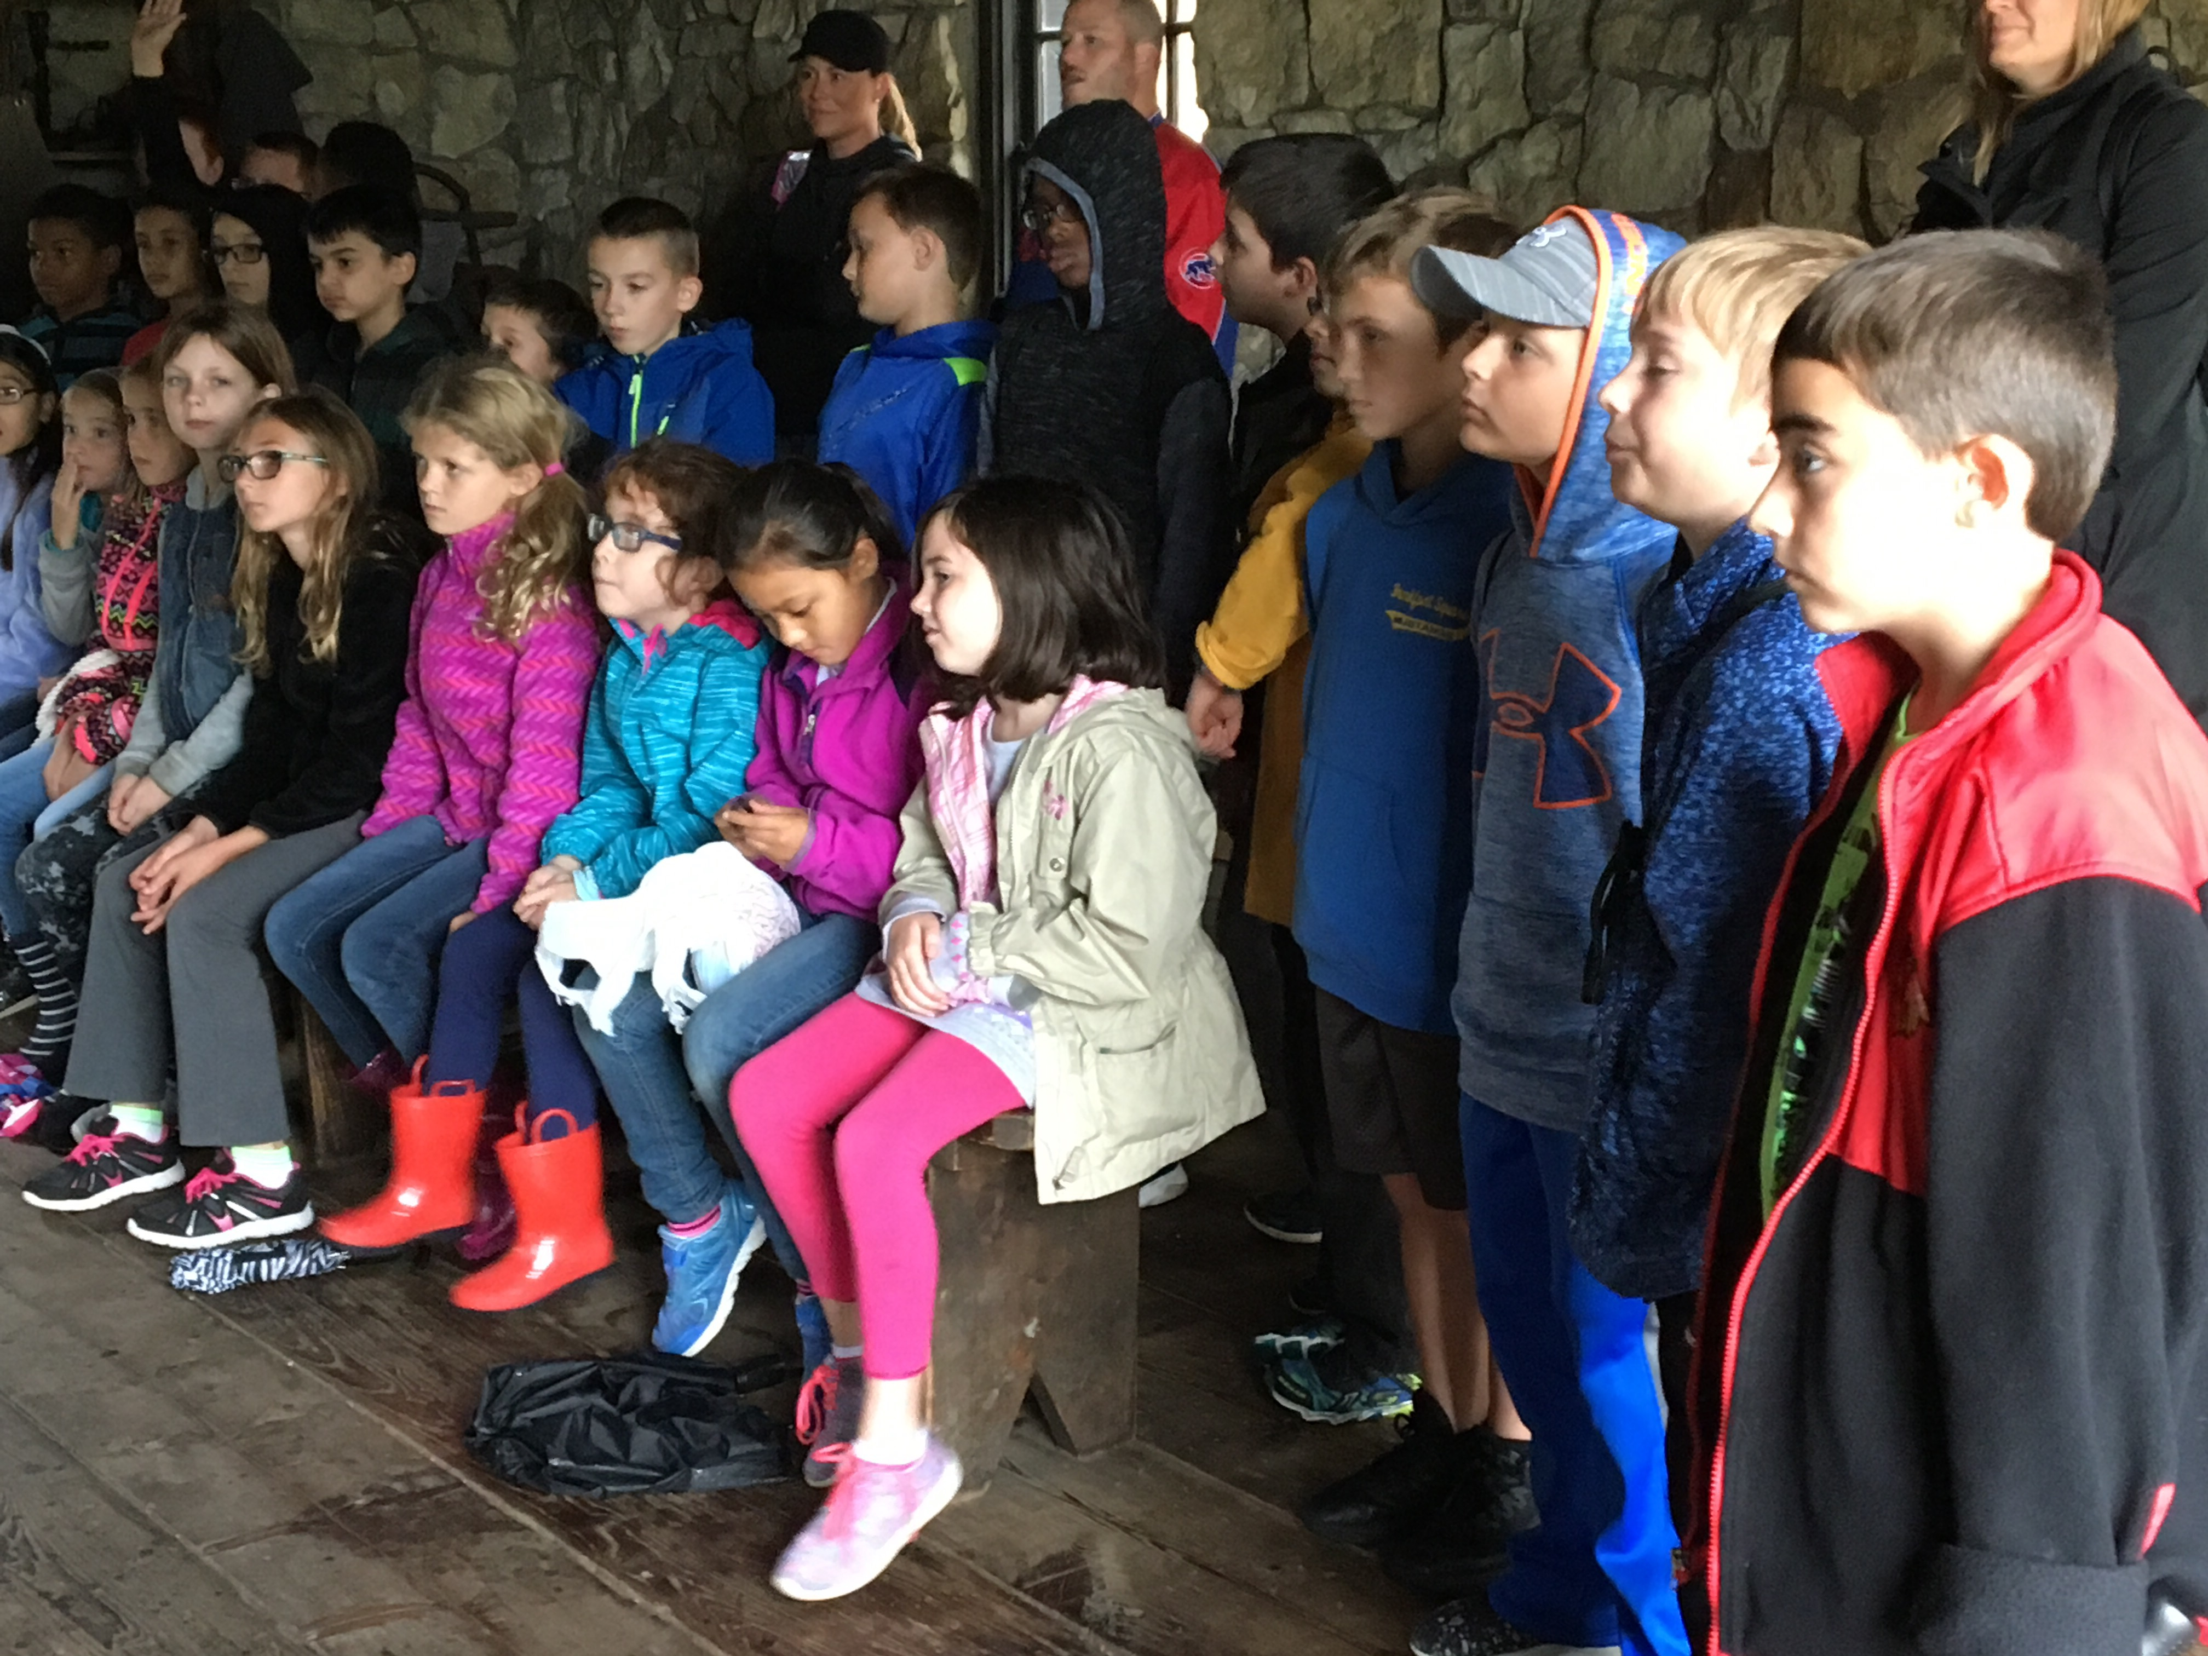

Slide 10
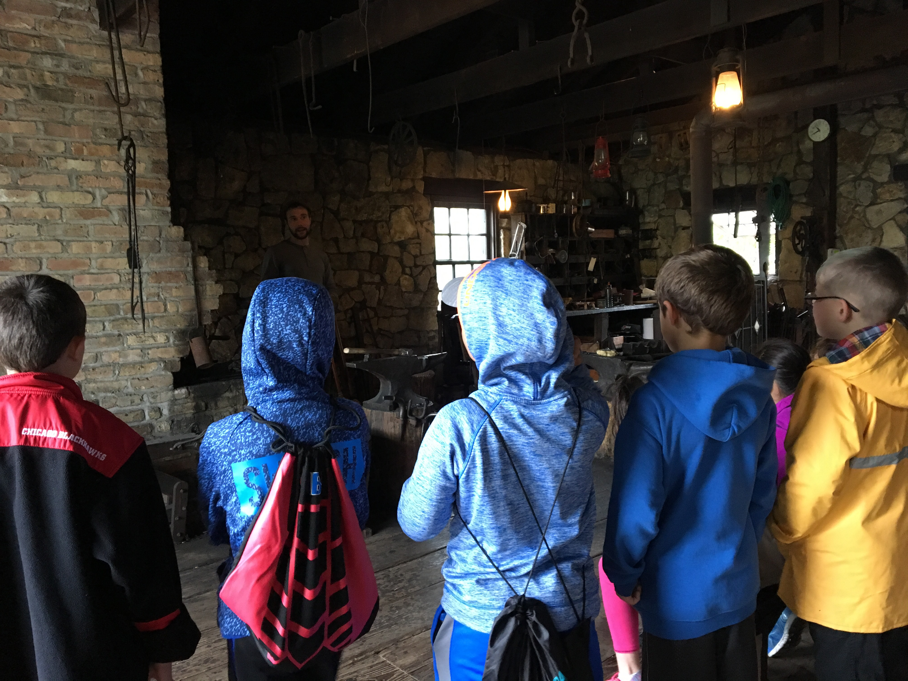

Slide 11
Log Cabin House

Slide 12
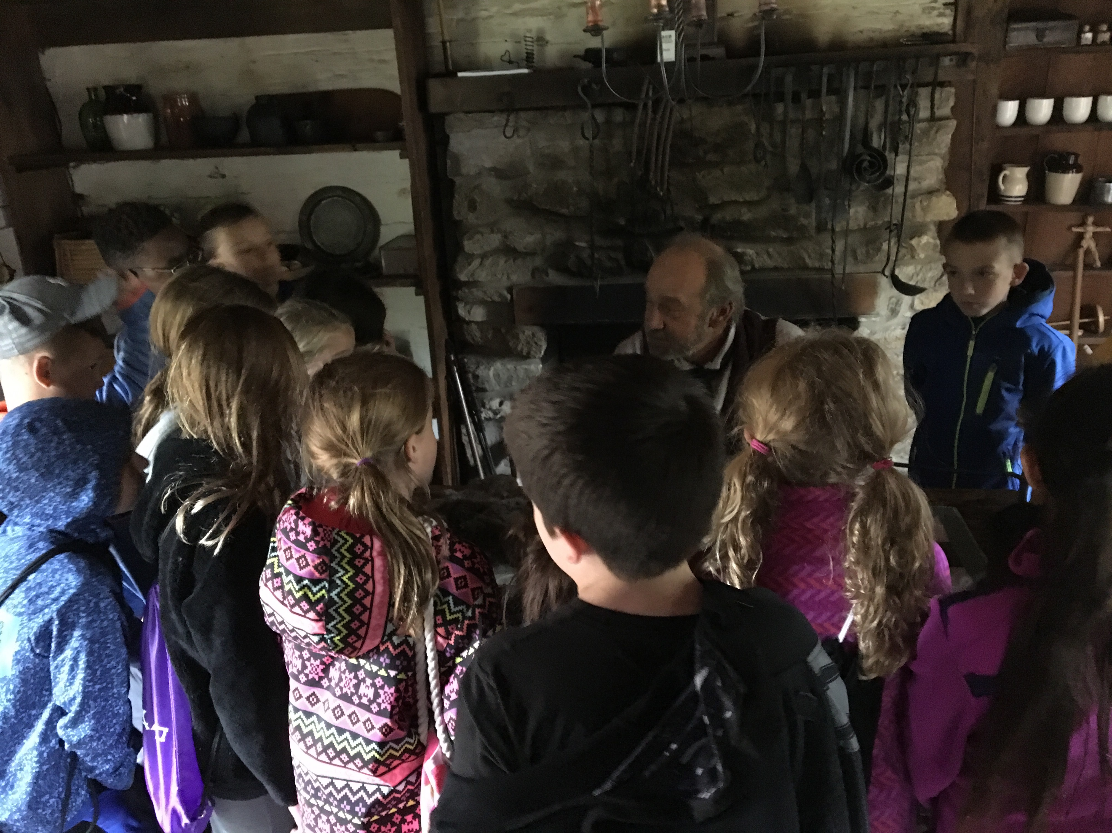

Slide 13
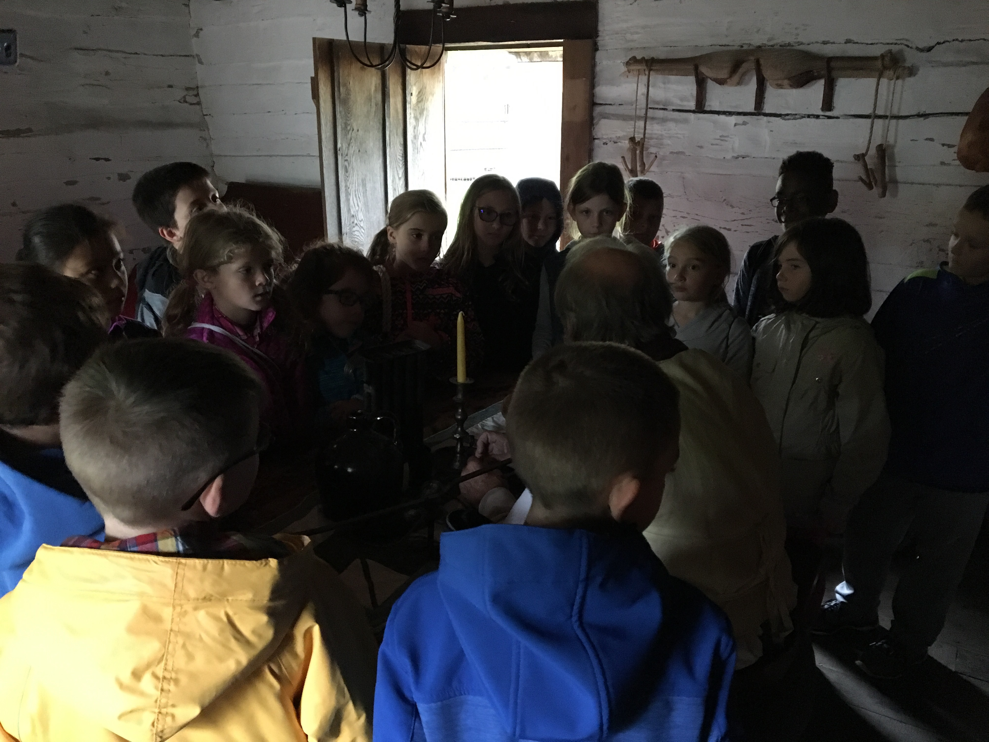

Slide 14
Mansion

Slide 15
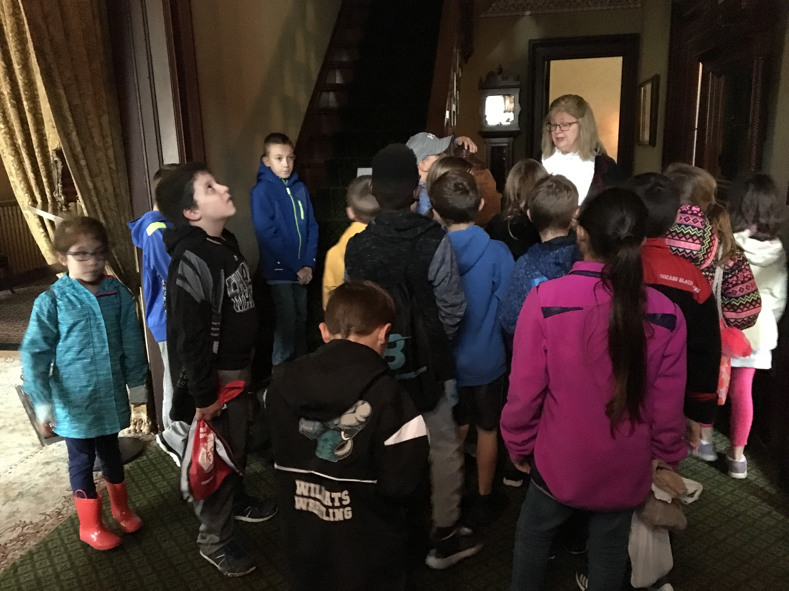

Slide 16
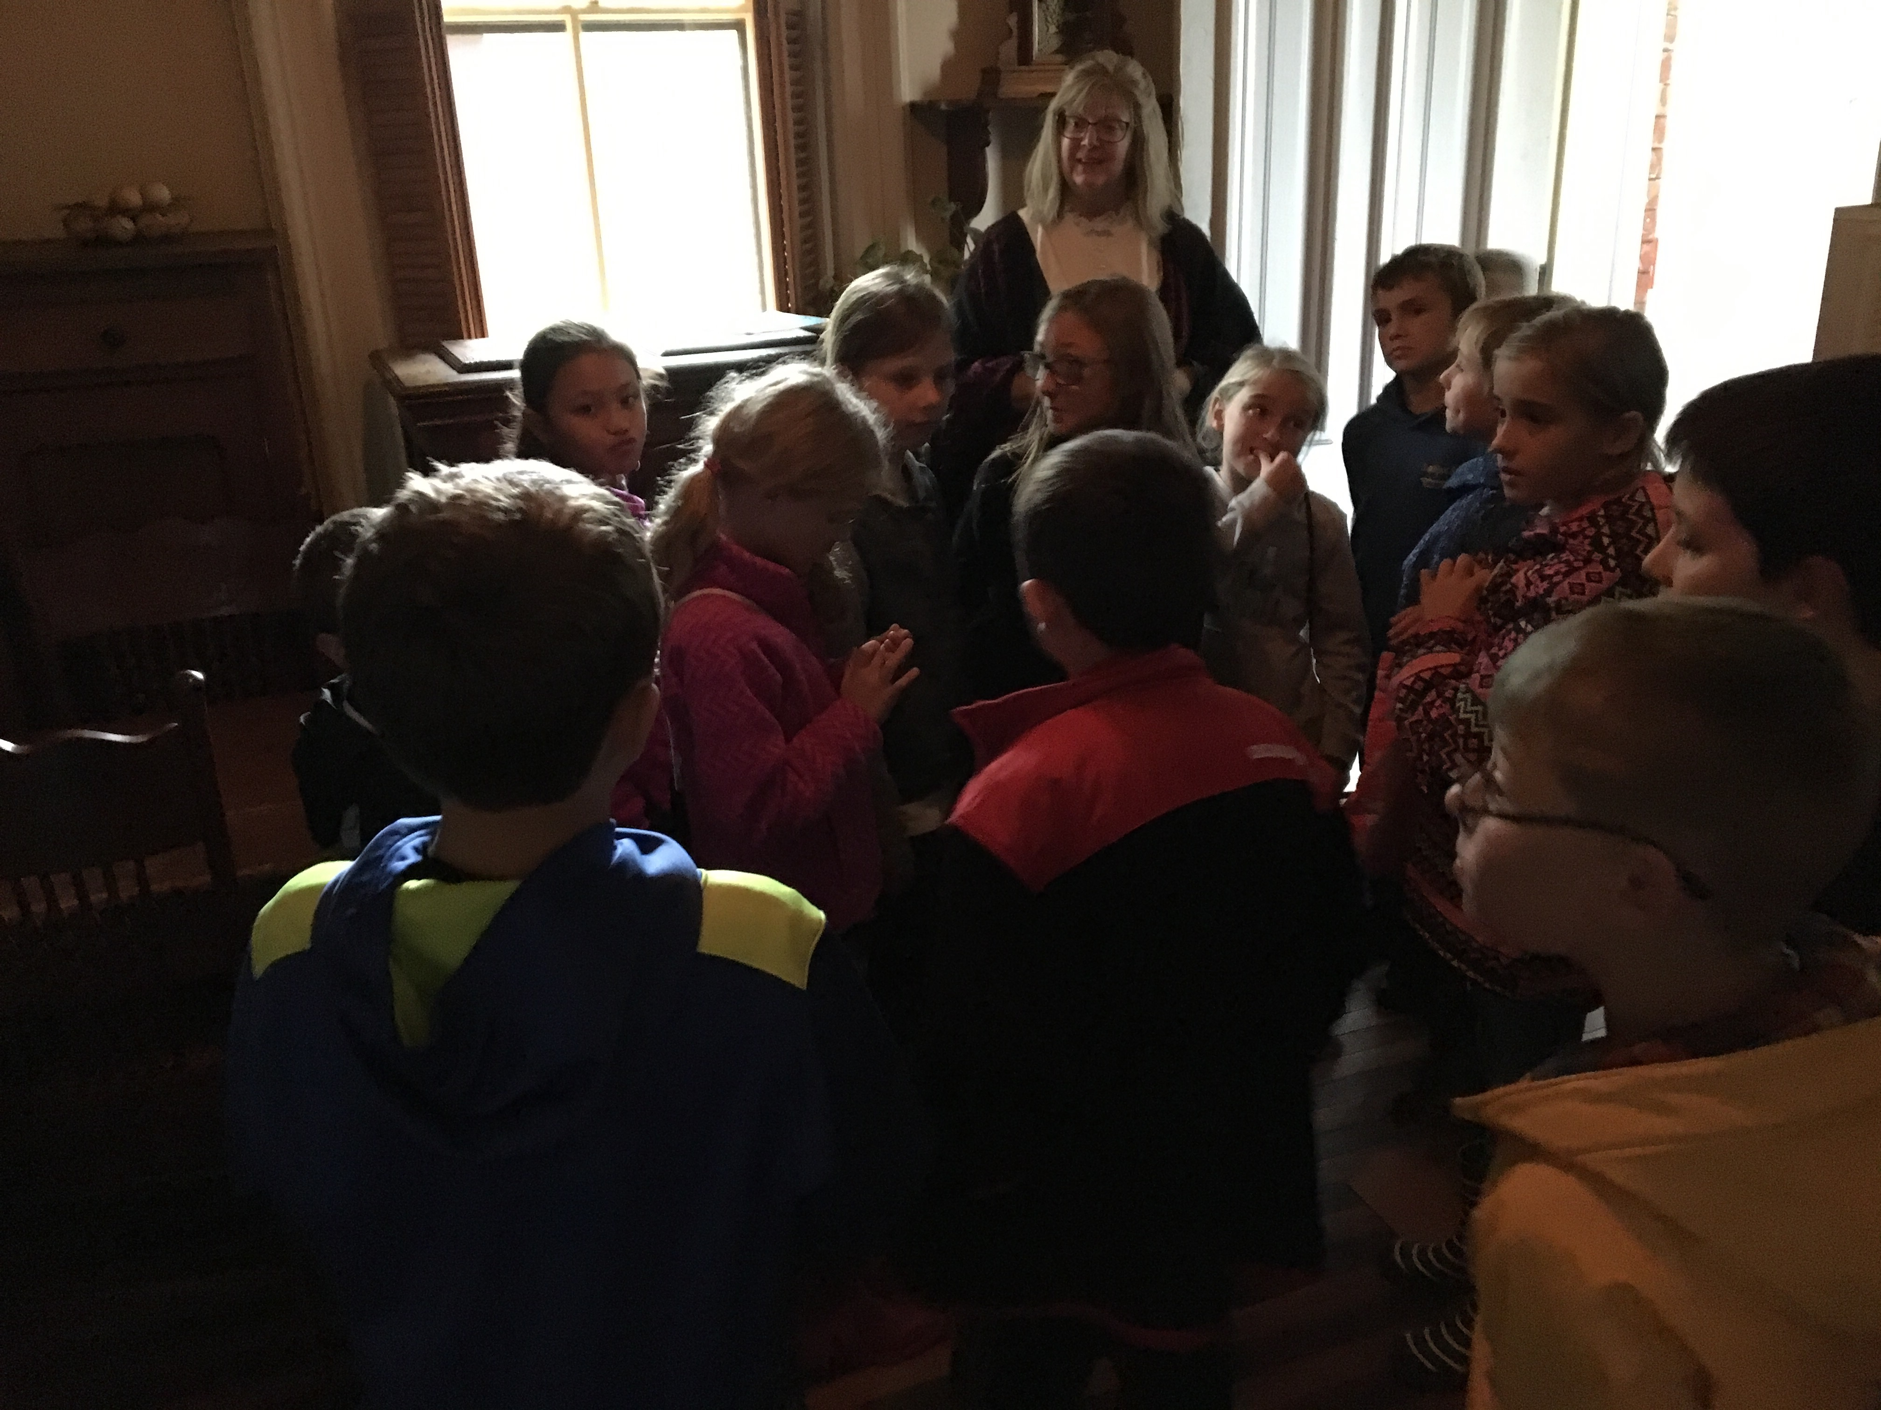

Slide 17
Printing Shop

Slide 18
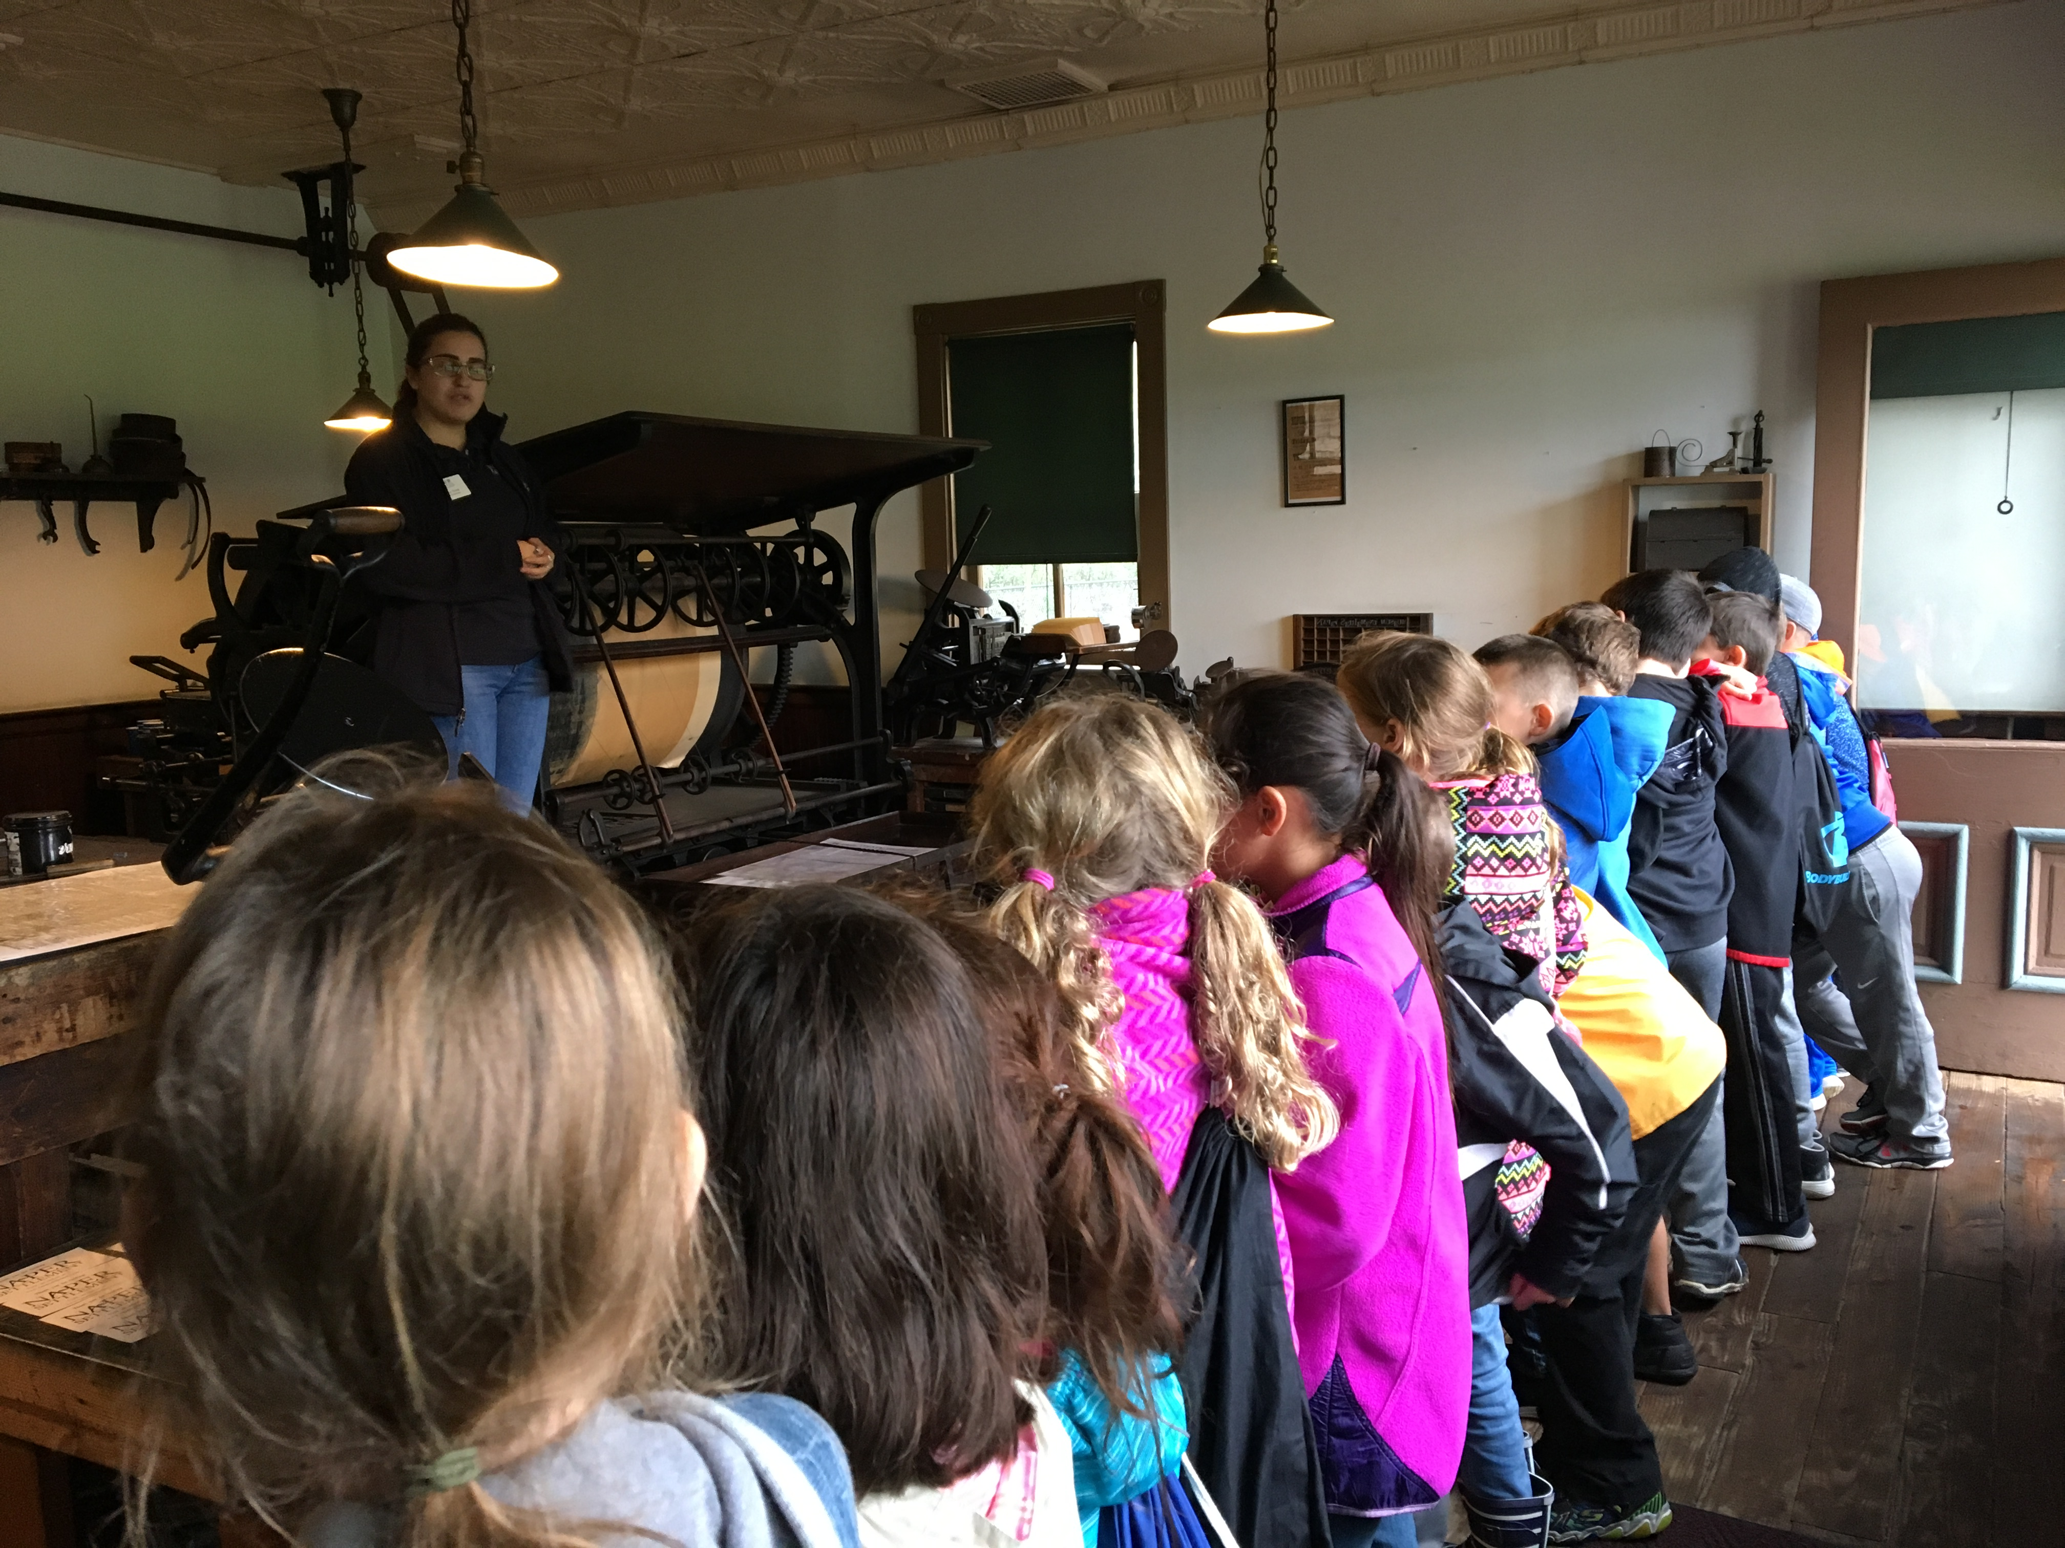

Slide 19
