Slide 1
Academic Improvement – Reading Ms. Schmidt

Slide 2
Academic Improvement Goals
Increase comprehension and understanding of fiction and nonfiction text.
Increase critical thinking, going beyond what is written in the text.
Increase fluency (rate, speed, accuracy).
Increase vocabulary and decoding skills.

Slide 3
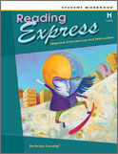
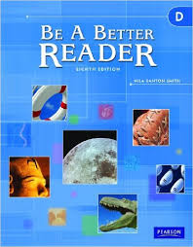
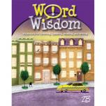
Textbook
Reading Express Workbook – Comprehension Intervention
Be a Better Reader Workbook – Supplemental Comprehension
Word Wisdom Workbook – Vocabulary Intervention

Slide 4
materials
Class Workbooks (stay in classroom, unless homework is assigned)
AR Book
Folder
Pencil

Slide 5
School & Classroom Policies
Students must follow all policies stated in the student handbook.
General Classroom Rules:
-Be Responsible. Come to class prepared.
-Be Respectful. No talking while teacher or others
are speaking.
-Be Responsible. Be in your seat when the bell
rings.
-Be Responsible. Make complete efforts on all
assignments.

Slide 6
Grading
Pass = 100% - 70%
Fail = 69% and below
Per Summit Hill School District 161 Policy:
Formative Assessment is the formal and informal processes teachers and students use to gather evidence for the purpose of improving learning. Assessment for learning is how we provide students valuable feedback on their progress toward achieving the specific learning target.
Summative Assessment provides evidence of student achievement for the purpose of making a judgment about student competence or program effectiveness. Assessment of learning is how we know our students have achieved specific learning expectations.

Slide 7
Placement Into Reading Improvement
Based on:
-STAR scores (Fall, Winter, Spring)
-Teacher Recommendation
Students are progress monitored with STAR and AIMSweb throughout the year to make sure placement is correct.
After data review, if a student proves not to need the Academic Improvement course, he/she will be placed into the Encore rotation.

Slide 8
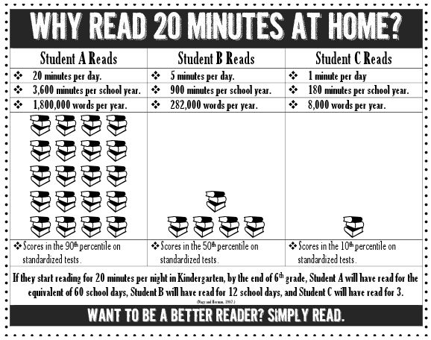
Why Reading Is Important

Slide 9
Topics Covered
Vocabulary Skills
-Prefixes, Suffixes, Root Words
-Context Clues,
-Connotation and Denotation
-Multiple Meaning Words
-Analogies
-Dictionary and Thesaurus

Slide 10
Topics Covered
Text Features
-Charts
-Graphs,
-Maps
-Headings and Subheadings
-Sidebars and Footnotes

Slide 11
Topics Covered
Text Structures
-Compare and Contrast
-Cause and Effect
-Sequential and Chronological Order
-Problem and Solution
-Question and Answer
-Proposition and Support

Slide 12
Topics Covered
Reading Comprehension:
-Author’s Purpose
-Main Idea and Supporting Details
-Inferences and Conclusions
-Fact and Opinion
-Propaganda
-Reading Critically

Slide 13
Topics Covered
Literary Elements
-Plot
-Conflict
-Character
-Setting
-Theme
-Mood and Tone
-Irony
-Symbolism

Slide 14
Topics Covered
Genres
-Short Stories
-Myths and Legends
-Newspapers, Magazines, and Electronic Sources
-Autobiographies and Biographies
-Poetry
-Information Materials
-Consumer and Workplace Documents

Slide 15
Topics Covered
Reading Strategies
-Previewing
-Self-Questioning
-Making Connections
-Monitoring
-Summarizing
-Evaluating

Slide 16
Contact Information
Please see my class website.
Lesson plans are listed under downloads.
Feel free to contact me via email: lschmidt@summithill.org
I am available for phone calls before school from 7:30-7:40, from 10:30-11:15, and after school from 2:30-2:40.

